Slide 1
Understanding and Managing the Financial Aid Process
Deniesha Newby
Assistant Director, Student Financial Aid
The Office of Student Financial Aid

Slide 2
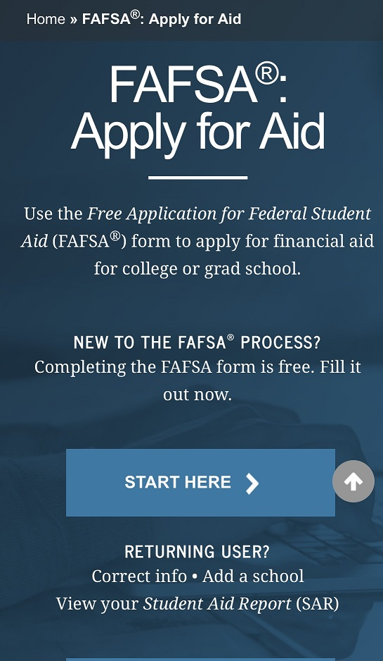
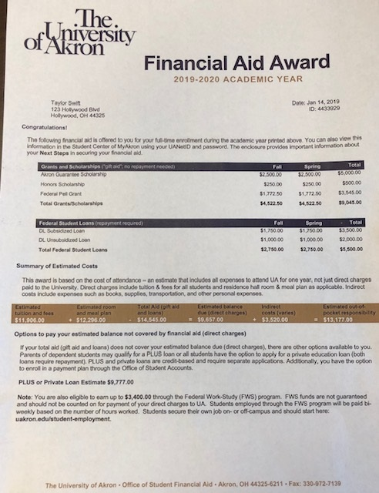
AGENDA
What is Financial Aid
The Process of Applying
Cost of Attendance
MyAkron & the Student Center
How to View and Accept Your Aid
Your Previous Aid
Next Steps

Slide 3
What is Financial Aid?
Financial Aid is a broad group of funding sources that assists students in meeting the cost of attending college and can include grants, scholarships, work-study programs, and student loans.

Slide 5
Cost of Attendance Examples
Graduate Students | Full Time 9 or more credits | 1/2 Time 4.5-8 credits | Less Than 1/2 Time 1-4 credits
Tuition and Fees | 17,384 | 9,158 | 4,320
Room and Board | 11,490 | 11,490 | 0
Books and Supplies | 1,000 | 500 | 250
Transportation | 1,600 | 1,600 | 0
Personal Expenses | 3,150 | 3,150 | 0
Total Ohio Resident | 34,624 | 25,898 | 4,570
Non Resident Charge | 9,788 | 4,894 | 2,448
Total Non-Ohio Resident | 44,412 | 30,792 | 7,018
*New students, starting in Summer 2022, Fall 2022, or Spring 2023
*Full-time enrollment is 9 or more credits
www.uakron.edu/finaid/cost-of-attendance

Slide 6
Types of Financial Aid
Gift Aid | Description
Grants | Awarded by federal and state government
Scholarships/Fellowships | Awarded by a variety of sources including the University, community groups, businesses, etc.
Self-Help Aid | Description
Student Employment/Federal Work Study | Money earned while working part-time on campus
Subsidized/Unsubsidized Loans (student) | Low interest loans, repaid by the student after graduation
Private Loans | Loans that students borrow (Might often needs a cosigner), repaid after graduation

Slide 7
How Do I Apply For Federal Financial Aid?
Studentaid.gov

Slide 8
Application Process Flow
Student completes FAFSA
UA receives results and determines if any additional information is needed and makes request
Student provides any additional information needed
Student receives Financial Aid Offer detailing financial aid offers.
UA reviews and finalizes awards

Slide 9
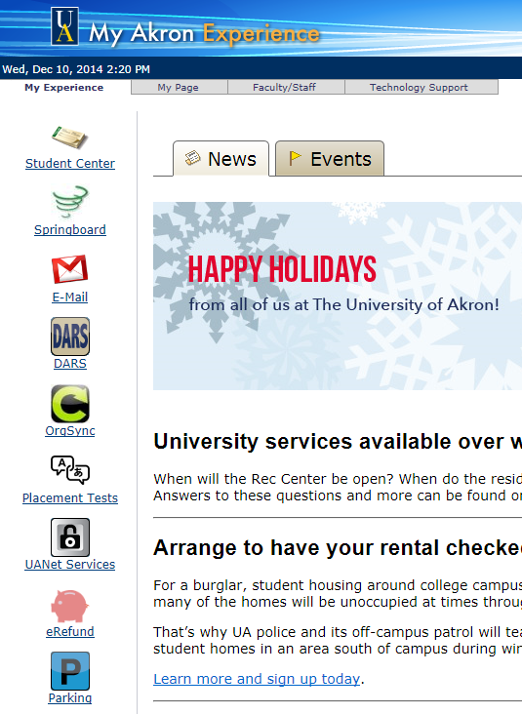
Check Your Email!
UA faculty members and offices on campus will communicate with you through your University email address.
It is important that you check your email at least once a day!

Slide 10
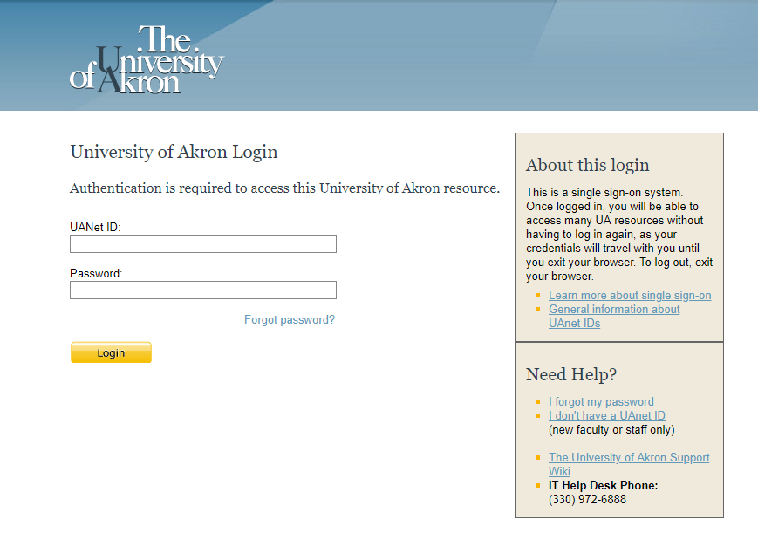
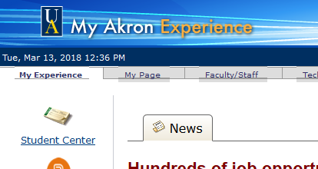
Student Center of MyAkron
https://my.uakron.edu
Students log in with the UANet ID and password (emailed from Admissions)
If you need to reset /activate contact ZipSupport at: 330 972-6888 or helpdesk@uakron.edu

Slide 11
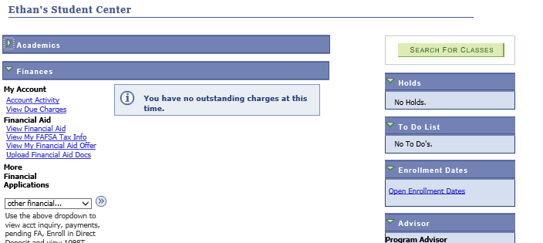
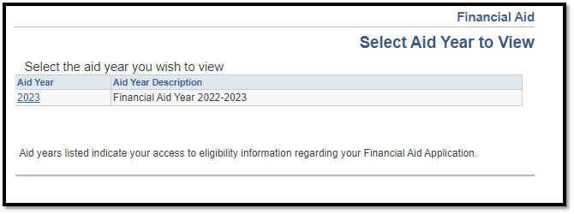

Slide 12
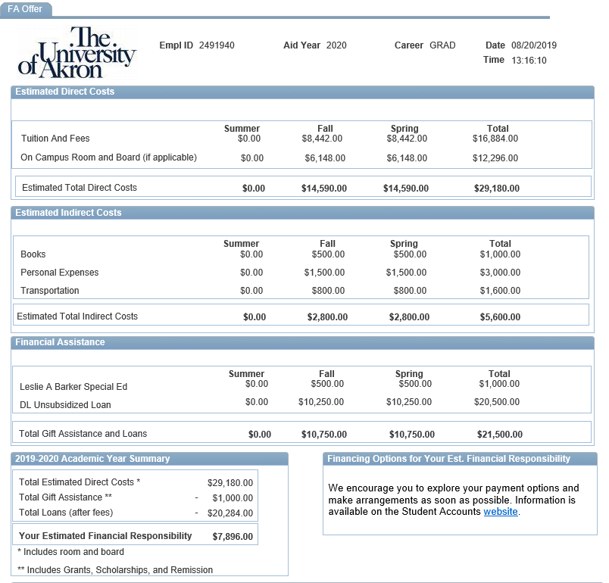

Slide 13
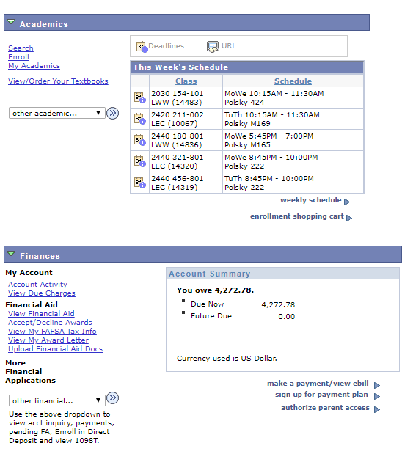
Accept/Decline/Reduce Awards

Slide 14
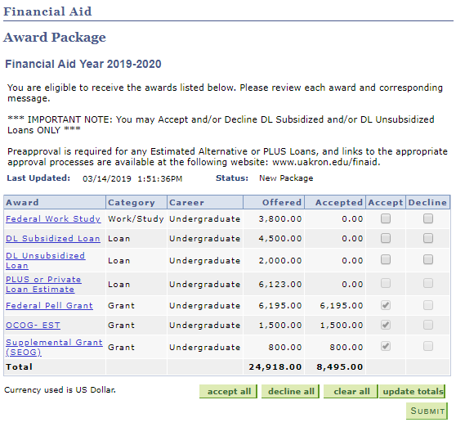
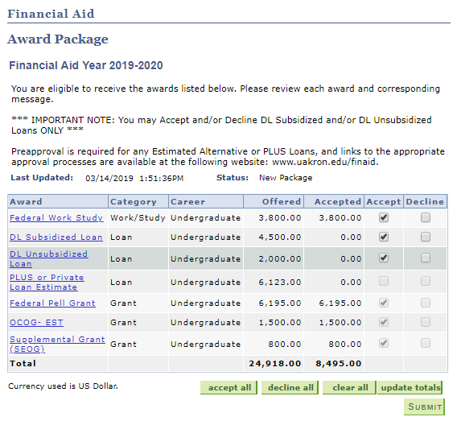
Accept/Decline/Reduce Awards
Check each award you wish to accept or decline (you can also reduce here)
Important! Estimates are NOT actual awards and cannot be accepted.
OCOG – EST will be removed and changed to OCOG (not an estimate) in late July.
PLUS or Private Loan Estimate – requires a separate application.

Slide 15
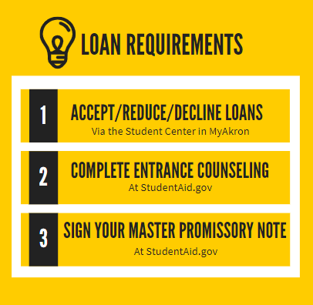
Loan Requirements
All students need to accept their federal direct student loans in the Student Center of MyAkron, every financial aid year.
First-time student loan borrowers need to complete two additional requirements the first time they borrow loans at UA:
Entrance counseling
Loan Agreement/Master Promissory Note (MPN)
Both of these can be completed online at studentaid.gov with the student’s FSA ID (username and password)

Slide 16
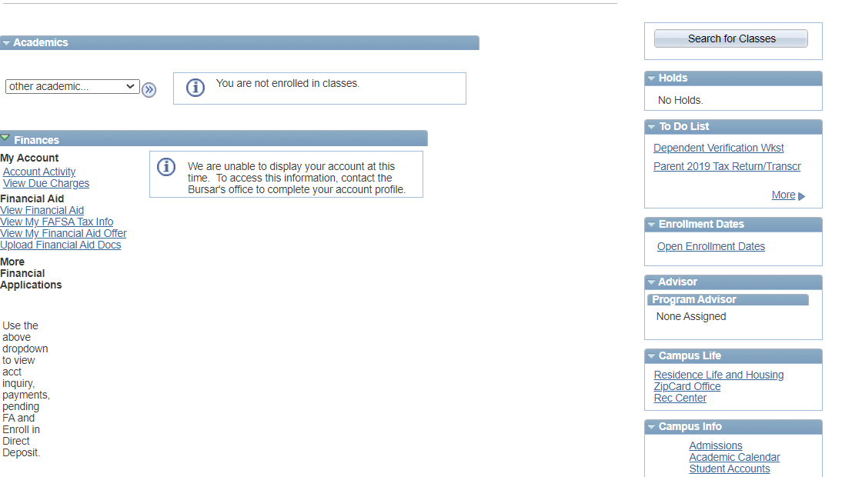
No Financial Aid Offer?
Notes:
Click on “more” to see the full list and details, including links/instructions.

Slide 17
Loan Considerations
Loan Limits (Annual and Aggregate)
Year | Dependent Undergraduates | Independent Undergraduates
First year (0-30 credits completed) | $5,500—No more than $3,500 in Subsidized loans | $9,500—No more than $3,500 in Subsidized loans
Second year (31-60 credits completed) | $6,500—No more than $4,500 in Subsidized loans. | $10,500—No more than $4,500 in Subsidized loans
Third Year + (completed 61 or more credits) | $7,500—No more than $5,500 in Subsidized loans | $12,500—No more than $5,500 in Subsidized loans
Aggregate Loan Limits | No more than $31,000 combined sub/unsub | No more than $57,500 combined sub/unsub
Grad/ Professional Students Loan Limits (Annual and Aggregate)
Masters or Doctorate program (MA, MBA,MD, JD, PhD, EdD) | Annual Limit $20,500 | No more than $138,500 combined sub/unsub (includes loans from undergraduate degree)

Slide 18
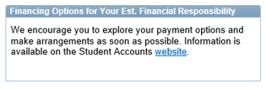
Financing Options
 | Grad Plus Loan | Private Loan | Payment Plan (Office of Student Accounts)
FAFSA Required? | Yes | No | No
Credit Check? | Yes – student | Yes – student (and cosigner) | NA
Rates | 7.54 | Varies by lender (based on credit history of applicant/ cosigner) | $35 application fee; 25% down payment
Application Process | Studentaid.gov | uakron.edu/finaid/private | uakron.edu/paymentoptions
Plus and Private loans are disbursed directly to UA. Any overage creates a credit balance which will be refunded by the Office of Student Accounts (can be used for books, expenses, etc.).
Notes:
Emphasis on length of time needed for us to process loans in July/August/September

Slide 19
Loan Lender vs. Servicer
Your loan servicer:
Manages the repayment of your debt/collects repayments
Tracks due dates and minimums
Ensures you don’t slip into delinquency or default
If you need to change your repayment plan, work out a new payment schedule, ask for deferral or forbearance, or verify any loan forgiveness you may qualify for, contact your loan servicer.
It’s your servicer’s job to keep you in good standing by giving you the support and resources you need.
Source: https://studentloanhero.com/featured/student-loan-servicing-explained-difference/

Slide 20
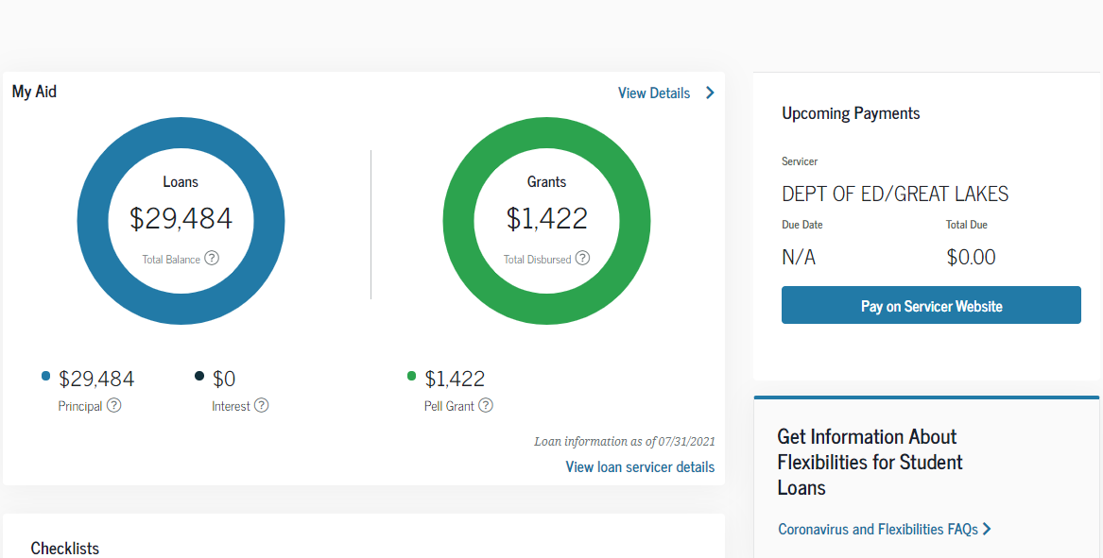
Student Loan Servicer Info
StudentAid.Gov
Check each of your loans for servicer information
You may not have the same servicer for all loans
Create an account at your servicer’s website
Note does not include private loans or institutional loans

Slide 21
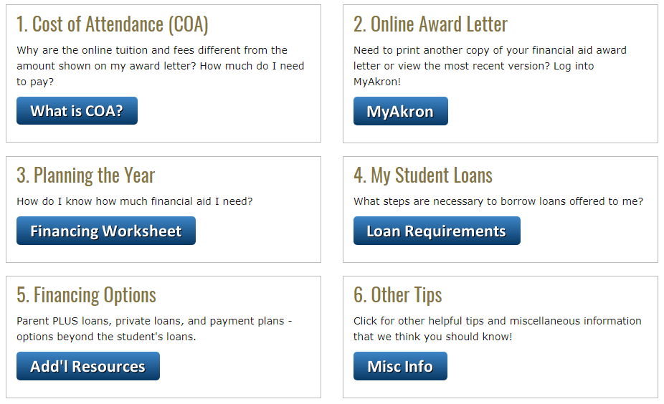
Your Next Steps - www.uakron.edu/finaid/next

Slide 22
External Scholarship Sources
Major College
Private foundations
Businesses and employers
Civic and charitable organizations
Churches
Local libraries
Scholarship Board- 2nd floor- Simmons Hall
Scholarship sites
- www.fastweb.com
- www.scholarships.com
- www.collegenowgc.org
Start applications early and pay attention to deadlines and all required documentation.
Never Too Late Not just for Undergraduates

Slide 23
Contact the Office of Student Financial Aid
Simmons Hall Room 204 330-972-7032
1-800-621-3847
Online at
uakron.edu/finaid/support
Live Chat
Available 24/7/365
Notes:
Emphasis on length of time needed for us to process loans in July/August/September

Slide 24
Questions

