Slide 1

Office of Accessibility 101
Simmons Hall, 105
Notes:
Welcome to Accessibility 101: An informational presentation for faculty, presented by the Office of Accessibility at The University of Akron.

Slide 2
GENERAL OFFICE INFORMATION
CONCLUSION AND NEXT STEPS
OUR MISSION
To ensure students with disabilities have equal access and opportunity to participate fully in the academic environment.
to provide reasonable accommodations and a supportive, well-resourced environment for students with disabilities in the university environment.
OUR GOAL
Notes:
The mission of the Office of Accessibility at The University of Akron is to provide students with full access to and the opportunity for full participation in the academic environment.
We are advocates of social justice for students with disabilities and work to end oppression by examining the social, cultural and institutional barriers to inclusion of all students.
We embrace the diversity of our student body and celebrate a culturally sensitive and accessible campus through outreach, partnership, and advocacy with many university departments.
The Office of Accessibility provides an accessible environment, while also working to remove any kind of barriers that might be in place for people with disabilities at The University of Akron. We also spend a signficant amount of time providing outreach and education to both the campus constituents and the community alike.

Slide 3


DEFINING DISABILITY
A disability is a physical or mental impairment
that substantially limits one or more major life activities.
U.S. Equal Employment Opportunity Commission. (2011). Regulations to Implement the Equal Employment Provisions of the Americans with Disabilities Act, as Amended, 29 C.F.R. § 1630.

Slide 4

DISABILITY DATA
21% of undergraduate students reported having a disability in 2019–20
11% of postbaccalaureate students reported having a disability in 2019–20
  U.S. Department of Education, National Center for Education Statistics. (2023). Fast Facts: Students with Disabilities (60).

Slide 5
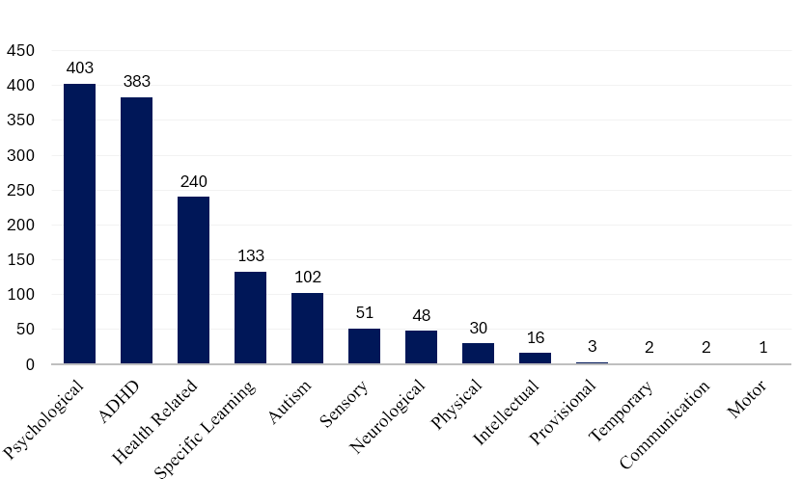
ACTIVE STUDENTS BY DISABILITY AT UA

Slide 6
REASONABLE ACCOMMODATIONS
What is an Accommodation?
An accommodation is a support that is put in place for a course, program, service, job, activity, or facility designed to eliminate or minimize disability-related barriers.
Accommodations vary based on individual circumstances and disability-related documentation.
Accommodations Must Align With Essential Course Elements
For an accommodation to be considered, it must not:
Compromise the essential requirements of a course, program, job, activity, or facility
Cause an undue administrative or financial hardship
Compromise the safety of the individual or others
Fundamentally alter the nature of a course or program
Notes:
Instructors play a key role in determining what is essential in their course or program. Disability accommodations must provide equal access, but they cannot require the institution to:
- Remove or change essential academic or technical standards
- Create unreasonable administrative or financial strain
- Allow participation in a way that creates safety risks
- Change the fundamental nature of the course (for example, removing a required skill or competency)
This is why collaboration between instructors and the disability services office is so important — instructors define the academic integrity of their discipline, and accommodations must work within those boundaries.

Slide 7
EXAMPLES OF ACCOMMODATIONS
Accommodations for students will vary based on individual circumstances and disability-related documentation.
  Classroom accessibility (relocation), auxiliary aids (PPT slides), transcribers/interpreters, attendance and/or assignment flexibility (flex plans), equipment (audio recorder), adaptive technology
  Extended time, testing in a distraction reduced space, test proctors (reader, writer)
  We also work with Residence Life & Housing for accessible on-campus housing approvals.
Classroom Accommodations
Testing Accommodations
Housing Accommodations
Notes:
Some examples of reasonable accommodations may include adaptive technology, accessible classrooms, extended testing time and distraction reduced space for testing, copies of powerpoints, use of a tape recorder, use of sign language interpreters, proctors for exams, and attendance. The Office of Accessibility also works with Residence Life and Housing to provide accessible on campus housing accommodations to qualified students.

Slide 8
HOW DO STUDENTS REGISTER?
Student applications are completed online at www.uakron.edu/access
Documentation that meets our disability verification guidelines must be submitted.
Accommodations are approved during an intake with a Disability Specialist.
Notes:
Intake and eligibility must be completed before accommodations can be used.
Students are responsible for requesting accommodations each semester.
Requests should be submitted as soon as your class schedule is available.

Slide 9
FACULTY RESPONSIBILITIES
Understand approved accommodations and consult the Office of Accessibility when clarification is needed.
Know the essential elements of the course/program and consult with the Office of Accessibility for any questions/concerns about accommodations.
Contact the Office of Accessibility with any questions or concerns.

Slide 10
STUDENT RESPONSIBILITIES
Register with the Office of Accessibility.
Meet with a Disability Specialist to complete the intake process.
Submit accommodation requests through STARS each semester to notify professors of approved accommodations.
Speak to professors about accommodations and complete any relevant Flex Plan agreements, with their input, if applicable.
Maintain necessary communication with instructors and the Office of Accessibility to coordinate services throughout the semester.
Notes:
Students play an active role in the accommodation process. They must register with our office, provide documentation, and meet with a Disability Specialist to determine eligibility. Each semester, they need to submit their accommodation requests through STARS so instructors are notified. Students are also responsible for speaking with their professors about how accommodations will be implemented and completing any Flex Plan agreements when applicable. Ongoing communication with both instructors and our office helps ensure that accommodations are implemented smoothly.

Slide 11
MEET OUR STAFF
Jessica DeFago, M.A.
Director
Tess Miller, M.Ed., CRC
Associate Director
Katie Allison, M.Ed.
Disability Specialist & Service Coordinator
Mary Choma, M.Ed., CRC
Disability Specialist & Service Coordinator
Rachael Kosar, B.S.
Office Manager
Leigh Sveda, B.A.
Adaptive Technology & Service Coordinator

Slide 12

The Office of Accessibility values collaboration between you, your students and our office. Thank you for your time.
If you would like an electronic copy of this presentation, please feel free to contact us at
access@uakron.edu
(330) 972 – 7928
Notes:
The Office of Accessibility welcomes any questions or concerns that faculty and staff have when working with students with disabilities. Please feel free to contact the office to discuss the information in this presentation, or with any other questions or concerns.

