Slide 1
How to Set up a MyLifeExpert Profile

Slide 2
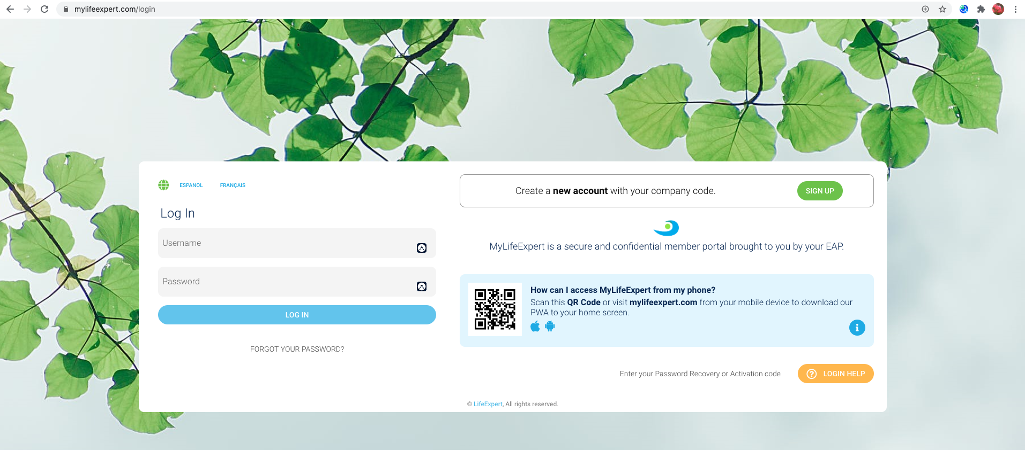
Creating your Individual Login for MyLifeExpert
Begin by visiting our website: mylifeexpert.com

Slide 3
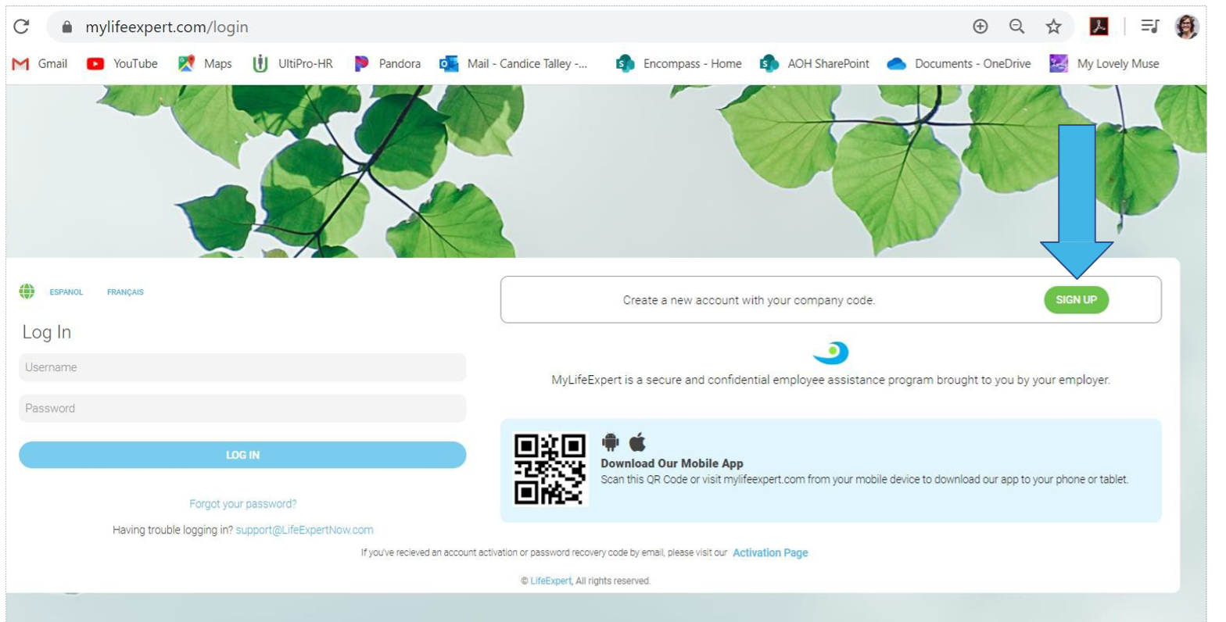
Creating your Individual Login for MyLifeExpert
​
Next, click on​ the SIGN UP button marked by the arrow above

Slide 4
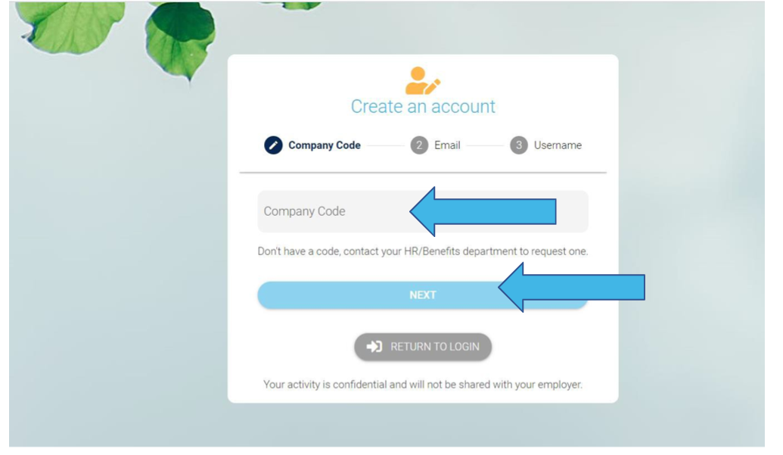
Creating your Individual Login for MyLifeExpert
​
Fill in the company code:
Click Next​

Slide 5
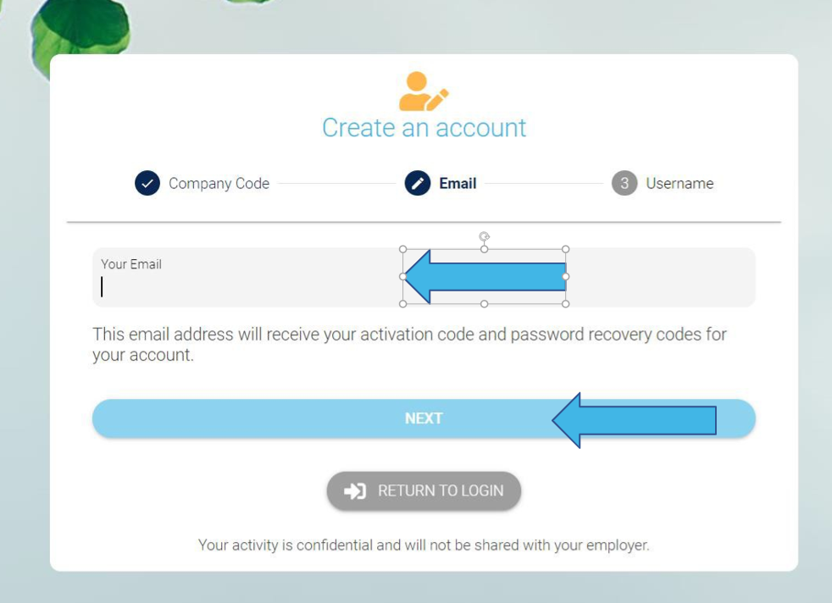
Creating your Individual Login for MyLifeExpert
​
Enter your email address
Click Next​

Slide 6
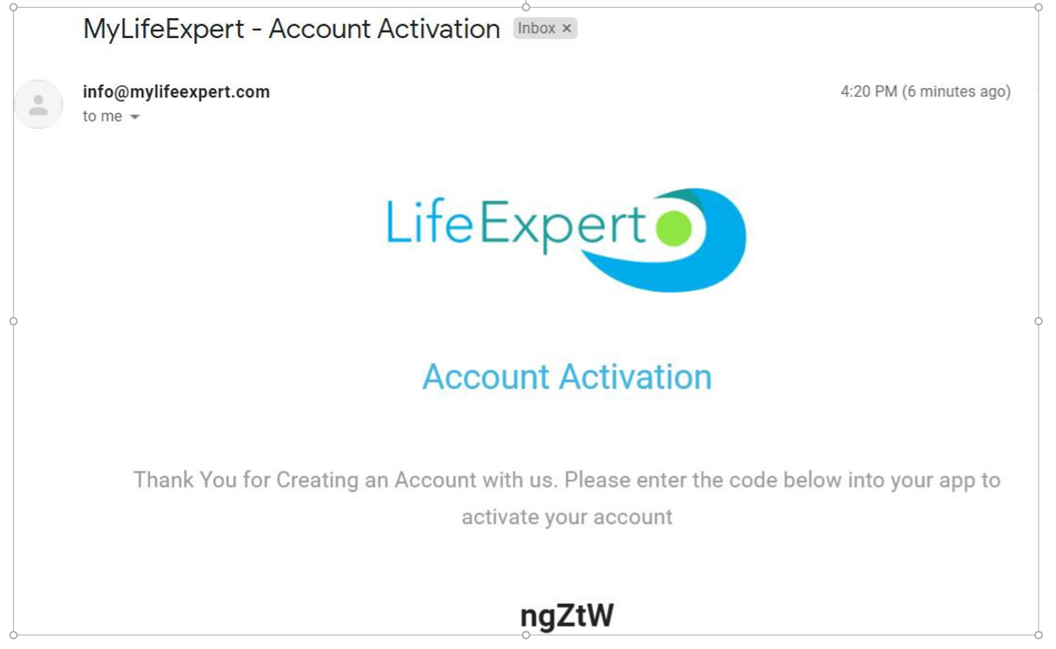
Creating your Individual Login for MyLifeExpert
Access the email account you entered for registration -​
You will receive an email FROM My Life Expert (info@mylifeexpert.com) with a verification code.​ (PLEASE CHECK YOUR SPAM/JUNK FOLDER)​

Slide 7
Creating your Individual Login for MyLifeExpert
Enter the code (Case Sensitive) and then click on “Verify your Code” ​

Slide 8
Creating your Individual Login for MyLifeExpert
Create your password. Be sure to write down your password and keep it in a safe place with the username you created.​

Slide 9
Creating your Individual Login for MyLifeExpert
Now you can Login by entering the Username and password you created.
Click​ Log In

Slide 10
Creating your Individual Login for MyLifeExpert
When you visit MyLifeExpert from a tablet or smart phone you will be asked if you would like to save the app to your home page
If you have any questions please email support@LifeExpertNow.com
Or Call at 800-292-2780

