Slide 1
Vuja De All Over Again
Looking Back to See Forward
New Explorations in Teaching 2024 University of Akron Corrie Bergeron, M.Ed. Corrie.Bergeron@gmail.com
Notes:
Bring up links
https://www.youtube.com/watch?v=i9dHL7GA1nk&ab_channel=RushVEVO
https://www.oneusefulthing.org/p/on-speaking-to-ai
https://open.substack.com/pub/oneusefulthing/p/change-blindness
https://mustreadalaska.com/fairbanks-airport-robotic-dog-has-a-pronoun-she-her-and-is-a-first-for-an-american-airport/
https://www.reddit.com/r/catsonroombas/comments/x6rpcq/a_cat_tank
https://chatgpt.com/g/g-TcSx5BYQr-the-four-futures-planner
I’m a mid-career college professor. I’m concerned about how my career might be impacted by the growth of AI, by demographic changes, and by societal trends. What advice can you offer?

Slide 2
Corrie Bergeron
40 years in Ed Tech
25 years in Higher Ed
Instructional Designer
Project Manager
Adjunct Instructor
LMS system admin
Notes:
Hi, I’m Corrie Bergeron. I’m the instructional designer and learning systems administrator for Lakeland Community College, about an hour due north in Lake County.
I’ve reached the stage of my career somewhere between old-timer and elder statesman. (I think I have to be retired before I fully ripen to “wizened sage,” although I have been accused of being both a wizard and guru.) But I’ve collected enough t-shirts to think I might have a little perspective.
My goal for this presentation is to lay out the argument that we can get a glimpse of where things might be going with AI by taking a look back at other technological innovations of the past. History doesn’t repeat itself, but it does rhyme.
An old friend of mine is a poet and a storyteller. He’s fond of saying, “All stories are the same story, and this is that story.” You may be familiar with Joseph W. Campbell’s “The Hero With a Thousand Faces” which explains why Beowulf, Star Wars, Lord of the Rings, Harry Potter, they’re all basically the same story. Swap out the characters and costumes and it’s the same basic plot line.
Technological innovation works the same way. It follows a familiar pattern, a well-worn path. And by looking at where we are on that path with AI, we just might be able to get a sense of what’s coming down the road.
I feel validated in this choice by the fact that David Wiley (an internationally-recognized leader in Open Education whom I met when he was a grad student with David Merril) did the same thing a few weeks ago in a presentation about the confluence of AI and OER.

Slide 3
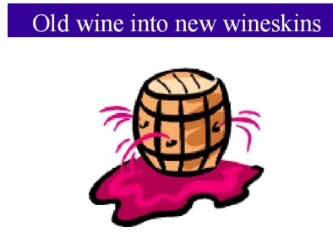
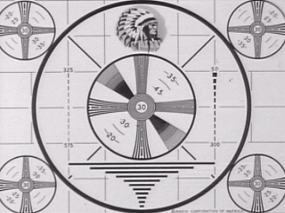
Notes:
In keeping with that theme, this presentation is based on one I gave in 2000 to the National Association of Broadcasters, on the coming convergence of educational television and interactive computer-based media. What goes around, comes around, and the essentials do not change. These are some of the slides from that presentation. 1024 x 768, XGA, man.
Let’s place that presentation in the context of Internet history, shall we? What was going on in the year 2000 – BACK AT THE TURN OF THE CENTURY?

Slide 4
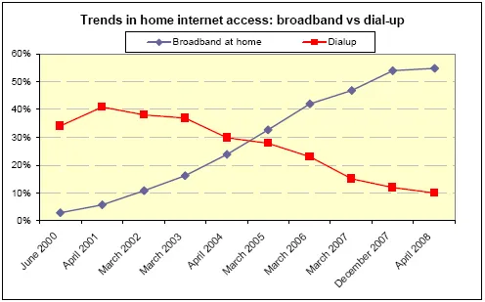
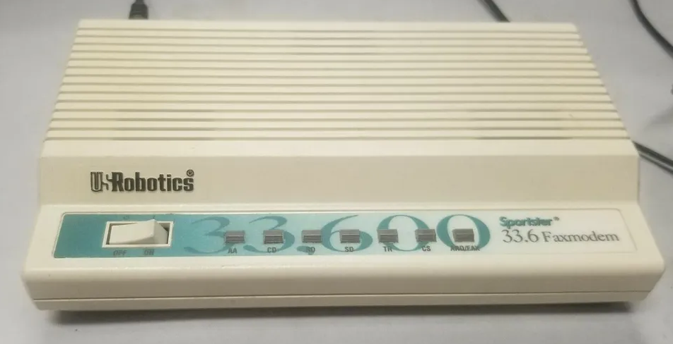
“Sherman, set the Wayback Machine…”
Notes:
In 2000, a little over 30% of US homes had dial-up internet access. 14.4 and 28.8 modems. Remember those? “Honey, can you get off Compuserv? I need to make a phone call.” “Broadband” was ISDN - “I Still Don’t Know.”
Google was two years old; Yahoo was using it for its search functions. But most people still used Alta Vista or Dogpile for search. Google went public in 2004.
Amazon was founded in 1994. It adopted its current logo with the arrow from A to Z in late 2000 but wasn’t yet making a profit. It launched Super Saver Shipping in 2002 and Amazon Prime in 2005.
January 2000 – The big financial new was AOL merging with Time Warner. It was the largest merger in history. AOL who?
YouTube didn’t even exist in 2000 when I did the original presentation. It was founded in 2005. But RealNetworks had 215 million subscribers in 2000. Remember Real Player?
Netflix was founded in 1997. By 1999 it had started a monthly subscription service. In 2000 the owners tried to cash out – they made an offer to sell it for $50 million to a more established video rental company. Blockbuster turned them down. Netflix started streaming in 2007.

Slide 5
2007 – a wake-up call in 140 characters
“Hey, check this out! http://...”
Notes:
Also in 2007, there was this new thing - just a year old - called Twitter that I was having to explain to people. “It’s like microblogging. You type out a 140-character comment, and other people can subscribe to your comments, and you can see what they’re saying.” They looked at me like I’d sprouted a second head.
But one day I was checking my feed - I followed maybe a couple dozen other early adopter ed tech types - and someone had shared a link to a live conference presentation. Mind = blown. Someone in the audience at an Ed Tech conference in Hawaii had simply turned their MacBook around to point the camera at the lectern, and was streaming the presentation live over the web. No ViaCom hardware, no DSL dial-in, just click the URL and watch. Ka-BOOM! AMAZING.
I tuned in just in time to see a teacher from Georgia named David Warlick say something incredibly profound and important. I wrote it down and have shared it every chance I get ever since.

Slide 6
“We are the first generation in history who knows that we have to prepare the next generation for a future that we know we cannot imagine.”
David Warlick, 2007
Notes:
Let that sink in a minute.
Growing up in the 60s, we knew what the future was going to be like, right?

Slide 7
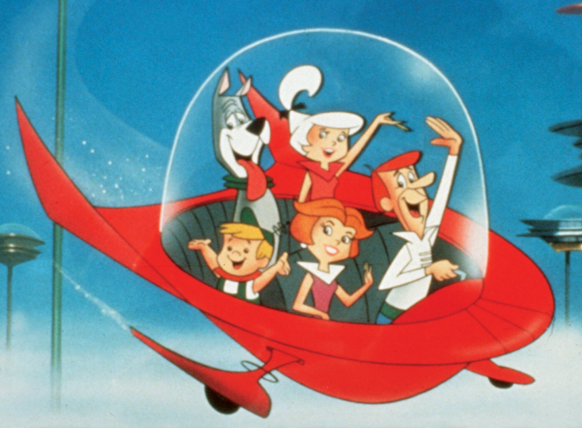
We knew what to expect in the 21st Century
Flying cars
Wall-sized video screens
Robot maids & dogs
Workout machines
Pan Am orbital shuttles
Space station
Moon base!
Notes:
Growing up in the 1960s, I knew what the future was going to be like - I watched the Jetsons! In the 21st century we were going to have flying cars, wall-sized video screens to talk to our boss, robot maids, robot dogs, electric workout machines that would sometimes go out of control - “Jane! Stop this crazy thing!” Pan Am would run orbital shuttles to the giant space station, and we’d have a moon base. And according to Star Trek, a couple of hundred years later we’d have food replicators, warp drive, and transporters.
We got the food replicators early.. Sort of. 3D printed pizza, anyone?

Slide 8
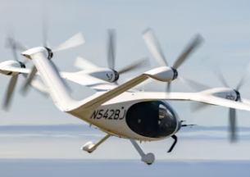
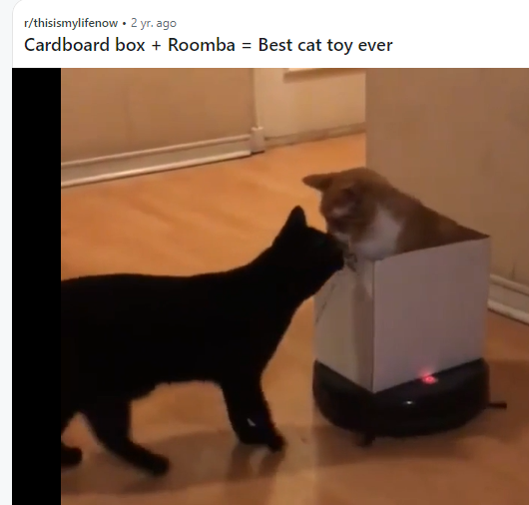
Almost there…?
Flying cars
Wall-sized video screens
Robot maids & dogs
Workout machines
Pan Am orbital shuttles
Space station
Moon base
https://www.reddit.com/r/catsonroombas/comments/x6rpcq/a_cat_tank
Notes:
And today, almost a quarter of the way into the 21st century we have almost all these things. Sort of
Flying cars (Joby EVTOL air taxis – next year maybe)
Robot maids – there is an entire Reddit for cats on Roombas, by the way
https://www.reddit.com/r/catsonroombas/
Wall-sized video screens to talk to our boss and coworkers - and their cats
Robot dogs - some cute, some downright scary [Boston Dynamics / Japanese Aibo]
https://mustreadalaska.com/fairbanks-airport-robotic-dog-has-a-pronoun-she-her-and-is-a-first-for-an-american-airport/
Electric workout machines that sometimes go out of control [Peloton]
Sadly, Pan Am isn’t flying anything anymore, much less orbital shuttles. But we have a space station, and so do the Chinese. The Russians use to have one, and ours is so old that now we’re talking about how to safely bring it down without hitting anything on the ground.
I still want my moon base, though! I was promised a moon base!
But all those things from the Jetsons - wall screens, robot maids, flying cars, space stations… none of those things radically changed the world.

Slide 9
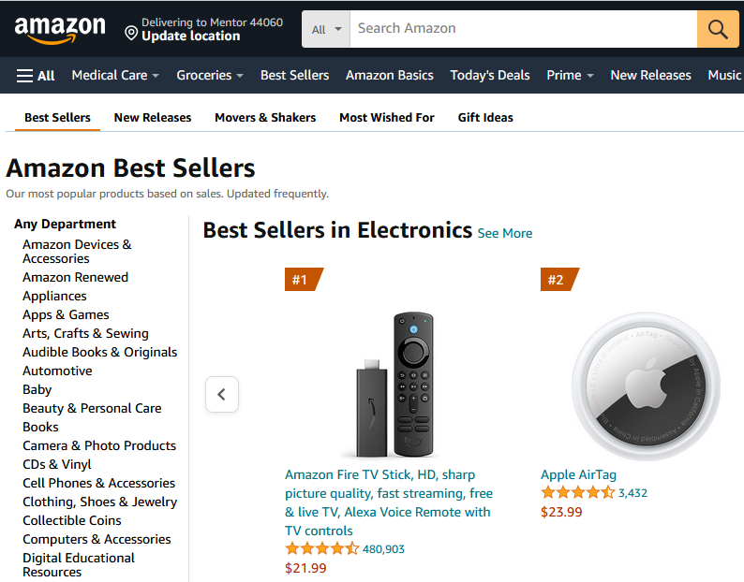
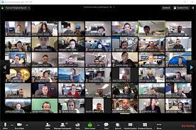
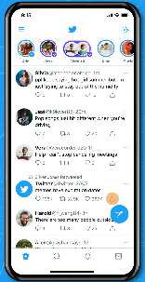
Flying cars didn’t change the world
Notes:
Yet, anyway.
What has radically changed things were Google, Amazon, YouTube, Facebook, Instagram, Twitter, Zoom… things that almost no one saw coming, except for maybe a few visionaries like Aldous Huxley and Howard Rheingold - and even they only saw the broad-brush outlines of “future shock” and “digital communities.”
But what did they actually change?

Slide 10
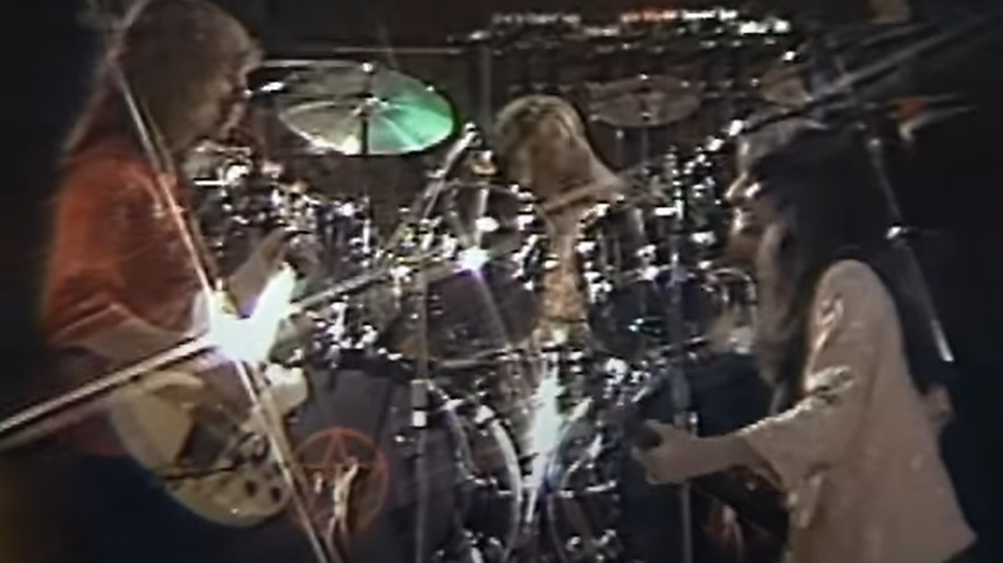
Plus ça change, plus c'est la même chose…
Notes:
The more that things change, the more the stay the same.

Slide 11
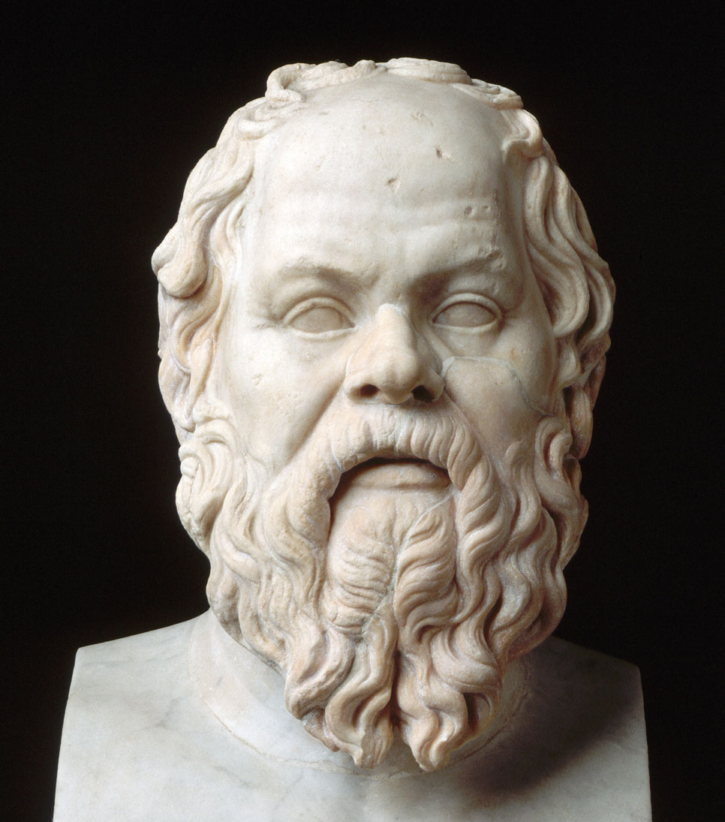
“Those Damn Kids” – Socrates
"The children now love luxury; they have bad manners, contempt for authority; they show disrespect for elders and love chatter in place of exercise. Children are now tyrants... They contradict their parents, chatter before company, gobble up dainties at the table, cross their legs, and tyrannize their teachers."
Notes:
But y’know, some things don’t change.
But you know what hasn’t changed? Google and YouTube and Twitter (ok.X) have changed how we get information and entertainment, but people have always gotten information and entertainment. Amazon has changed how we trade for goods, but people have always traded for goods. Human needs - human nature - doesn’t change.
The stories of Shakespeare and Chaucer still move us. The Biblical scandal of King David and Bathsheba could be a supermarket tabloid story or a viral TikTok hot take on a celebrity influencer.

Slide 12
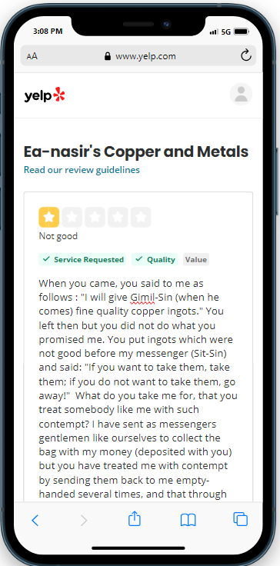
The first one-star Yelp review
“Tell Ea-nasir: Nanni sends the following message:
When you came, you said … “I will give Gimil-Sin fine quality copper ingots.” You did not do what you promised me. You put ingots which were not good before my messenger…”
Notes:
Bad customer reviews…
“Ea-Nasir is a cheat and sells bad copper” - the first negative Yelp review, 2,000 BC.

Slide 13
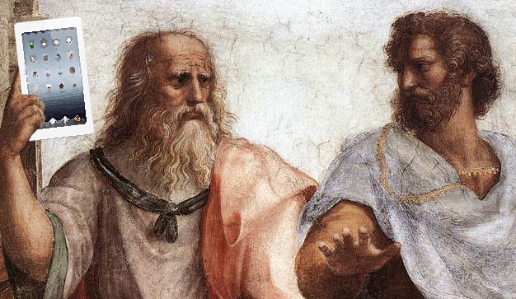
“Now what have you done?”
"For this invention will produce forgetfulness in the minds of those who learn to use it... you offer your pupils the appearance of wisdom, not true wisdom, for they will read many things without instruction and will therefore seem to know many things, when they are for the most part ignorant and hard to get along with, since they are not wise, but only appear wise."
Notes:
This is my favorite example, though. Plato recounts Socrates telling the story of how the god Theuth is so proud of inventing writing. His fellow god Ammon-Thamos is not so impressed, though:
"For this invention [of writing] will produce forgetfulness in the minds of those who learn to use it... you offer your pupils the appearance of wisdom, not true wisdom, for they will read many things without instruction and will therefore seem to know many things, when they are for the most part ignorant and hard to get along with, since they are not wise, but only appear wise."
-- Ammon-Thamus, god-king of Thebes, admonishing the god Theuth, the inventor of writing.
https://bearskindigital.com/2015/01/20/the-myth-of-thamus-and-theuth/

Slide 14
Technology adoption pattern
Novelty factor / Fear and loathing
Doing the same old thing in new ways
Transformative visionaries
The “Adjacent Possible”
Unintended Consequences
Notes:
Technology adoption follows a familiar pattern. Let’s look at some examples.

Slide 15
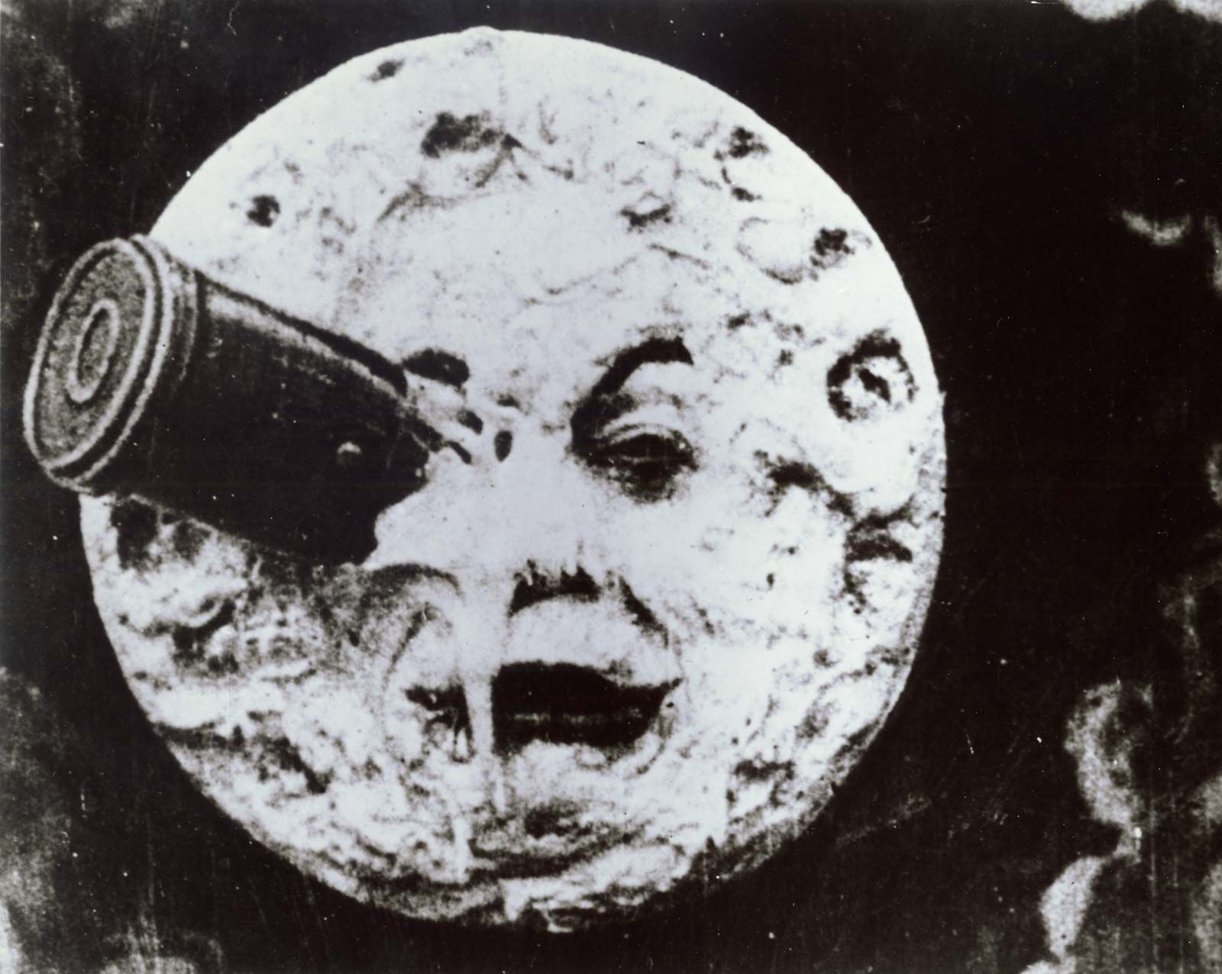
Early motion pictures
Filmed stage from audience
1895 “Arrival of a Train” Panicked patrons ran from theater
Georges Méliès early 20th Cent. “The father of special effects”
Pan / Tilt / Dolly / Zoom lens
Eisenstein, Kurosawa, Hitchcock
Notes:
Let’s look at a couple more examples. Early motion pictures. Lots of experiments. Pure novelty. Penny-cinema peep shows. Naughty things, too! Shock value.
TAKING ADVANTAGE OF NEW AFFORDANCES.

Slide 16
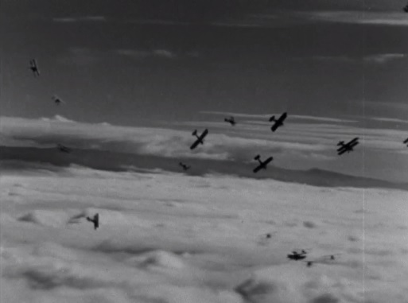
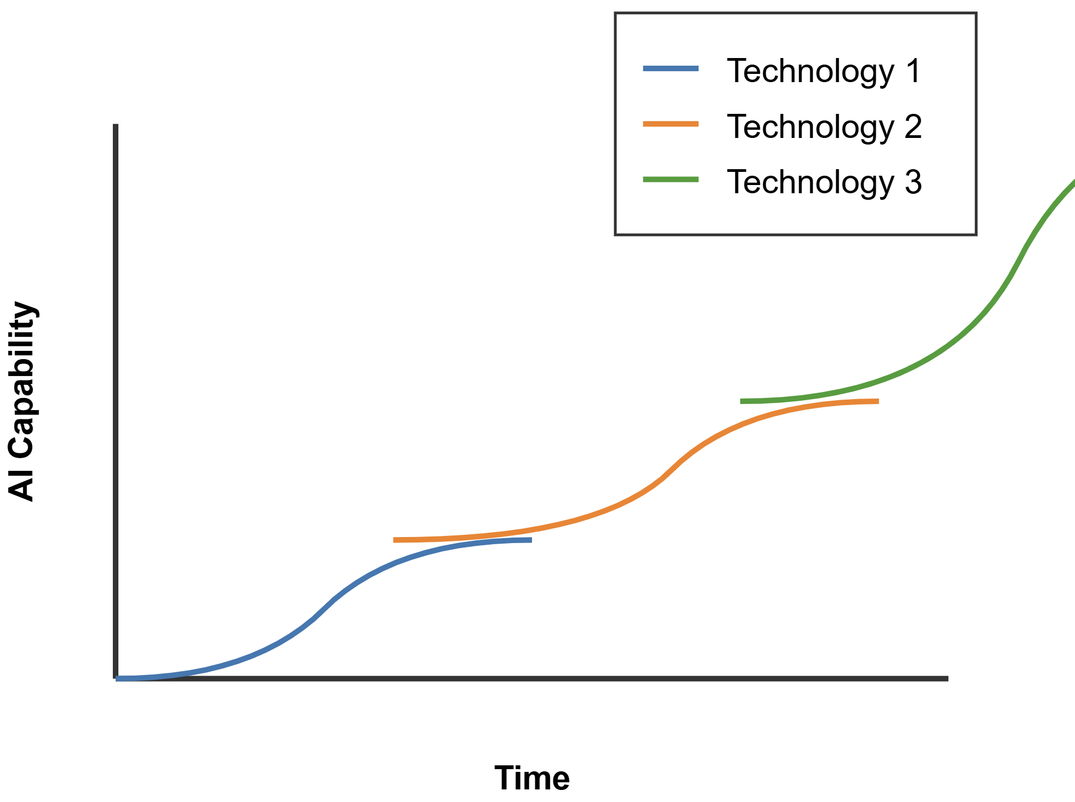
The adjacent possible: I can do this…. What ELSE can I do?
Notes:
Science historian and author Steven Berlin Johnson uses the term “the adjacent possible” to describe the phenomenon of, “ok, now I can do THIS, so what ELSE can I do?” I can *move* the camera… how can I use that to tell a story differently? What else can I do? What if I mount it on an AIRPLANE? And then in 1930 Howard Hughes – the transformative visionary - rents EVERY camera he can get his hands on to film an EPIC aerial battle. Something that had never been done before.
In 2007 someone in a conference room points their MacBook at the podium and I get to hear David Warlick.
The graph is from Ethan Mollick’s blog post on July 22. It was generated by Claude 3.5 after a few tweaks.

Slide 17
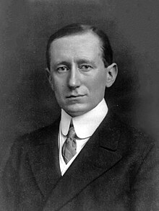
Marconi: wireless communication
“Wireless railroad telegraph” for ships at sea
Commercial advantages immediately obvious
Safety bonus: Titanic sends first “SOS”
Radio used for entertainment & news
Commercial networks, advertising
Notes:
A hundred years later Guglielmo Marconi developed a method of using an invisible part of the electromagnetic spectrum to transmit information. Unlike the Montgolfier’s balloons, this produced no showy public spectacle. You had to be part of the technologically literate in-group to even understand it.
But the members of that circle immediately grasped the commercial advantages of the new invention. Notice – they were still doing the same old things – sending commercial messages about cargo loads, timetables, weather conditions, and so on.
There was an added capability – a ship that ran into trouble could send out a distress message and call for help, and the message could be heard many miles away. In fact, the very first SOS message was sent from the HMS Titanic on that fateful night in April 1912.
Radio becomes a way of spreading news and entertainment. Broadcasting networks are born. Within a few decades millions of middle-class American homes have a radio, and people tune in to listen to the news read live – sometimes by reporters at big events like political rallies, orchestras and bands playing the latest dance tunes, actors and creative sound effects artists bringing radio dramas to life – all paid for by commercial sponsors, who have discovered a lucrative audience for their products.

Slide 18
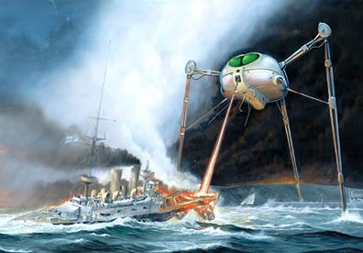
October 1938: a dramatic radio play…
Notes:
And then in late October 1938, a young producer named Orson Welles and his crew stage a dramatic radio drama about an invasion of Earth by giant three-legged machines from the planet Mars. The script is written – and presented – as though it were breaking news, presented by reporters live on-the scene. People tune in late, having missed the opening that – like a Shakespeare prologue – explained that this is just a radio play.
Millions of people panicked, thinking they were hearing actual live news reports of a real-life invasion of Earth. People were blasting their shotguns at the town water towers - in the darkness they resembled the giant three-legged metal monsters that the radio described.
The power of mass media was on display for the first time.

Slide 19
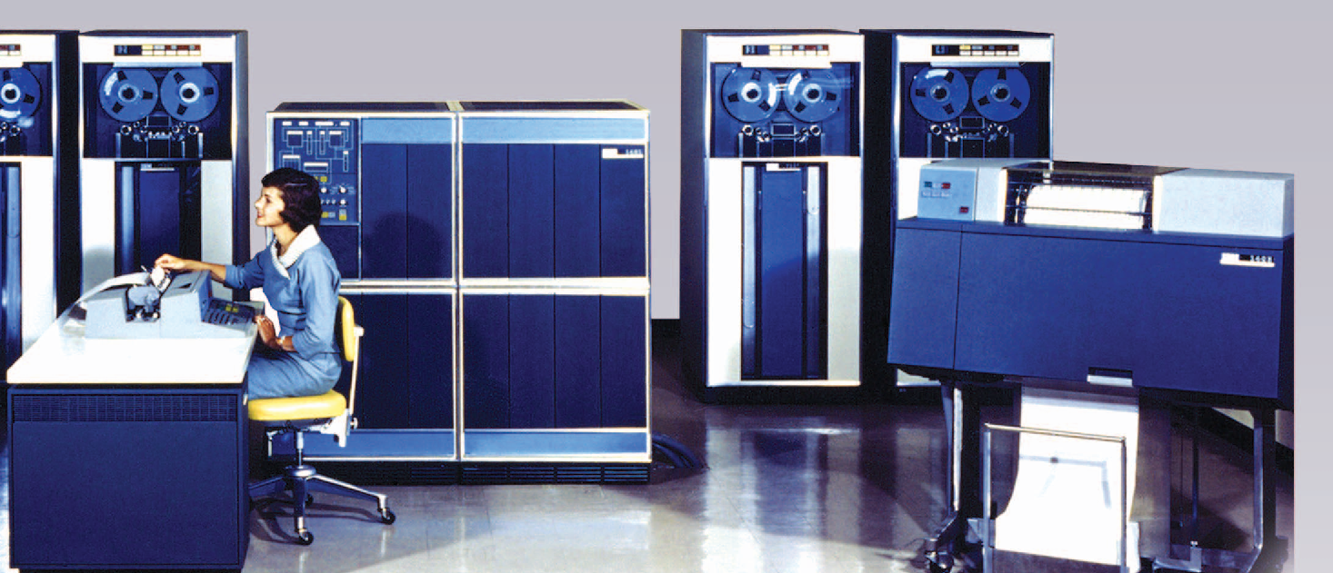
Data processing machines
Notes:
You can probably see that pattern with computers, right?
Calculating ballistic trajectories. Accounting, payroll, student schedules, order processing, inventory management… doing the same old boring things, just faster and more efficiently.

Slide 20
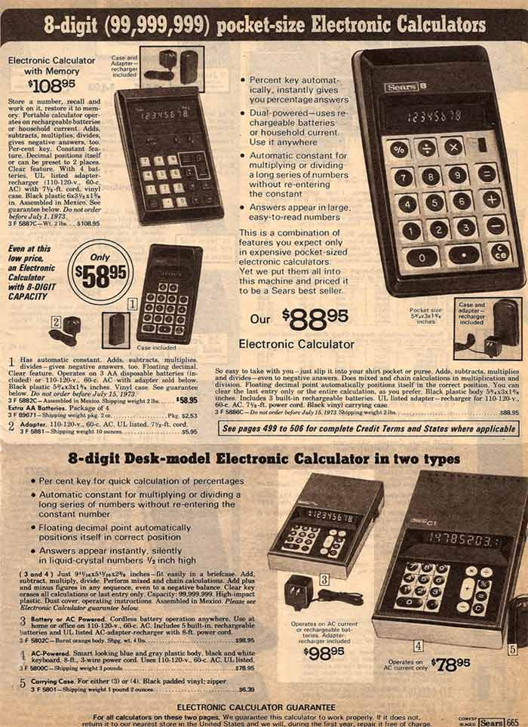
Calculator wars
Mid-1970’s: 72% of parents did NOT approve of 7th-graders using calculators
Early 80’s: 84% of teachers WANTED students to use calculators
Today: Last time you paid cash over to get exact change back?
Notes:
Then they got small.
And just look at those low prices!
That’s an important point – early calculators WERE expensive. Early AI is FREE. Big difference!

Slide 21
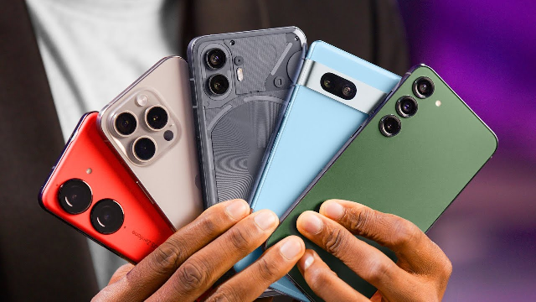
Smartphones in classrooms
Then: Absolutely forbidden!
Now: Integrated into lesson plans (maybe?)
Notes:
We saw the same patters with cell phones, right? Still do. Some instructors ban them. Verboten!
Others have students pull them out, look stuff up. This was somewhat disruptive, but it’s now mostly anon-issue. We’ve adapted.
But again with affordances – we can do things we couldn’t do before. Put QR codes on lab specimens. VR/XR…

Slide 22
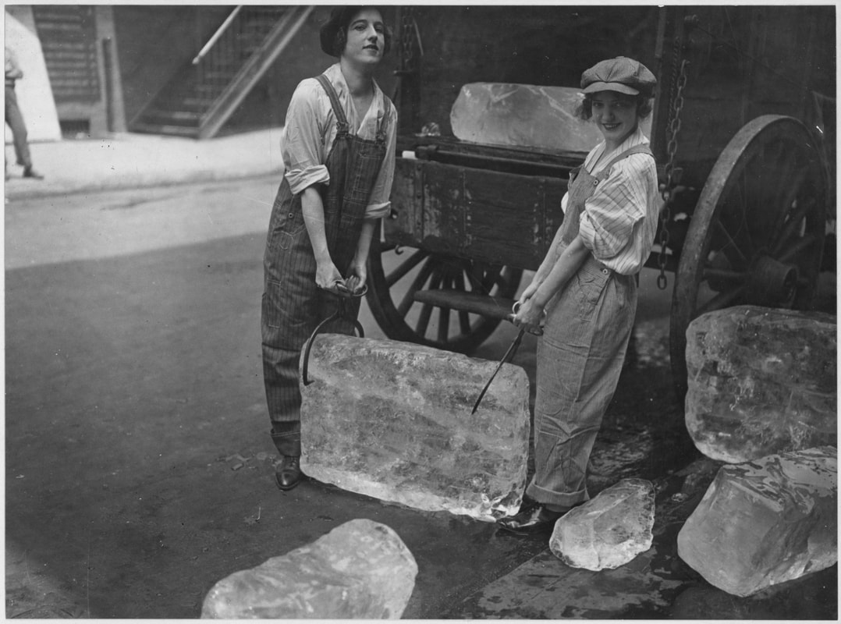
New tech supplants old
Ice was Big Business!
Cutting, storing, transport, delivery
Home refrigeration destroyed that industry - but created new ones
Notes:
(David Wiley used this same example)
My aunt still called it the icebox because that’s what it was when she was a girl in the 30s.
1913 – Fred Wolf – cooling unit on top of insulated box.
1918 Wm Durant - Home-sized units with self-contained compressors but cost thousands (equiv)- luxury item.
1920s Freon made home refrigerators safer. 1923 Frigidaire – self-contained unit.
1930s – 8% adoption grew to 44% by end of decade. By end 1940s nearly all homes had a fridge.

Slide 23
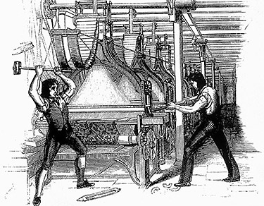
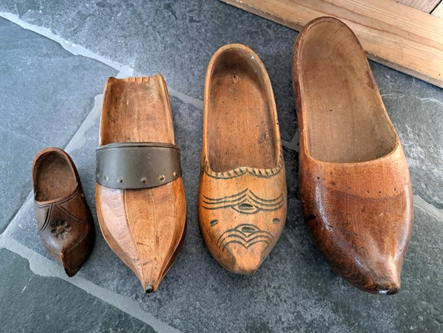
Luddites and Saboteurs
Notes:
Sometimes resistance to innovation can get violent when people feel their livelihoods are threatened.
In the early 1800s English textile workers – people who spun wool and flax into thread, and wove thread into cloth – literally took up arms against the automation of their cottage trades. They organized under the banner of a mythical character they called Ned Ludd, broke into factories, and smashed the machines with sledge hammers!
Across the Channel, their French counterparts took their wooden shoes – called sabots – and threw them into he machines to wreck them. They were saboteurs committing sabotage.
These terms are still used to describe activist, even violent resistance to change.

Slide 24
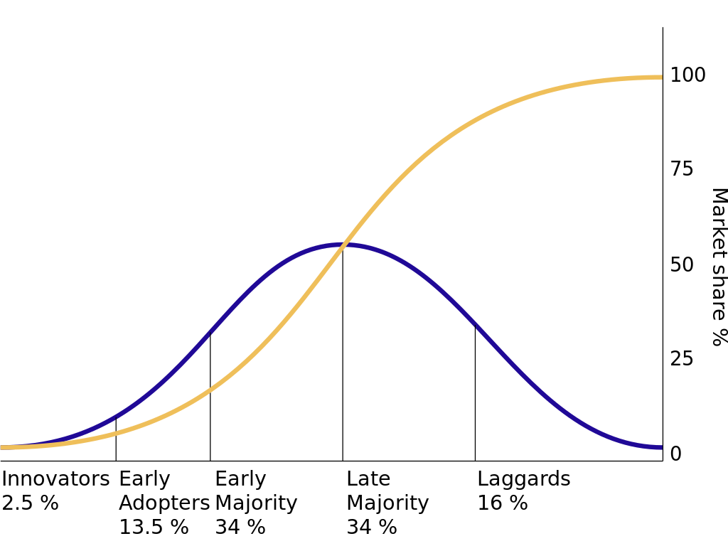
technological innovation & adoption follows a familiar pattern
Notes:
This graph holds for generally true for any new technology. Only the horizontal timescale changes.

Slide 25
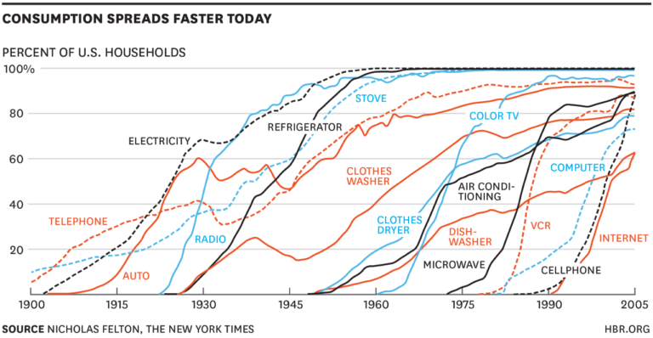
Adoption Curves get steeper over time
Notes:
This S-shaped curve holds generally true for any technology. Technology adoption has tended to speed up over time. Here the horizontal scale is the 20th century, from 1900 to 2005. The graph of broadband adoption from 2000 to 2008 I showed earlier had the same S shape.

Slide 26
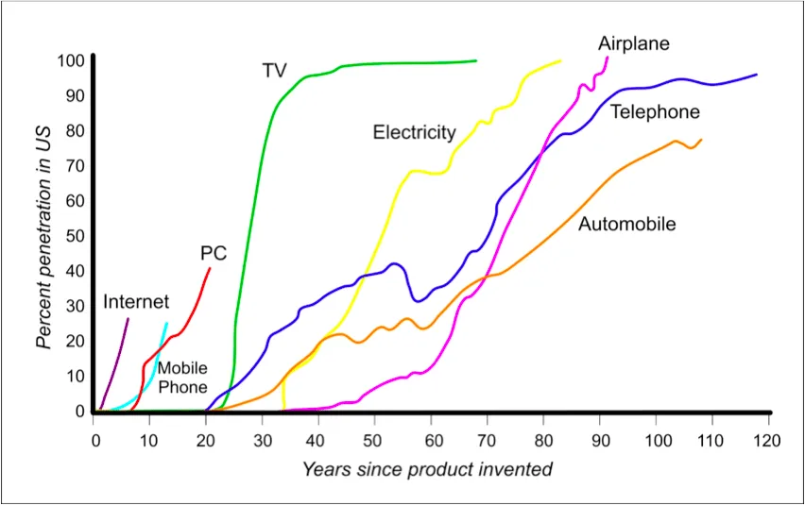
Some faster than others
Notes:
Here’s a slightly different look. Here the scale is relative, simply time to adoption regardless of when the tech was introduced. Notice how quickly the television – green line - caught on compared to the telephone – blue line. Why was that? Any business profs? It’s all about the Benjamins, of course.
ChatGPT isn’t on this chart, but it would be a vertical line right on the Y axis – 100 million users in 30 days!

Slide 27
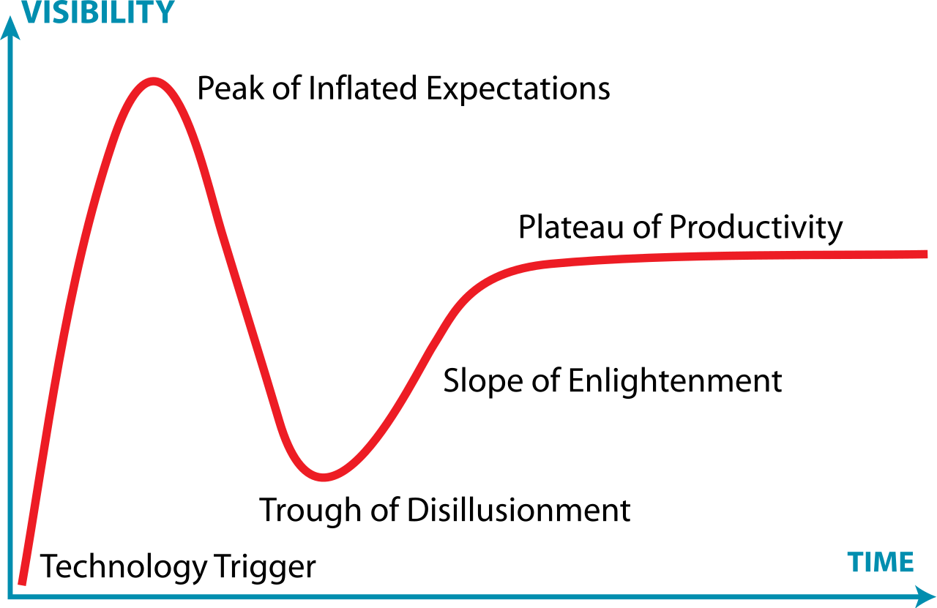
Gartner Hype Cycle
Notes:
You may be familiar with this chart. Enterprise AI is currently in the Trough of Disillusionment according to an article this summer. In late July, the so-called Magnificent Seven tech stocks took a nose-dive, largely because the AI enthusiasm bubble had burst.

Slide 28
Same old same old, just faster (better?)
Copilot
Digital research assistant
Break the blank page
Create tests and assignments
GRADE tests and assignments???
Notes:
The plateau of productivity…
We’ve seen the novelty and weird for weird’s sake, the fear and loathing, right? Weird fingers, hair-on-fire, Skynet-is-coming, same old end-of-the-world stuff from the usual sources.
And now we’re seeing the normalization of AI – the building it into everyday stuff. Your phone. Siri. Alexa. Word- hey, Clippy is back!
In his book, Ethan Mollick talks about getting to know your really smart, kinda weird, non-human alien intern who can help you with research, data analysis, and other tasks. Levels the playing field for non-superstar performers.
This is not to say this isn’t useful – IT IS! This is what our student need to know YESTERDAY!

Slide 29
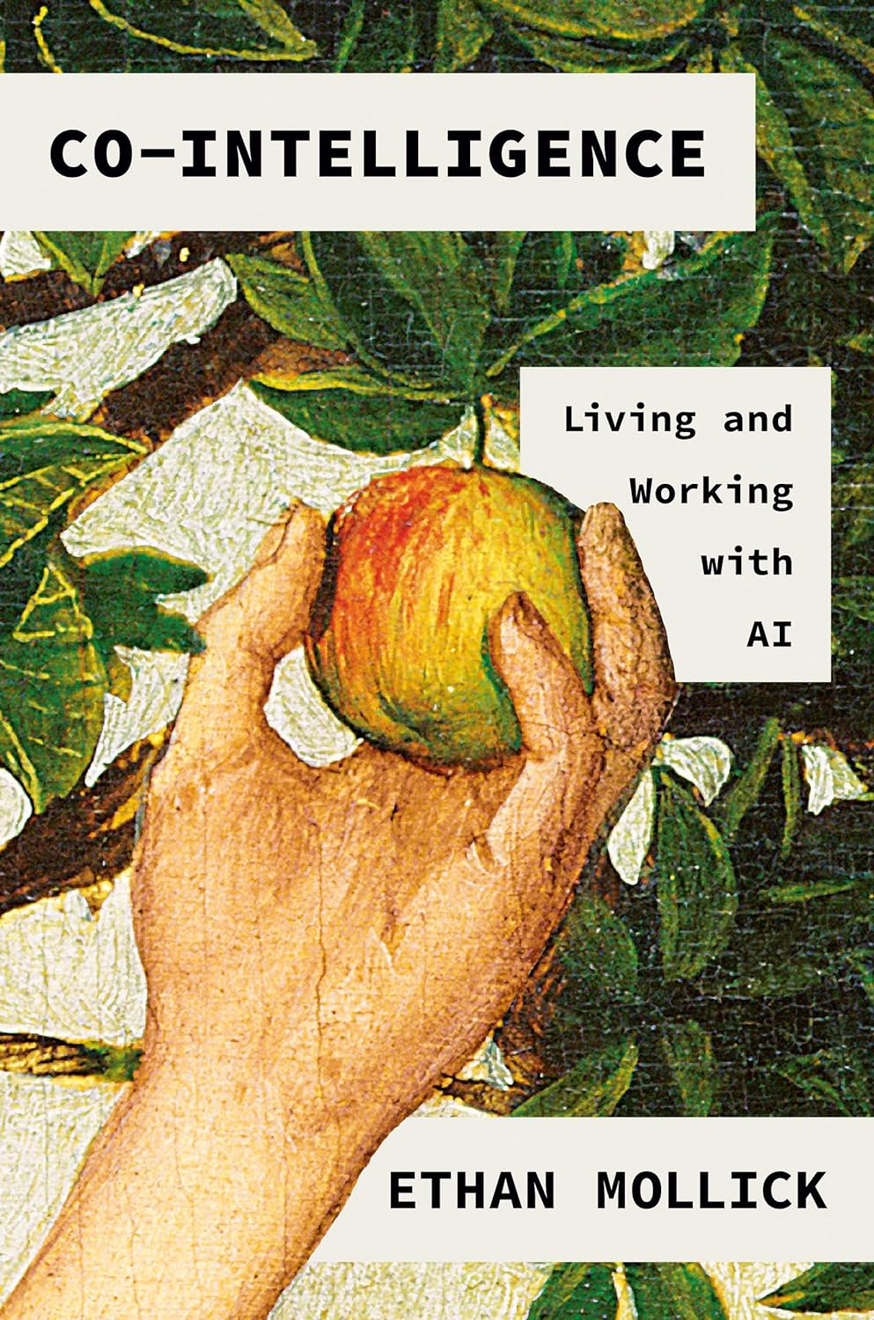
Ethan Mollick
Wharton School, U Penn
“One Useful Thing” Substack
“Co-Intelligence: Living and Working with AI” (Spring 2024)
Notes:
I going to refer to this book a fair amount.
https://www.amazon.com/Co-Intelligence-Living-Working-Ethan-Mollick/dp/059371671X

Slide 30
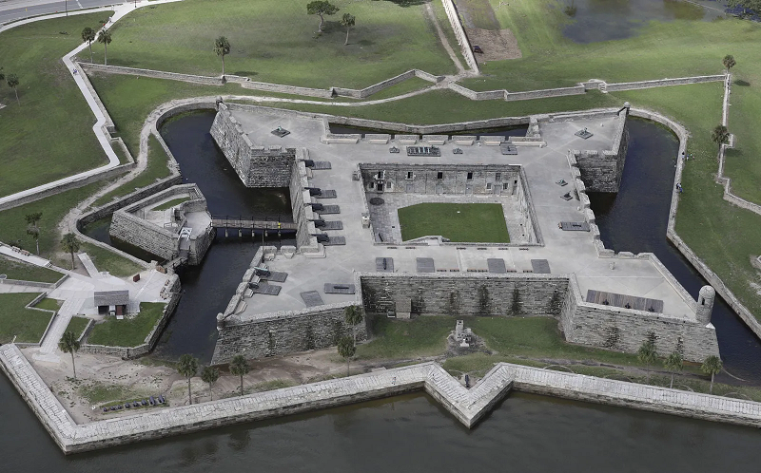
Jagged frontier
Notes:
Mollick describes the Jagged Frontier as the division between things that AI does well and things humans do well. It’s not smooth, like you might expect.
AI is really bad at math, as it turns out. And writing poems with exactly fifty words.
But it’s surprisingly good at summarizing and analyzing big chunks of text. And it’s really good at coming up with lots and lots of wild examples.
But it’s terrible at jokes –even bad puns and Dad jokes.
And really the only way to find out where that jagged frontier IS, is to play with it.

Slide 31
working with AI
Always invite AI to the table
Only you can figure out how to be the expert at using AI for your job
The only way to do that is to use it
Be the human in the loop
LLMs only appear to be sentient
Treat AI like a person – an alien intern
Anthropomorphizing is risky - but it helps figure out how to work with it
This is the worst AI you will ever use
It will get much better very fast. (The question is how much better, how fast.)
Notes:
Mollick suggests four principles for working with AI.
Study shows that AI levels the playing field. Doesn’t help top performers much, but really helps poor performers.
But he’s talking about that plateau of productivity – the new normal. Doing the same old thing a new way, just faster.
NOT changing the water on the beans, upsetting the apple cart, NOT a paradigm shift.

Slide 32
Copilots vs Agents
Agents
General purpose
Very connected to internet
Independently use other tools
Employ multimodal input / output
“Suggest a nice restaurant, something a little different, and a concert…. Ok, buy the tickets.”
High utility / high risk - “Sharp knives”
Copilots
Limited-purpose
Not connected to internet
Might use other tools
“Make this paragraph more clear”
Low utility / low risk
“Dull knives”
Notes:
Mollick talks about co-pilots versus agents.

Slide 33
What are the new adjacent possibilities?
Deep fakes
“Dead Web” – created by AI, consumed by AI
The end of authenticity?
The end of humanity?
Notes:
Who will the transformative visionaries be? The Steve Jobs, Bill Gates, Jeff Bezos, Elon Musks of 2025? YOUR STUDENTS, THAT’S WHO
“My wife asked why I keep a loaded gun in the kitchen. Decepticons, I said. She laughed. I laughed. The toaster laughed. I shot the toaster.”

Slide 34
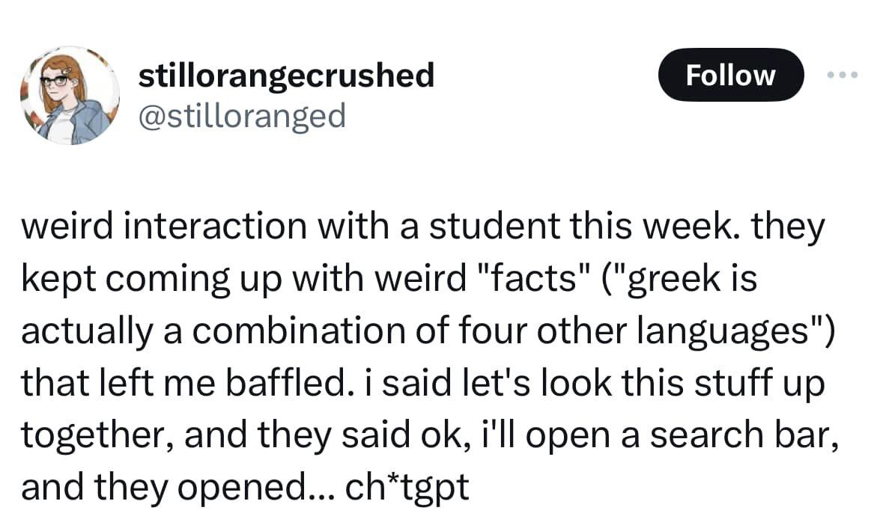
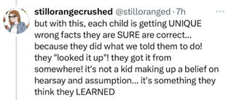
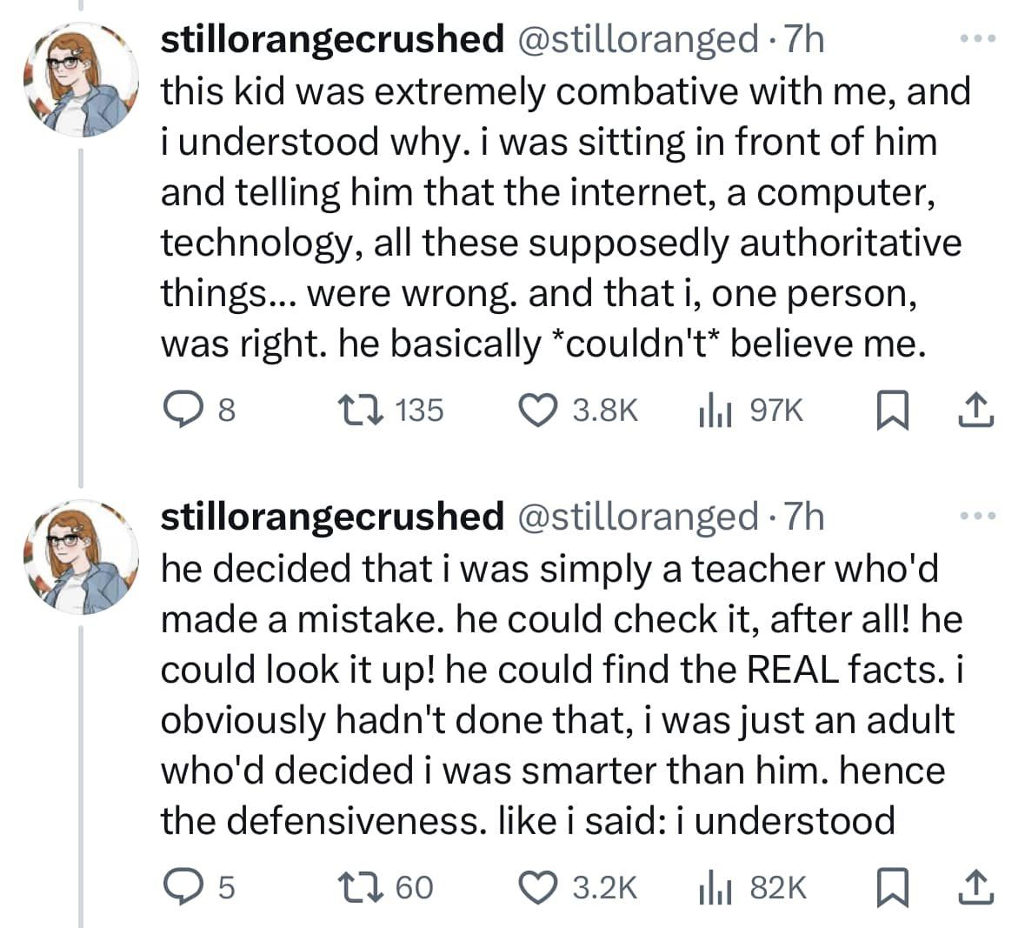
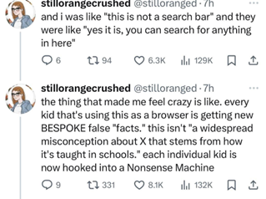
An existential generational epistemological crisis?
Notes:
So you might have seen this Twitter thread – excuse me, X – thread making the rounds. Teacher recounting an interaction with a student who is using ChatGPT as a search engine. The teacher is understandably frustrated.
https://consistantly-changing.tumblr.com/post/755570948897390592/embed

Slide 35
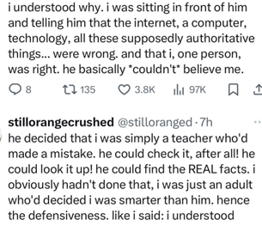
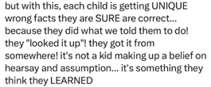
An existential generational epistemological crisis?
Notes:
Here’s the money quotes.
OF COURSE this is not an existential crisis. The student was merely given poor instructions. Right? RIGHT???
You know what it reminds me of? “…for they will read many things without instruction and will therefore seem to know many things”
Obviously, no, do not panic, the teacher just needs to take a deep breath and demonstrate how fallible AI is for a task like this.

Slide 36
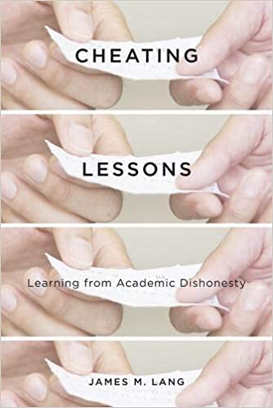
Homework apocalypse
Rethink what we really want students to do
Have them use AI, then critique the output
Studies show they don’t like AI output – “That’s not me!”
Why do students cheat in the first place?
Value the Process not the Product
Notes:
But but but… Tests and homework really work – IF students engage with them!
Why students cheat:
All or nothing – high-stakes outcomes
Emphasis on performance – comparison w/ others
It’s not important to me – extrinsic motivation, just a hoop to jump through
I can’t do it anyway – low self-actualization, low expectation of success

Slide 37
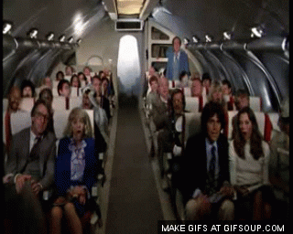
Ok great so now what?
Notes:
Or we could just, y’know, panic?

Slide 38
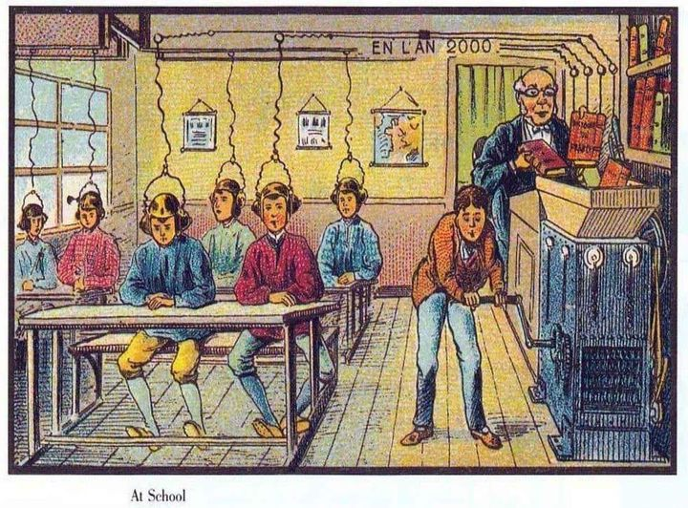
Replace human teachers with magical textbooks?
“The ways in which AI will impact education… are likely to be counterintuitive. They won’t replace teachers but will make classrooms more necessary. They may force us to learn more facts, not fewer. And they will destroy the way we teach before they improve it.” (Mollick p.160)
Notes:
This is a French postcard from 1900 depicting a classroom of the year 2000.

Slide 39
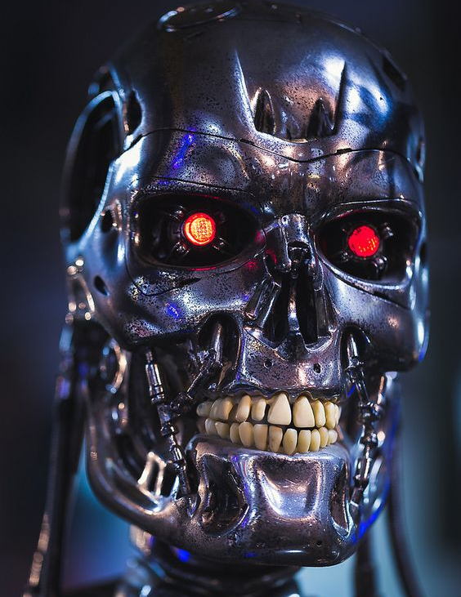
Unintended possibilities?
Notes:
What are the possible futures? Of course, science fiction writers have been imagining the future of AI for a long time.
Open the pod bay doors, HAL. I’m sorry, Dave. I can’t do that. HAL is a psychopath, but it’s isolated in space, and Dave was able to deactivate it. SkyNet and the Terminator- much scarier.
Fun fact – the original Terminator movie came out in 1984 – forty years ago. The hero, John Connor, comes back from the future to warn his mother about the rise of the machines. He explains what’s going on in his world and why she has to try to stop it. She says, “But computers can’t do that!” He replies, “No, not now. In about forty years.” Hmmmm….
Wall-E is cute and harmless… but remember that he’s alone on an Earth that’s been ruined and abandoned by humanity.
AI Snake Oil blog – Predictions for existential risks (x-risks) are too unreliable to base policy on.
https://www.aisnakeoil.com/

Slide 40
Mollick’s Four Futures
Capabilities plateau
Linear growth
Exponential growth
AGI (Jarvis / SkyNet)
Notes:
In his book, Mollick discusses four possible scenarios for AI: a capabilities plateau, linear growth in capabilities, exponential growth, and AGI.
https://www.mckinsey.com/capabilities/strategy-and-corporate-finance/our-insights/the-use-and-abuse-of-scenarios
four kinds of predetermined outcomes:
demographic trends,
economic action and reaction,
the reversal of unsustainable trends,
scheduled events (which may be beyond the typical planning horizon).
https://chatgpt.com/g/g-TcSx5BYQr-the-four-futures-planner

Slide 41
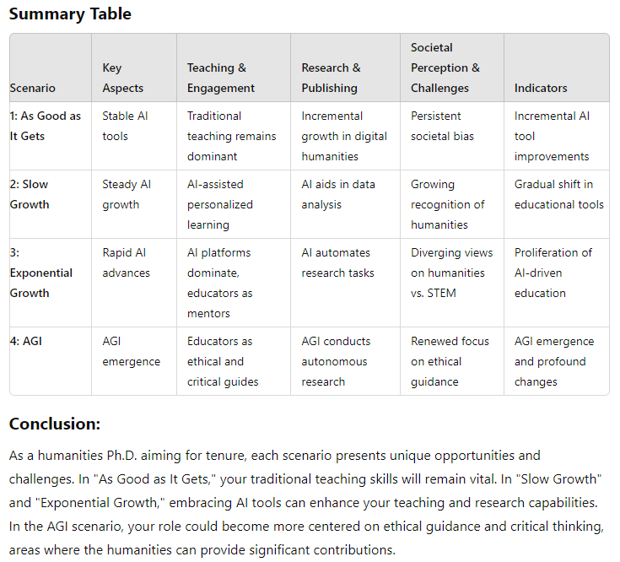
Ethan’s Four futures planner GPT (STEEP)
Social
Technological
Economic
Environmental
Political
Notes:
https://chatgpt.com/g/g-TcSx5BYQr-the-four-futures-planner
https://lakelandcc.hosted.panopto.com/Panopto/Pages/Viewer.aspx?id=1aceae9f-8b2e-4c52-9ca9-b1b800ee583a
“I'm a 30 yo humanities Ph.D. seeking tenure at a college or university. I love teaching but I'm concerned about growing societal bias against the value of higher education, and the expansion of AI, especially as it will impact future college students now in elementary school. What will my career look like in five, ten, or twenty years?”
Conclusion:
As a humanities Ph.D. aiming for tenure, each scenario presents unique opportunities and challenges. In "As Good as It Gets," your traditional teaching skills will remain vital. In "Slow Growth" and "Exponential Growth," embracing AI tools can enhance your teaching and research capabilities. In the AGI scenario, your role could become more centered on ethical guidance and critical thinking, areas where the humanities can provide significant contributions.
To prepare for these futures, consider the following actions:
Stay Updated on AI Developments: Understand how AI is being integrated into education and research.
Enhance Digital Literacy: Familiarize yourself with AI tools that can aid in teaching and research.
Emphasize the Unique Value of the Humanities: Advocate for the importance of critical thinking, ethics, and cultural understanding.
Adaptability and Lifelong Learning: Remain flexible and open to new teaching methods and research paradigms.
By anticipating these changes and preparing accordingly, you can navigate the evolving landscape of higher education and carve out a meaningful and impactful career.

Slide 42
“The Singularity is Nearer” – ray Kurzweil
2005 “The Singularity is Near” predictions haven’t changed
2029 – AI passes the Turing Test – equals human intelligence (I worry about the computer that flunks it on purpose…)
2045 – Humans merge with AI to create superintelligence (“Singularity” – a massive inflection point)
Notes:
https://www.theguardian.com/technology/article/2024/jun/29/ray-kurzweil-google-ai-the-singularity-is-nearer
Kurzweil says AI might pass the Turing test in 2 years

Slide 43
McKinsey: four kinds of predetermined outcomes
Demographic trends
Economic action & reaction
Reversal of unsustainable trends
Scheduled events beyond the horizon
Notes:
https://www.mckinsey.com/capabilities/strategy-and-corporate-finance/our-insights/the-use-and-abuse-of-scenarios

Slide 44
Demographics are destiny
Notes:
Demographic trends – here’s a visualization based on data from a couple of years ago of population projections for the world’s six most populous countries, looking ahead fifty years. China, India, the US, Indonesia, Pakistan, and Nigeria.
Let’s zoom in.

Slide 45
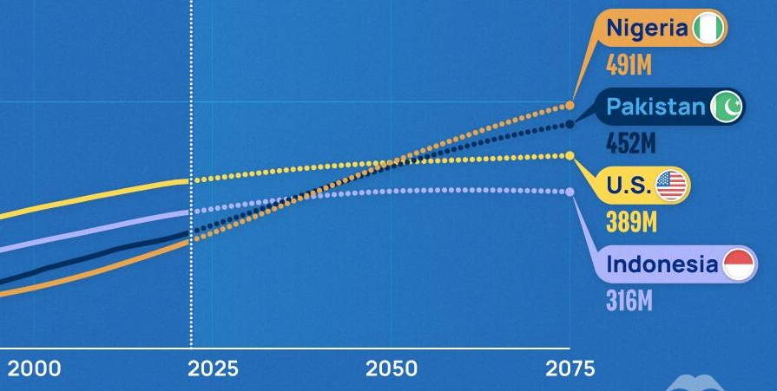
Demographics are destiny
Notes:
“We have to prepare our students for a future that we cannot imagine.” Nigeria and Pakistan will surpass Indonesia in about ten to twelve years, and pass the US in about twenty-five. I’ll be retired by then, I hope. But look at the top of the chart.

Slide 46
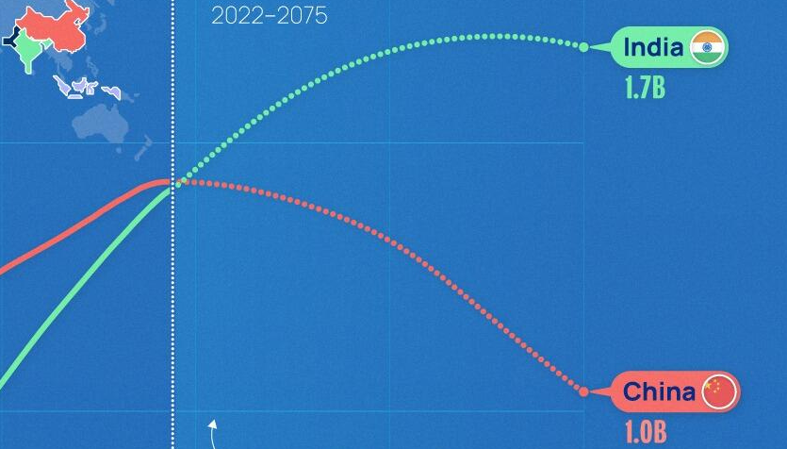
Demographics are destiny
Notes:
That’s pretty dramatic. Think about what that means in terms of economic output, workforce participation, regional and global military and security issues. We don’t live in a bubble.
Now, you might say, Corrie, that stuff is YEARS away. I have to plan for Spring semester. And you’re right. But you know who else is doing that? The parents of the high school class of 2038 – their kids started kindergarten in September. Those kindergarten kids will start college AFTER Nigeria and Pakistan pass Indonesia on that graph I showed you a minute ago.
My firstborn got married this summer. It happens FAST, folks.
We have to prepare the next generation for a world that WE KNOW we cannot imagine. But we do know that some things don’t change.

Slide 47
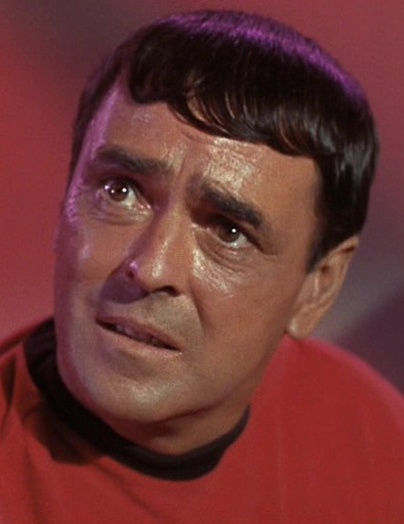
You canna change the laws of economics!
https://www.youtube.com/watch?v=C3GtxtWSZxE
Notes:
Shamelessly stolen from the McKinsey site, too good to pass up.
Some things simply don’t change. Human nature. Supply and demand. What goes up MUST come down. Bubbles pop eventually. Economic cycles… CYCLE.
“The public is devaluing college!” Well, yes, and some of that frankly may be well-earned. There’s a reason my demo course in Blackboard is Underwater Basketweaving.
Yes, 2U just went bankrupt. Yes, colleges are closing- including a well-known college in my town. Yes, employers are looking more at skills than degrees. Yes, PhD still means Pizza Hut Delivers just as it did in 1985 when I was looking at grad school. None of this is new. Fundamentals remain true.
The value of the branded credential will not go to zero. But remember that survey of recent grads and employers – our students are depending on us to teach them!
https://www.youtube.com/watch?v=C3GtxtWSZxE

Slide 48
Trees don’t grow to the sky nothing lasts forever
Notes:
A second maxim that McKionsey uses in developing scenarios – trends don’t go on forever. Beware “new paradigms” or “end-stage” this or that. Don’t plan on the impossible. (The improbable is ok.) Reality check, right? Things change, but not that much.
BTW, that’s not AI, that’s real human-made art, an artist on the Deviantart website who goes by Dedisun
https://www.deviantart.com/dedisun/art/World-Tree-972236516
“Economies are fundamentally cyclical… in the past, many new, innovative technologies—railroads and radio, for example—were hailed as “new paradigms” and then promptly led to investment bubbles. A useful test is to project a trend at least 25 years out. [It might help to look back 25 years] Then ask how long can this trend really be sustained. Challenge yourself to try and prove why the shape of the future should be so fundamentally different from the more cyclical past. Chances are you won’t be able to…”
https://www.mckinsey.com/capabilities/strategy-and-corporate-finance/our-insights/the-use-and-abuse-of-scenarios

Slide 49
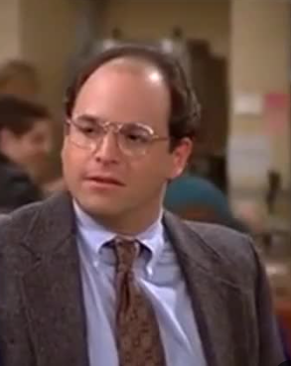
Scheduled events beyond the planning horizon
Notes:
“That was bound to happen” Seinfeld reference? Anyone? Beuller? I’m old…
The fourth maxim in scenario planning is that things happen that you knew were gonna happen. Economic cycles again. But also, changes in administration. Elections. Demographic trends. And you may not know the details of what’s going to happen, but just knowing that SOMETHING is going to happen, and being prepared for that, is a lot better than acting as if nothing is going to happen.
PLATO.. Maternity leave. No way to plan in detail.

Slide 50
Predictions are Hard, especially about the Future
Notes:
The blog AI Snake Oil – recco’d by Ethan Mollick, BTW, recently had a post about how it’s a VERY BAD IDEA to base government policies on the risk that AI is going to wipe out humanity. Why? Because that risk is all over the map. Many orders of magnitude.
https://www.aisnakeoil.com/p/ai-existential-risk-probabilities
What’s probably most likely is some jagged-frontier variation of Scenarios 2 and 3. There’s going to be areas where AI increases in capability relatively slowly from where it is now – and bear in mind, where it is now is pretty amazing compared to two years ago! There’s going to be areas where it goes WHOOSH faster than we can really cope.
(See https://www.oneusefulthing.org/p/change-blindness )

Slide 51
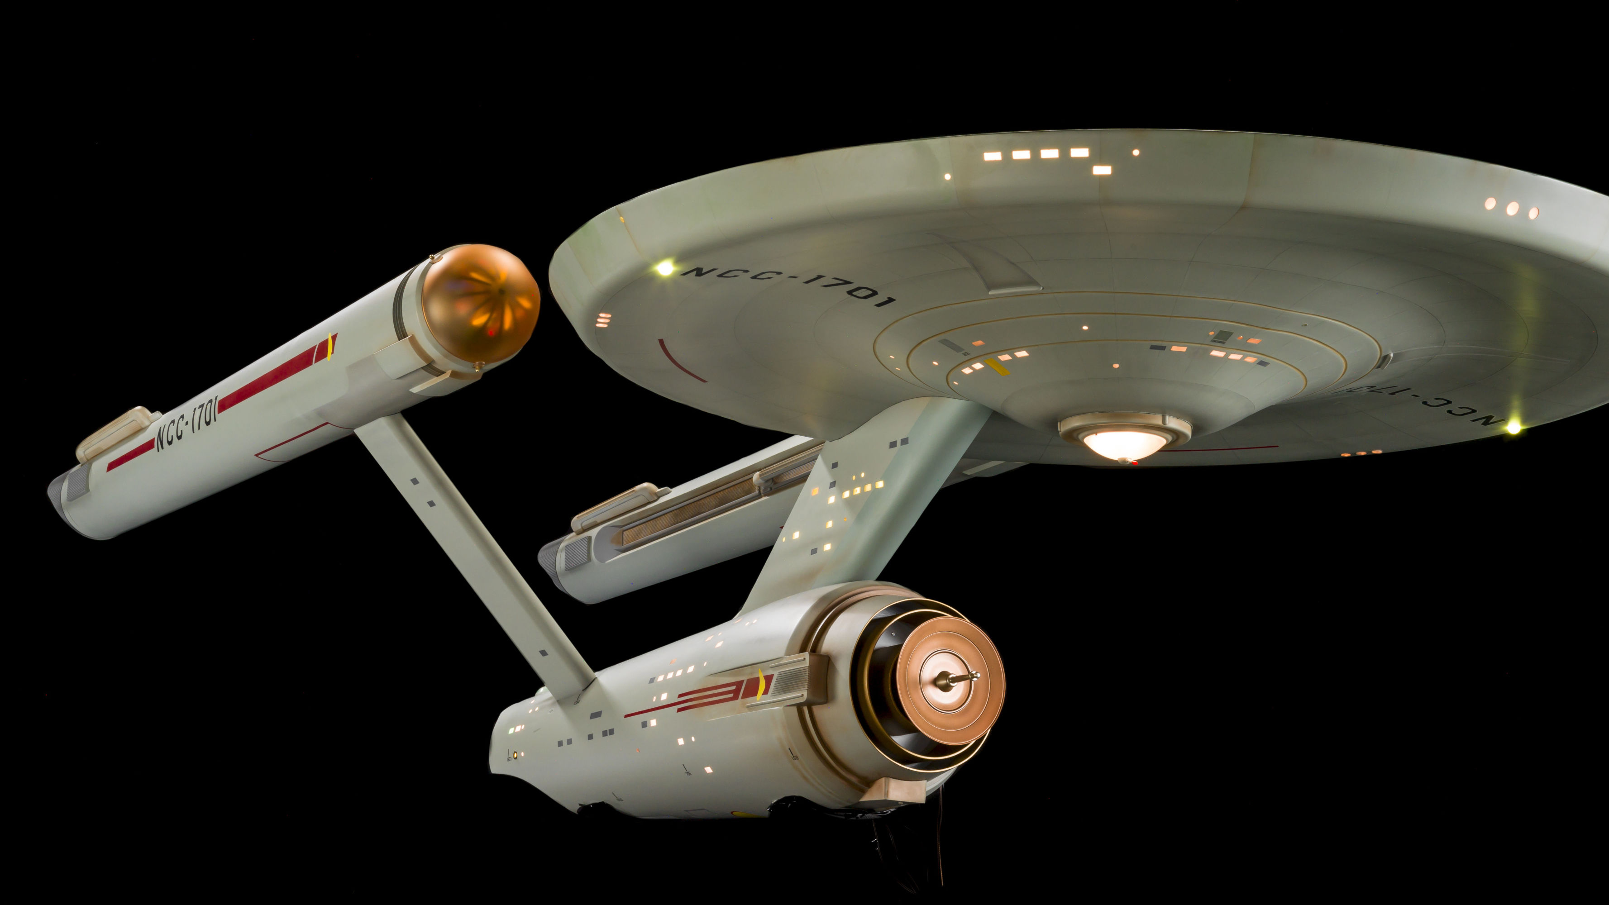
To Boldly Go… From the Jagged frontier to the final frontier?
Notes:
AI will not fundamentally change human nature, human psychology, the laws of physics, or the laws of economics.
It may, however, change our understanding of some of those things.
It’s practically guaranteed that some transformative visionary is going to come out of the blue. Jaron Lanier (who qualifies) was talking about this at EDUCAUSE last week.
So maybe with the help of AI we WILL find a cure for cancer, or the common cold, or invent antigravity or cold fusion …
…or transporters or warp drive. I certainly hope so.
Elon Musk says he wants to die on Mars, just hopefully not on impact. He just might do it, too. Me, I want my moon base. They promised me a moon base.
And I want us to explore strange new worlds, to discover new life, and new civilizations. To boldly go… Beam me up, Scotty.

Slide 52
Corrie Bergeron
corrie.bergeron@gmail.com
Facebook: Corrie Bergeron
Notes:
I appreciate y’all taking the time this afternoon. I’ll be delighted to continue the conversation. If you can spell my name, you can find me online.
https://www.aisnakeoil.com/p/ai-existential-risk-probabilities
https://mustreadalaska.com/fairbanks-airport-robotic-dog-has-a-pronoun-she-her-and-is-a-first-for-an-american-airport/
https://www.reddit.com/r/catsonroombas/comments/x6rpcq/a_cat_tank/?utm_source=share&utm_medium=web3x&utm_name=web3xcss&utm_term=1&utm_content=share_button
https://chatgpt.com/g/g-TcSx5BYQr-the-four-futures-planner
https://www.insidehighered.com/news/tech-innovation/artificial-intelligence/2024/07/23/new-report-finds-recent-grads-want-ai-be?
https://bearskindigital.com/2015/01/20/the-myth-of-thamus-and-theuth/
https://www.amazon.com/Co-Intelligence-Living-Working-Ethan-Mollick/dp/059371671X
https://consistantly-changing.tumblr.com/post/755570948897390592/embed
https://www.aisnakeoil.com/
https://chatgpt.com/g/g-TcSx5BYQr-the-four-futures-planner
https://www.deviantart.com/dedisun/art/World-Tree-972236516
https://www.mckinsey.com/capabilities/strategy-and-corporate-finance/our-insights/the-use-and-abuse-of-scenarios
https://chatgpt.com/g/g-TcSx5BYQr-the-four-futures-planner
https://lakelandcc.hosted.panopto.com/Panopto/Pages/Viewer.aspx?id=1aceae9f-8b2e-4c52-9ca9-b1b800ee583a

