Slide 1



AI Strategies for New Directions in Learning: Pioneering Successful Pathways
Amy Heston, Ph.D. (‘05*), Walsh University
Toni Nicoletti, Ph.D., Oberlin College
2024 NEXT Conference
Nov. 1, 2024
* = The University of Akron
Notes:
Amy & Toni introduce themselves

Slide 2


Introduction
Collaboration: Quality Matters (QM) Ohio Consortium
Shared Vision: Pioneering AI innovation at mid-sized liberal arts institutions
Walsh Pathway: Division of Math & Science
Oberlin Pathway: Faculty partnership
Notes:
Amy

Slide 3

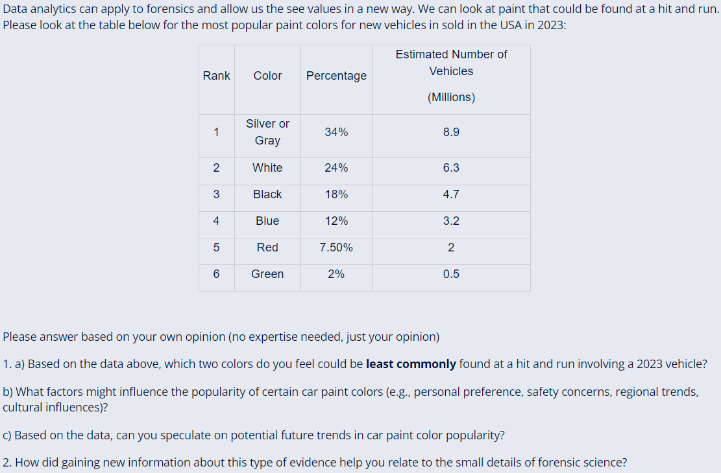
Data Analytics Across the Curriculum
Campus-wide Initiative:
Dr. Michael Dunphy, VPAA
Data Analytics Activities
  Career readiness
Forensic Chemistry, NS 215
Discussion forum
AI-created data analytics
Notes:
Amy

Slide 4

Chemistry Internship, CHEM 390
AI-driven improvements:
Created stepwise procedure to find internships (aligns with mission/core values)
Provided a rubric to evaluate this alignment
Suggested ways to avoid bias in assessment of internship
Gemini was the only AI tool that created a rubric in an easy-to-read table format.
  Table format increases efficiency by simplifying assessment
Notes:
Amy

Slide 5
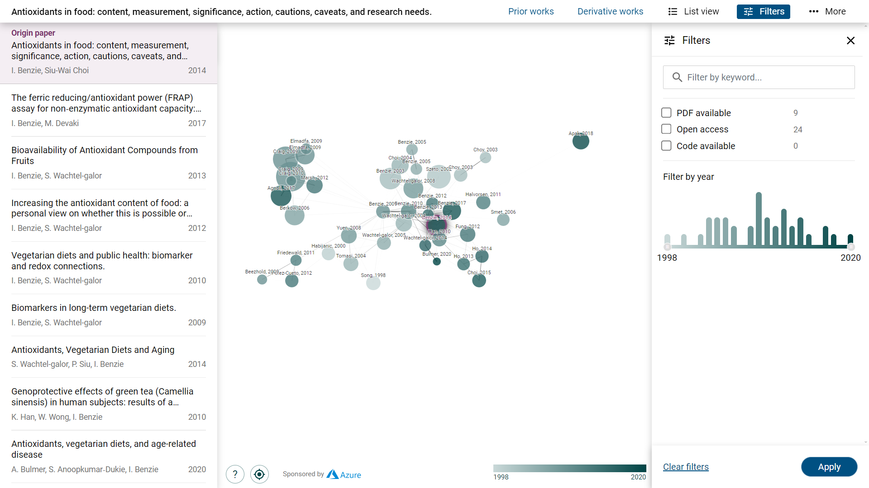
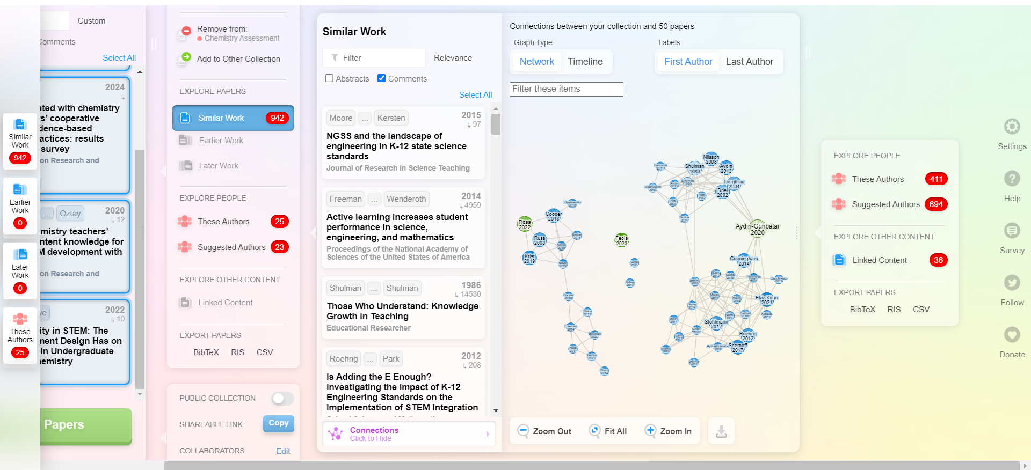
Streamlining Research Design:
Connected Papers & ResearchRabbit
Time-saving AI tools for scholarly work: Searching & Connecting Ideas
Saves time for students, faculty advisors, and collaborators
Connected Papers
ResearchRabbit
Notes:
Amy

Slide 6
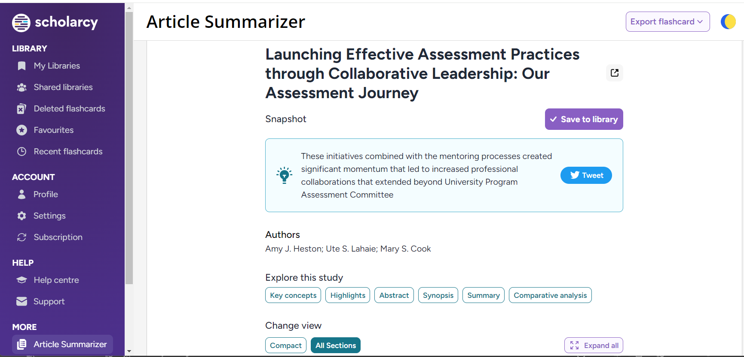
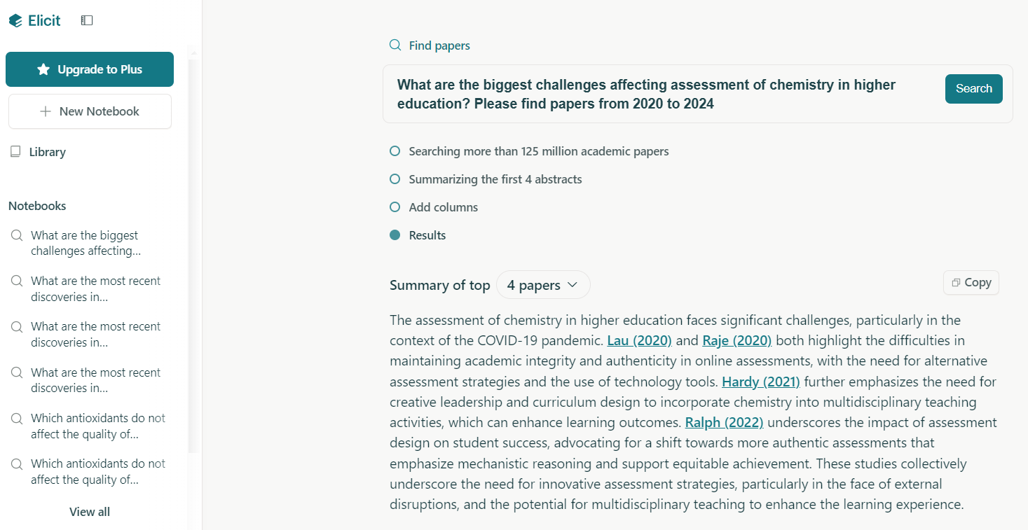
Scholarcy & Elicit
Time-saving AI tools for scholarly work: Snapshots, Key Concepts, Summaries, & Practical Applications
Saves time for students, faculty advisors, and research collaborators
Scholarcy
Elicit
Notes:
Amy

Slide 7
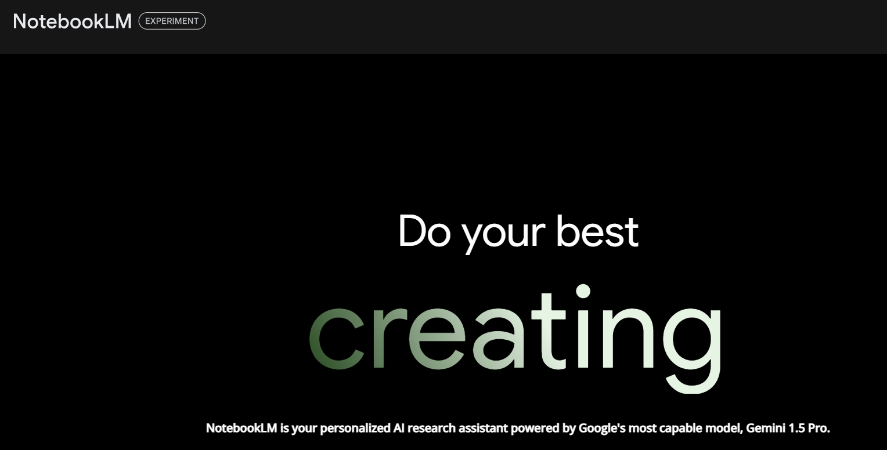
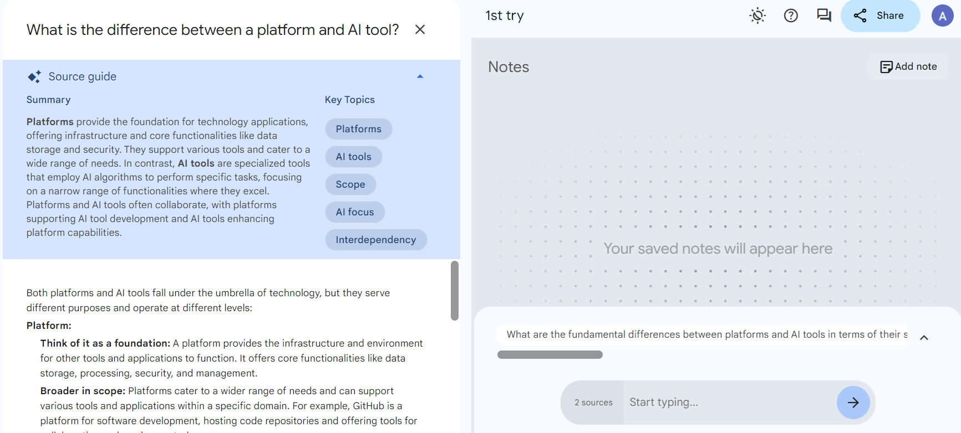
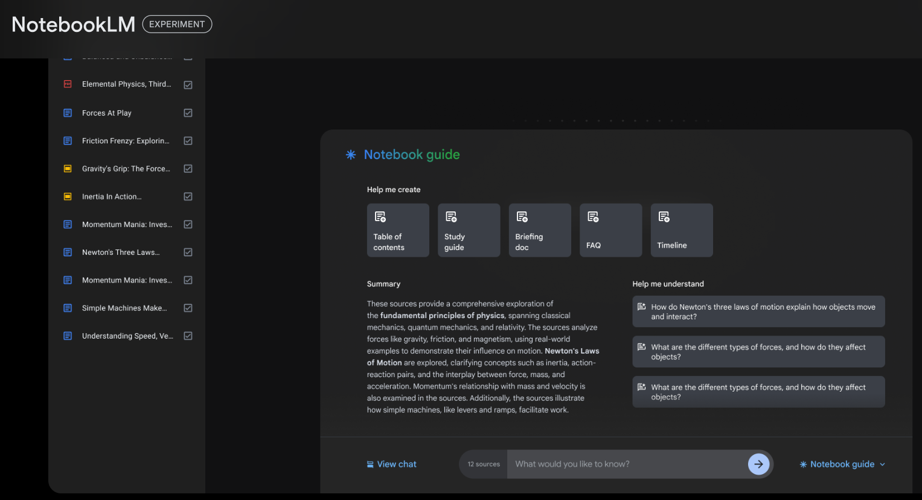
NotebookLM
Time-saving AI tools for scholarly work: Reports Trends in Multiple Documents, Analyzes Notes, Creates Timelines, Briefing Docs or FAQs, or Ask the AI Questions about Your Documents, & More!
Source-grounded AI: Train AI on specific/personalized notes & trusted information: Virtual AI Research Assistant!
Notes:
Amy

Slide 8

Course Design Models in the Age of AI
Notes:
My presentation is titled Course Design Models in the Age of AI

Slide 9
ESOL Accreditation Project
May 2024 - October 2024: Collaboration with ESOL Program Manager for Accreditation Preparation
Collaborated bi-weekly to design a comprehensive year-long curriculum, focusing on both teaching objectives and student learning outcomes.
Developed course alignment maps to ensure cohesive learning objectives across all courses.
Created assignments and established master shells for some courses in the program in Blackboard.
Leveraged AI tools, particularly ChatGPT, to formulate course learning objectives, emphasizing emerging digital and information literacy areas.
Notes:
For my project, I worked with a faculty member at my college, Professor Larissa Fekete, to complete the preparation for an ESOL Accreditation program. We collaborated two times per week between May and October to develop the program’s mission statement, year long curriculum, including both teaching objectives and student objectives, creating course maps for the main courses in the program, as well as some assignments, rubrics, and master shells for courses in the program. In this process, we leveraged AI to formulate learning objectives, including objectives for digital and information literacy areas.

Slide 10
The Role of AI in Developing Course Objectives
Brainstorming: ask AI to write a course objective based on the course type (ESOL) and level (intermediate course in ESOL).
Generalize: use established teaching objectives from the year-long curriculum to prompt AI to help us consolidate teaching objectives into concise course learning objectives that reflect the key tasks students will complete throughout the course.
“Make it Better!”: copy/paste a fairly well-developed learning objective in AI and ask AI to “make it better” or “refine” the learning objective.
Notes:
In this process, we used AI to write course objectives, to provide us with consolidate teaching objectives into concise learning objectives, and in some cases, to refine our learning objective and help Prof. Fekete to state exactly what she was trying to do in the classroom in the course outcomes and objectives.

Slide 11
Conclusion and Next Steps
AI worked better when we already had well-developed teaching objectives, not just vague ideas and general descriptions of what we needed.
The instructor had taught these courses for several years and had a well-developed teaching curriculum and clear ideas about what she was trying to accomplish in the courses.
  AI did not always reflect her depth of knowledge and passion for the direction she was trying to take the classes.
  AI also did not have experience with the students, and the challenges and needs the instructor had observed over time, which should be reflected in the course curriculum, i.e., written in the course objectives. She has a real stake in seeing her students succeed!
  It helped us brainstorm and refine course objectives.
My work with the instructor as a model for working with faculty to create curriculum, learning objectives, and course maps.
Notes:
Lessons for AI in Education:
AI excels with clear guidelines: We found that AI tools performed best when provided with well-developed teaching objectives, student tasks, or specific instructions, rather than broad or vague themes.
Human expertise is irreplaceable: While AI can assist, it cannot replicate the depth of passion and experience that educators bring. For example, Prof. Fekete, with her years of experience, worked diligently to align course learning objectives with the high standards of the program. Her vision and dedication went beyond what AI could achieve on its own, making AI a helpful tool, but not a replacement.
---

Slide 12
Hidden Gems of Our Collaboration
Sharing AI successes and challenges at smaller institutions
Generating new ideas for future scholarly work
Motivation to keep going in the ever-changing times
Processing AIs effect together
Notes:
Amy:
Toni:
Collaborating during these rapidly changing times has been incredibly motivating. While I often view AI as a useful supplement rather than a replacement for human roles, there are moments when its capabilities leave me in awe, making me question what our roles will look like in just a few years. Working together allowed us to not only explore creative ways to use AI and discover new tools, but also to reflect on how AI will reshape our roles and lives, while recognizing its limitations.

Slide 13

Our Twists and Turns
Choosing best path when AI gives multiple (data analytics, internships)
Keeping up with new AI tools
Sometimes, AI provided too many great ideas
AI can’t replace instructor experience
Prompts mattered to the success of AI responses
ID and faculty member became a pioneering team!
Notes:
Amy blue & Toni red

Slide 14

Implementation Strategies for Becoming an AI Pioneer
Explore and explore more!
Save AI prompts and output for:
  Future presentations
  Possible publications
  Initiating collaborations
Open mindset: Look for opportunities to blend AI in current collaborative projects
Notes:
Amy blue, Toni red
Toni:
As we navigate the evolving landscape of AI, it’s crucial to seek opportunities for collaboration. Working together not only helps us better understand the effects of AI but also enables us to discover its most effective applications in our work.
Initially, our project focused on the accreditation process for the ESOL program, with no intention of integrating AI. However, as we collaborated, it became clear that AI could play a significant role in enhancing our efforts.
I encourage you to actively look for similar opportunities within your own projects. Engage with your peers to explore AI tools and tackle related challenges together. This collaborative approach can be invaluable in advancing your goals and maximizing the potential of AI in your work.

Slide 15
Future Work
Utilizing AI tools for new research projects
New course for Spring 2025: AI for Forensic Investigation
Creating AI culture and policy
Exploring AI for course design and philosophy learning activities
Notes:
Amy blue, Toni red

Slide 16
Q & A
Amy Heston, Walsh University, aheston@walsh.edu
Toni Nicoletti, Oberlin College, tnicolet@oberlin.edu
Notes:
Toni

