Slide 1
Embracing Innovation in Education: Triumphing the Integration of Artificial Intelligence
Dr. Ritu Sharma Purdue University
Prof. Ramona Anand Lorain County Community College NEXT Annual Conference 2024

Slide 2
A decorated and multiple awards winning educator & community leader
President of the Global Indigenous People Leadership Team
Founding member of Asian American Pacific Islander ERG
Executive education specialist for United Nations
Board of directors for NOSS and AWAC
Published as the 2019 Top Educators in Ohio
Pursues a rigorous scholarly agenda and publish widely, serve on editorial boards, and review for national and international scholarly journals, publications, and conferences
A widely sought-after speaker, facilitator, and collaborator
Earned local, national, and international recognition for leadership and futuristic approach to engaged scholarship
Recognized as one the Top Ten Educators in the USA in 2012

Slide 3
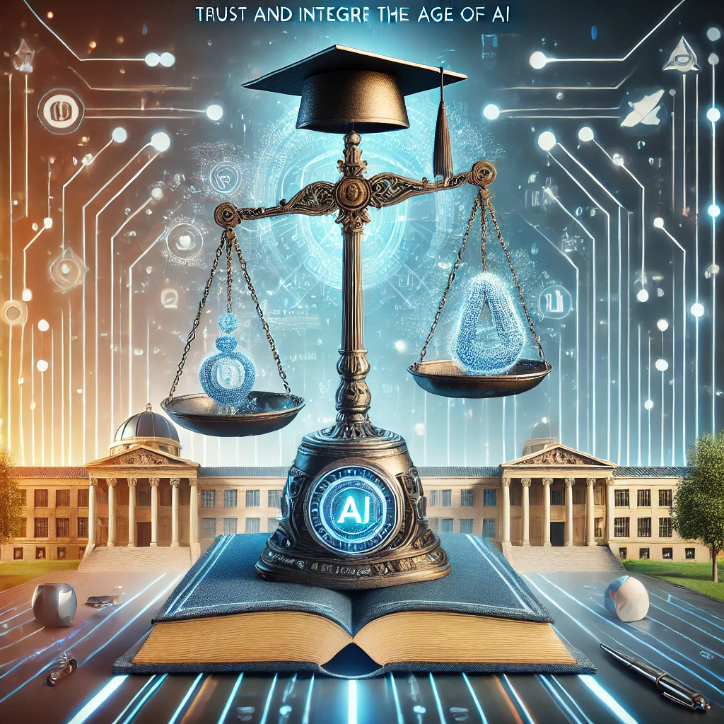
AI + Integrity-Based Authentic Assessment
1
Meaningful Evaluation
2
Ethical Foundation
3
Personalized Feedback (Alabidi, et. al., 2023)
Notes:
Ritu

Slide 4
Benefits of Authentic Assessment
Improved Learning
Engaged Students
Practical Skills
Notes:
Ritu

Slide 5
Challenges of Traditional Assessment Methods
Narrow Scope
Lack of Personalization
Incentivizing Cheating
Limited Feedback
Notes:
Ritu

Slide 6
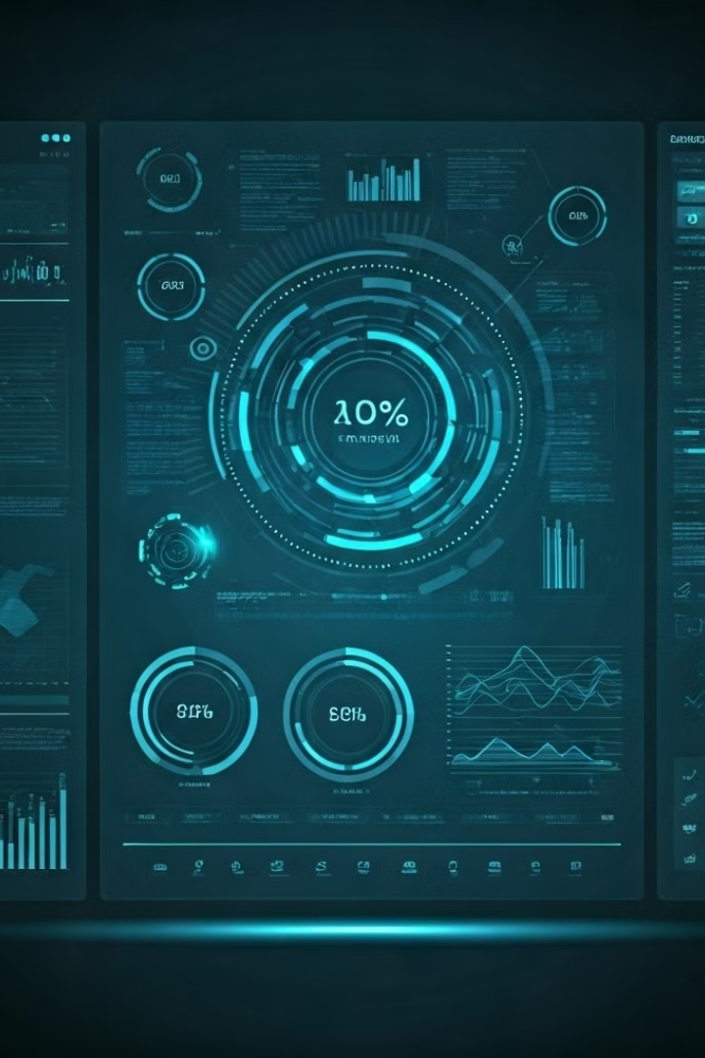
Integrating AI in Authentic Assessment
Adaptive Assessments
Automated Grading
(Jukiewicz, 2024)
Detailed Analytics
Integrity Monitoring
Notes:
Ritu

Slide 7
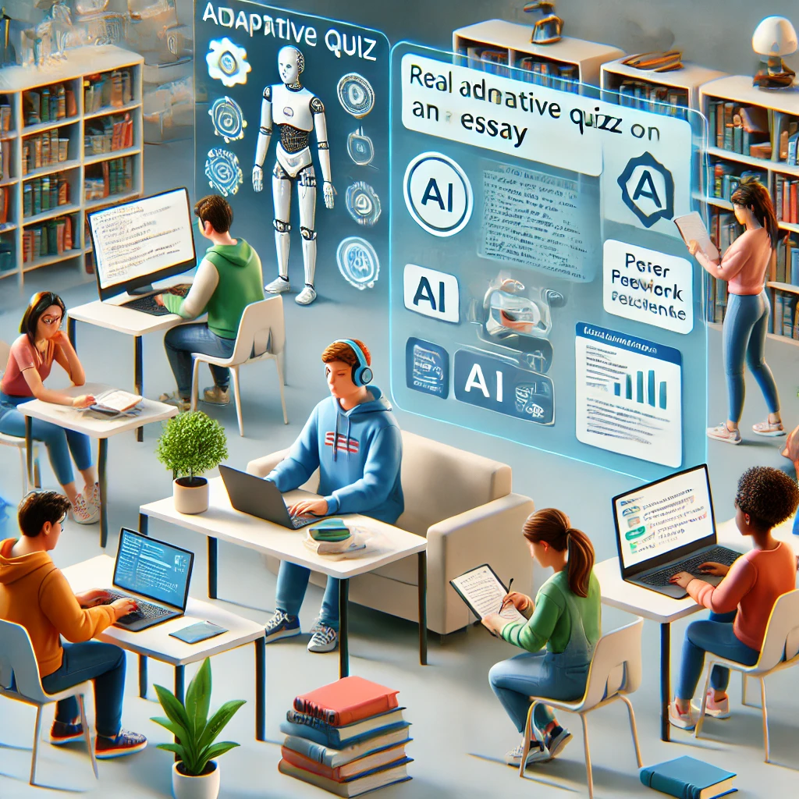
Examples
Adaptive testing
Automated scoring
Simulations & virtual lab
AI powered peer assessments
AI Chatbots for feedback
(Yang, et. al, 2023)
Notes:
Ritu

Slide 8
Examples: AI for In-Class Activities & Assessments
Content Knowledge & Applications
Create and correct a misunderstanding
Scientific Inquiry & Critical Thinking
Critical and creative prompting
Values in Psychological Science
Critical analysis across AI tools and stereotypes
Communication, Psychological Literacy, & Technology Skills
Understanding systemic biases as reflected in AI
Personal & Professional Development
Enhancing employability with a mock application
(Miserandino, 2024)
Notes:
Rekha

Slide 9
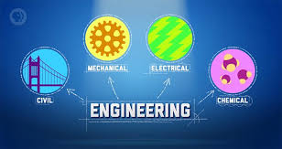
Artificial Intelligence:
Engineering Branches

Slide 10
AI & Electrical Engineering
Circuit Design
Optimization
Smart grids
Automation
Electromagnetic
Thermal Simulation

Slide 11
AI & Civil Engineering
Structural health monitoring
Construction management
Building information modelling
Site analysis
Urban Planning & Smart Cities

Slide 12
AI & Mechanical Engineering
Design simulation
Predictive conditioning
3D printing
Product life cycle management
Ergonomics

Slide 13
AI & Computer Engineering
Chat bots
Cyber security
System on chip organization
Natural language processing
Accelerated Hardware
Neuromorphic Computing

Slide 14
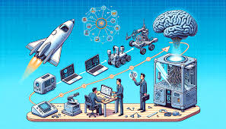
AI & Aerospace Engineering
Spacecraft design
Health monitoring
Flight control
Robotic space exploration
Satellite image analysis
Weather prediction

Slide 15
Ethical Considerations
1
Bias Mitigation
2
Privacy and Data Security
3
Transparency and Accountability
Notes:
Ritu

Slide 16
References
Alabidi, S., AlArabi, K., Alsalhi, N. R., & al Mansoori, M. (2023). The dawn of ChatGPT: Transformation in science assessment. Eurasian Journal of Educational Research (EJER), 106, 321–337. https://doi.org/10.14689/ejer.2023.106.019
Jukiewicz, M. (2024). The future of grading programming assignments in education: the role of ChatGPT in automating the assessment and feedback process. Thinking Skills and Creativity, 52, 101522, doi: 10.1016/j.tsc.2024.101522
Miserandino, M. (2024). Authentic and creative assessment in a world with AI. Teaching of Psychology, 0(0), 1-6. doi: 10.1177/00986283241260370
Yang, X., Wang, Q. and Lyu, J. (2023), Assessing chatgpt’s educational capabilities and application potential. ECNU Review of Education, doi: 10.1177/20965311231210006
Uncited images are from public domain or AI generated
Notes:
Includes Ritu’s and Rekha’s references so far

