Slide 1
AI for Research Endeavors: Efficiency in a Flash!
Dr. Amy J. Heston (’05*)
Walsh University
2024 NEXT Conference
Nov. 1, 2024
*= The University of Akron
Notes:
Amy & Toni introduce themselves

Slide 2
Poll
What’s your primary role?
Faculty
Instructional Designer
Administrator/Director/Dean/Chair
Are you are involved in any type of scholarly work (undergraduate/graduate research or your own project)?
Notes:
Amy

Slide 3
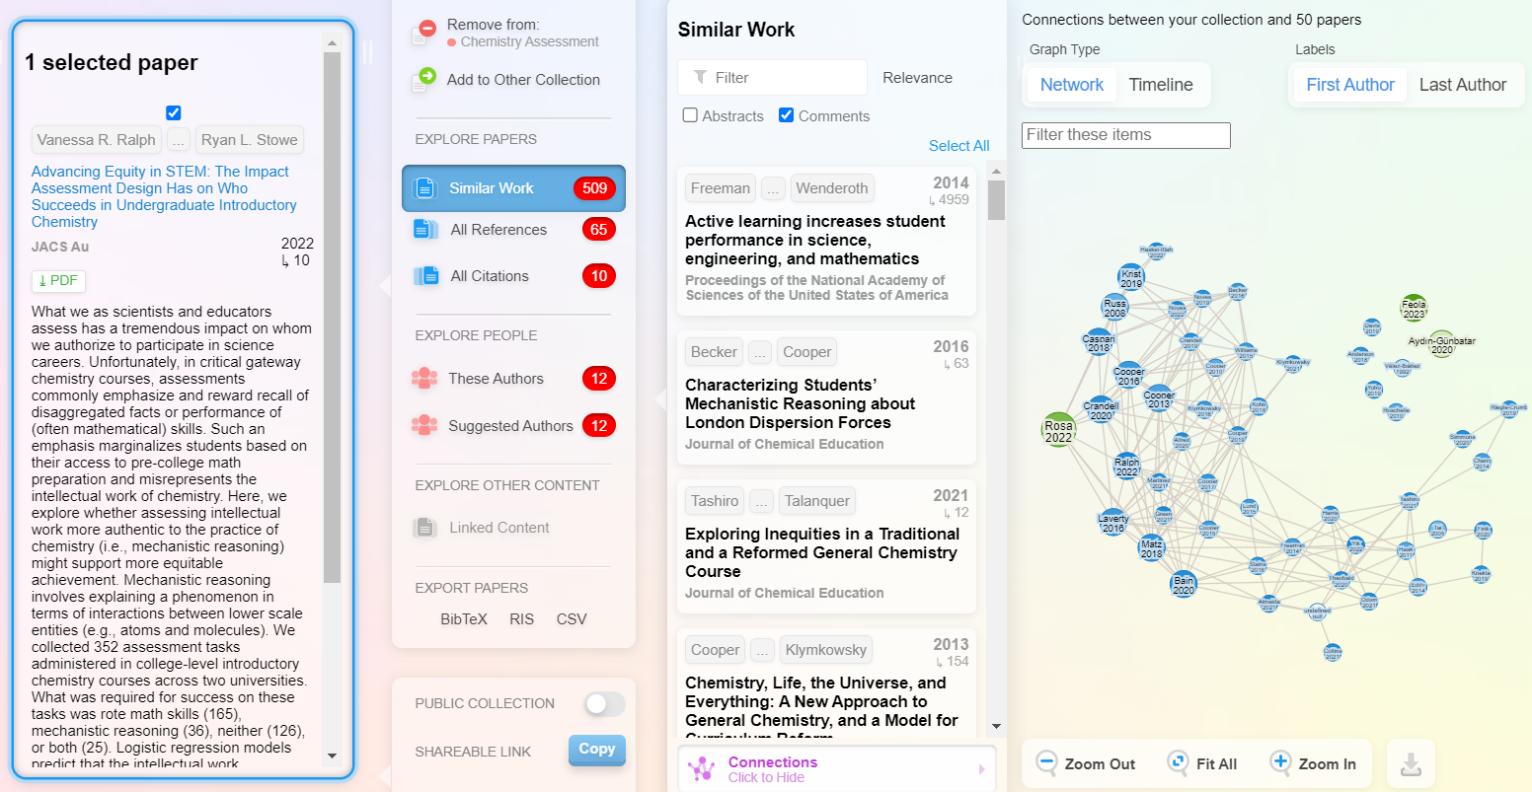
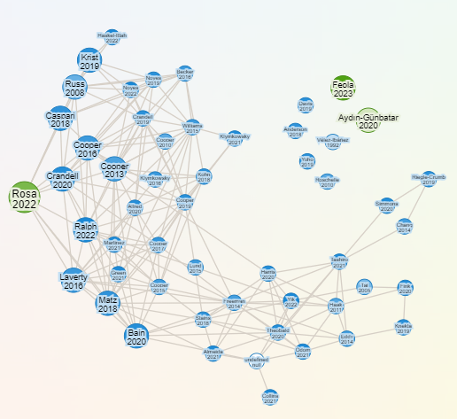
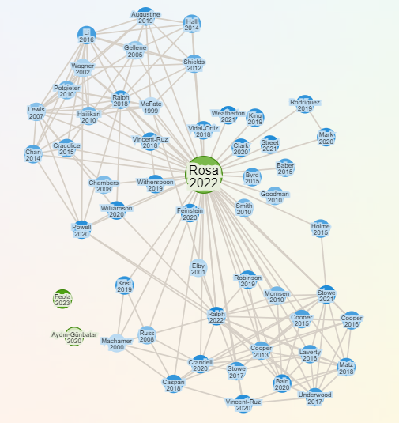
Streamlining Research: ResearchRabbit
Time-saving AI tool for scholarly work: Connecting Ideas, Designing Research Pathways, & Answers This: Where do I look next?
Saves Time for ALL Scholars: students, faculty advisors, & collaborators
Improvement of HIPs: UG/G research & collaborative projects
Output from Search
Related Work
All References
HIPs = High Impact Practices termed by AAC&U
Cost = Free!
Notes:
Amy

Slide 4
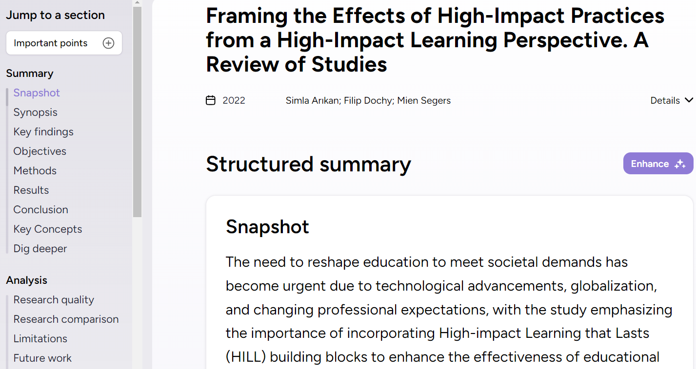
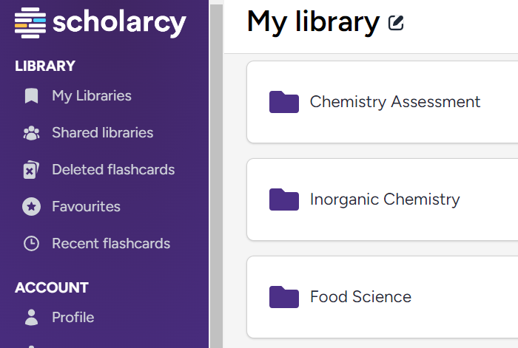
Scholarcy
Time-saving AI tool for scholarly work: Snapshots, Key Concepts, Summaries, & Practical Applications.
Saves Time for ALL Scholars: students, faculty advisors, & collaborators
Create Your Library
Summary & Analysis
Cost = Free Trial then $9.99/mo.
Notes:
Amy

Slide 5
Invitation for Collaboration
Contact me!
Dr. Amy J. Heston
Professor of Inorganic Chemistry
Walsh University
aheston@walsh.edu
Notes:
Toni

