Slide 1
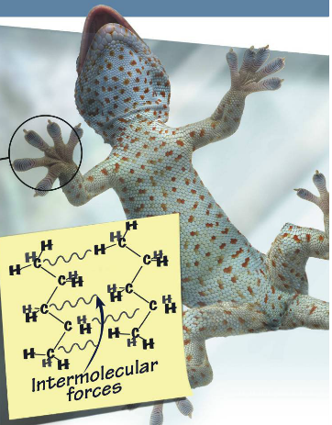
Intermolecular forces (IMF)
Name: _______________________________________
What is happening here?
What’s happening here?

Slide 2
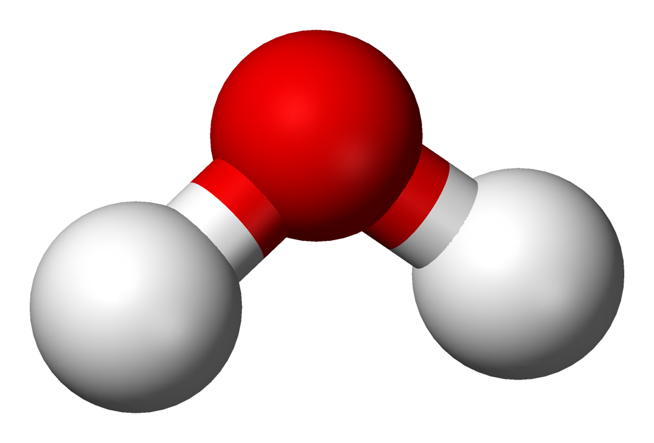
Intramolecular bond vs intermolecular force
…
…
…
…
Think of intranet…
...

Slide 3
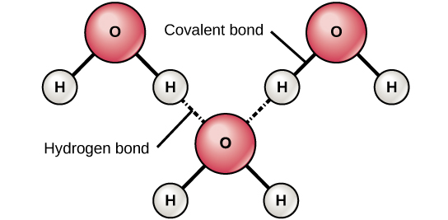
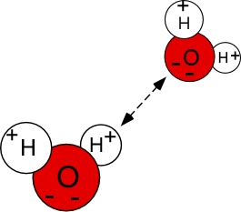
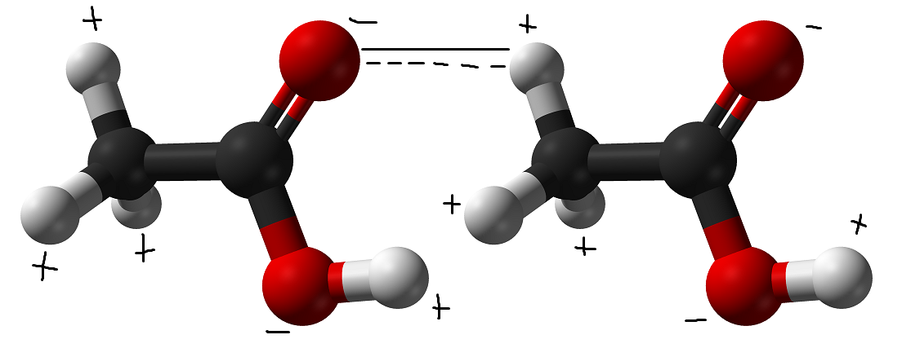
Intramolecular bond vs intermolecular force
Intermolecular force is …
…
This is like the internet…
…

Slide 4
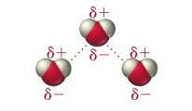
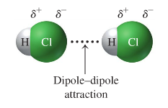
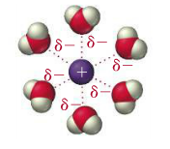
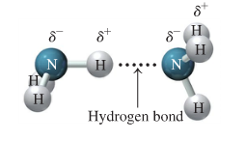
Four kinds of intermolecular forces
Intermolecular forces In the order of weakest to strongest:
…
…
…
…

Slide 5
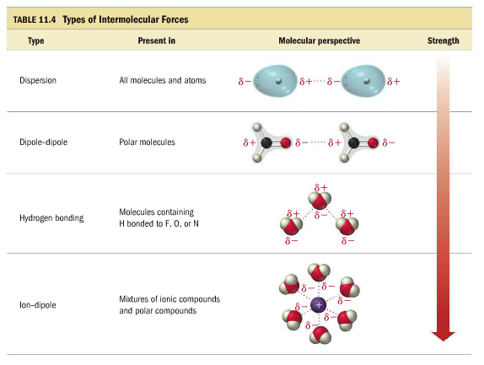
Intermolecular forces
Professor dave
Without intermolecular forces…
The __________the imf the ________ the boiling point… WHY?
The ________the Imf the __________ the boiling point… why?

Slide 6
What is a dipole?
Before we define each type of intermolecular force let’s define dipole.
Dipole –
in other words –
Draw an example of a molecule with a dipole below:

Slide 7
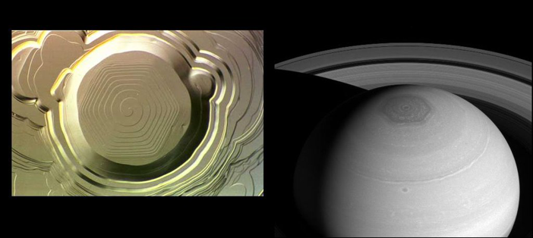
Defining each IMF: Dispersion Force
The dispersion force is also called
…
The dispersion force is …
…
…
The dispersion force is caused by…
Draw a picture of helium with a dispersion force below:

Slide 8
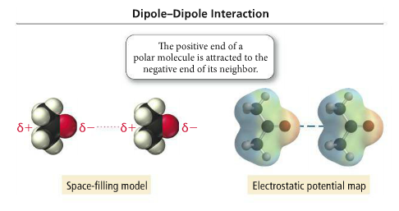
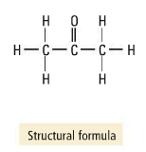
Defining each IMF: Dipole-Dipole force
Dipole-dipole force is an interaction __________________________________________
A polar molecule has a ____________________________
Examples:

Slide 9
Defining Each IMF: Hydrogen bond
Hydrogen bond – not a bond, not a bond, _____________________, not a bond!!!!!
…
The following bonds (actual bonds) create a very strong dipole
…
…
…
…
________________is a great example of hydrogen bonding in action!

Slide 10
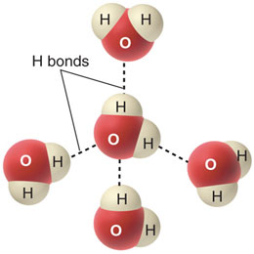
Defining Each IMF: Hydrogen Bonding
Draw a few pictures of substances hydrogen bonding:

Slide 11
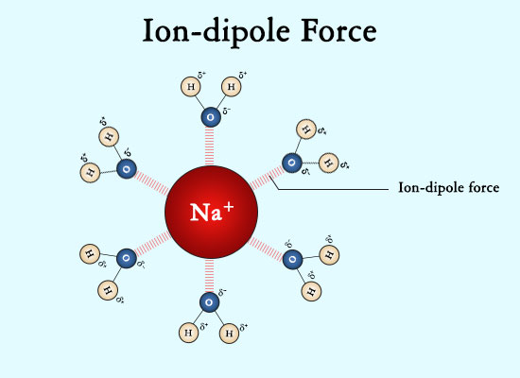
Defining Each IMF: Ion-Dipole Force
The Ion-dipole force is the ______________________ imf
…
This is why some __________ compounds will __________________________.
Draw a picture below:

Slide 12
references
Tro, “Chemistry: A Molecular Approach”, 3e
https://en.wikipedia.org/wiki/File:Water-3D-balls.png
https://sciencestruck.com/intermolecular-forces-with-examples
https://www.quora.com/What-is-an-intramolecular-bond
http://mbocchini.blogspot.com/2011/02/intermolecular-forces.html
https://courses.vcu.edu/PHY-rhg/astron/html/mod/018/index3.html
https://www.pinterest.com/pin/830773462482297448/
https://chemistry.stackexchange.com/questions/59665/water-hydrogen-bond/59958

