Slide 1
Micelles to the Rescue:
How Soap Transports Debris
Ryan Kiddey
Research Experience for Teachers (RET)
The University of Akron

Slide 2
History of Soap Making - A Brief Overview
Soap may be the first chemical compound ever synthesized by man!
2,800 B.C. – excavations reveal Babylonians were making soap by boiling animal fat with ashes.
  Used to clean wool and cotton used in textile making
  Used for medicinal purposes
1550 B.C. – Egyptian writing reveals soap Egyptians made soap by mixing animal and vegetable oils with alkaline (base) salts
  Egyptians medical scrolls recommend a soap for skin conditions

Slide 3
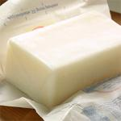

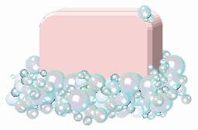
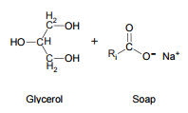
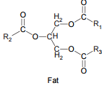

The Chemistry of Soap
FAT LYE (Base) SOAP
    (CRISCO) (NaOH)

Slide 4
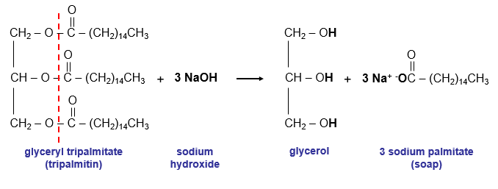
The Chemistry of Soap
Saponification is commonly used to refer to the reaction of a metallic alkali (base) with a fat or oil to form soap.
The soap incorporates the glycerol and forms an Amphiphilic molecule
  Amphoteric means, one half is hydrophilic and the other is hydrophobic

Slide 5
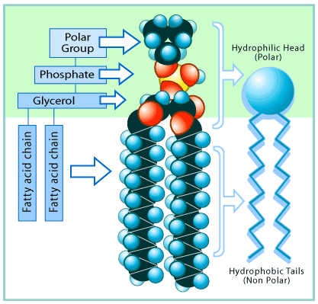
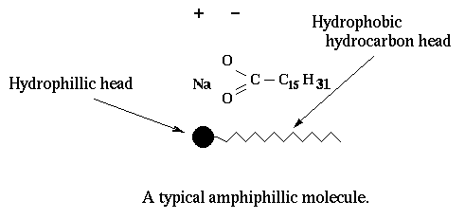
Chemistry of Soap
Amphiphilic Soap Molecule

Slide 6
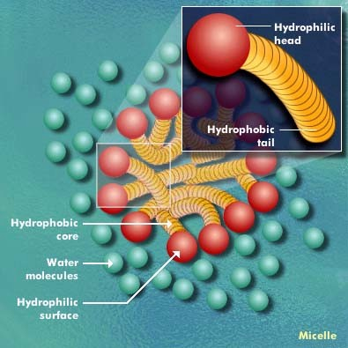
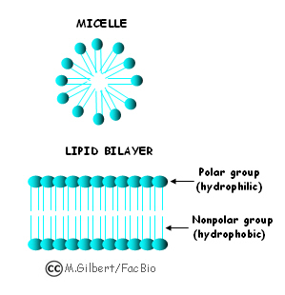
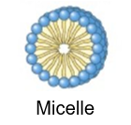
Chemistry of Soap
Soap molecules act like a diplomat, improving the relationship between water and oil.
How?
  When soap is added to the water, the hydrophilic (polar) heads of its molecules stay in the water (they are attracted to water),
  The long hydrophobic (nonpolar) chains join the oil particles and remain inwards (escaping from the water).
This behavior forms a micelle.

Slide 7
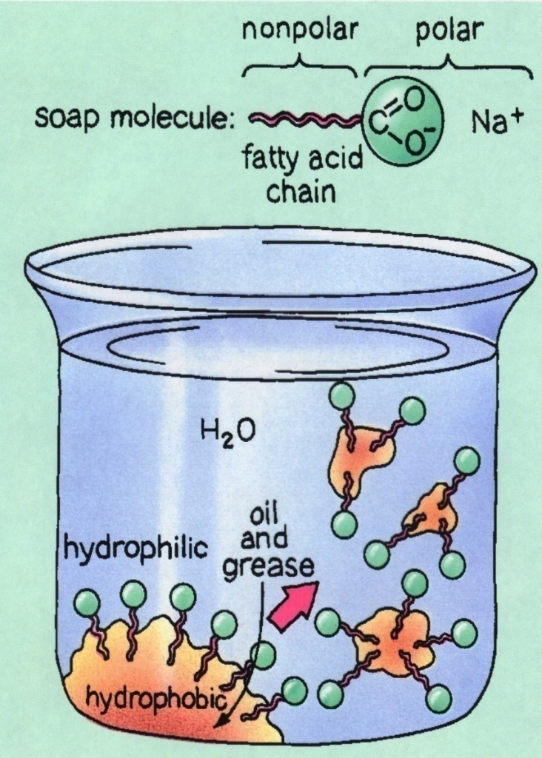
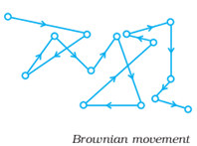
Micelles Formation
How Soap Works – Video
When enough soap is added to water the soap molecules (sodium stearate) aggregate into micelles.
Micelles are colloid particles
Colloid particles stay suspended in solution due to collisions with other molecules in the solution
The specific colloid formed is called an Emulsion
  Emulsion: when the dispersing solute (micelles) is in liquid form within a liquid solvent (water)
When viewed under a microscope, colloids are very jittery due to Brownian Motion

Slide 8
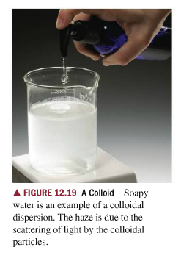
Micelle Formation
The “colloidal particles” are micelles which form immediately when the soap dissolves in water.
This forms a ‘haze’
Individual micelles are too small to be seen by the naked eye.
50-100 nm in size

Slide 9
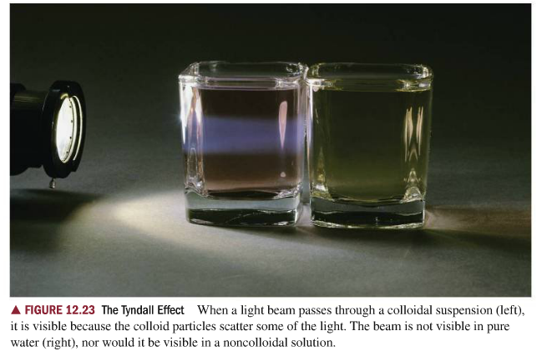
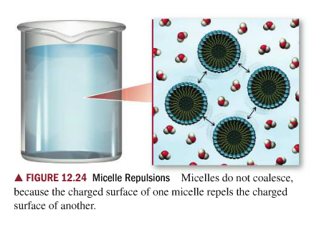
Micelle Formation
You can tell if a substance is a colloid if the substance refracts light when shined into a colloidal solution. This refraction is called the Tyndall Effect.

Slide 10
Micelles form when using Soap
Why can’t water just clean everything? Why use soap?
  Surface tension keeps water from easily spreading across a surface
  Surface tension must be weakened in order to get water to spread across an oily surface. Water is not attracted to oil because oil is a nonpolar substance
Soap can weaken surface tension because soap is a surfactant
  Surfactant: SURface ACTive agents (they reduce surface tension of water)
Surfactants inhibit the intermolecular attractions between water molecules, and this IMF attraction is what causes strong surface tension in water.
The soap allows the water to flow more smoothly which allow micelles spread across an oily surface to collect grime to be washed away.

Slide 11
Soap Breaks Surface Tension
Soap Breaking Surface Tension
Marangoni Effect – Soap Powered Boat

Slide 12
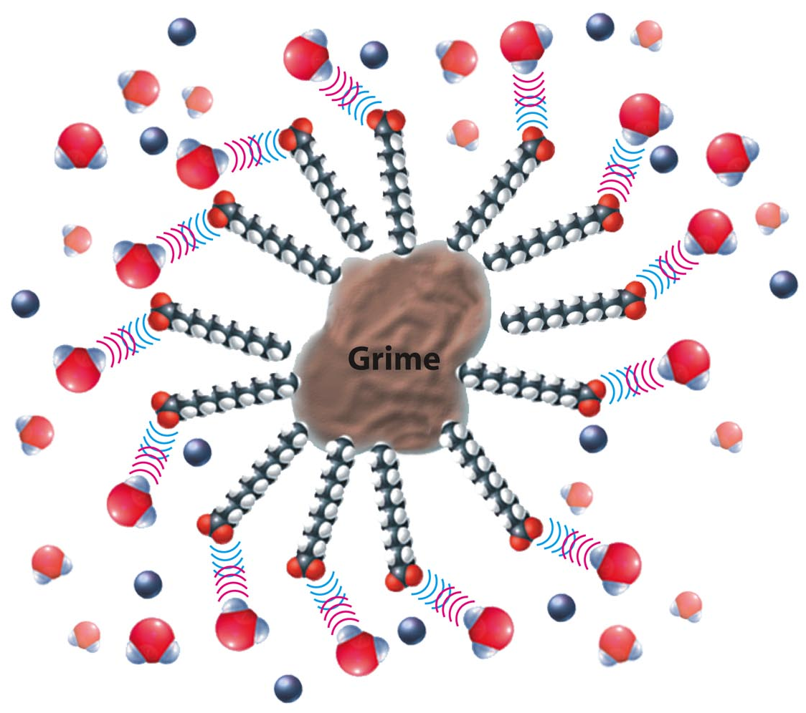
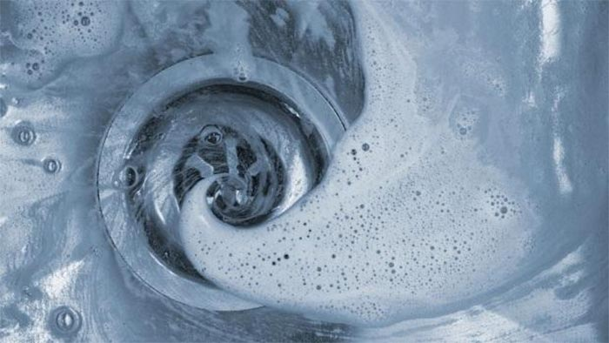
Micelles to the rescue
The micelles carry the oily dirt particles away from the skin (or surface).
The water molecules hold the micelles in solution and carry them down the drain!

Slide 13
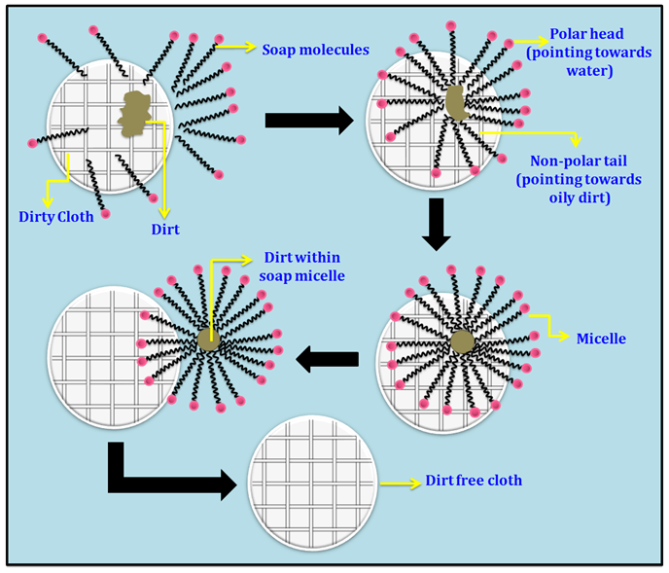
Describe what is happening:

Slide 14
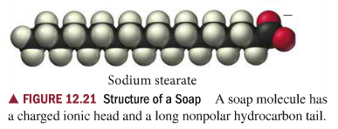
Water Hardness Affects Micelles Formation
What is water hardness?
  Water that has a lot of dissolved ions in it is considered hard water.
  A common dissolved ionic compound in water is Calcium Carbonate (CaCO3)
    0-60 mg/L CaCO3 (Soft Water)
    61-120 mg/L CaCO3 (Moderately Hard)
    121-180 mg/L CaCO3 (Hard Water)
How does hard water affect soap?
  The hydrophilic (polar) end of an individual soap molecule is negatively charged. So what do you think happens when using soap in hard water?

Slide 15
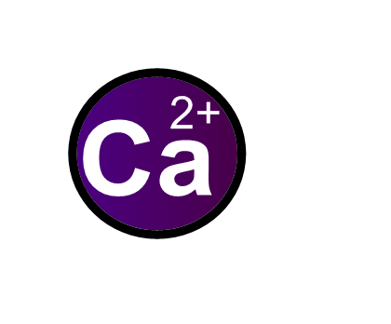
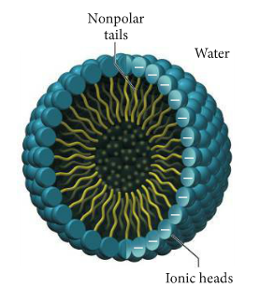
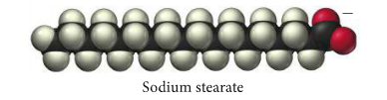
Water Hardness Affects Micelle Formation
(IN WATER) CaCO3 (s) → Ca²⁺ (aq) + CO3²⁻ (aq)
Micelles will not form because the soap molecule will no long be amphoteric, it will become non-polar
“Soap Scum” will form and the soap will not clean properly.

Slide 16
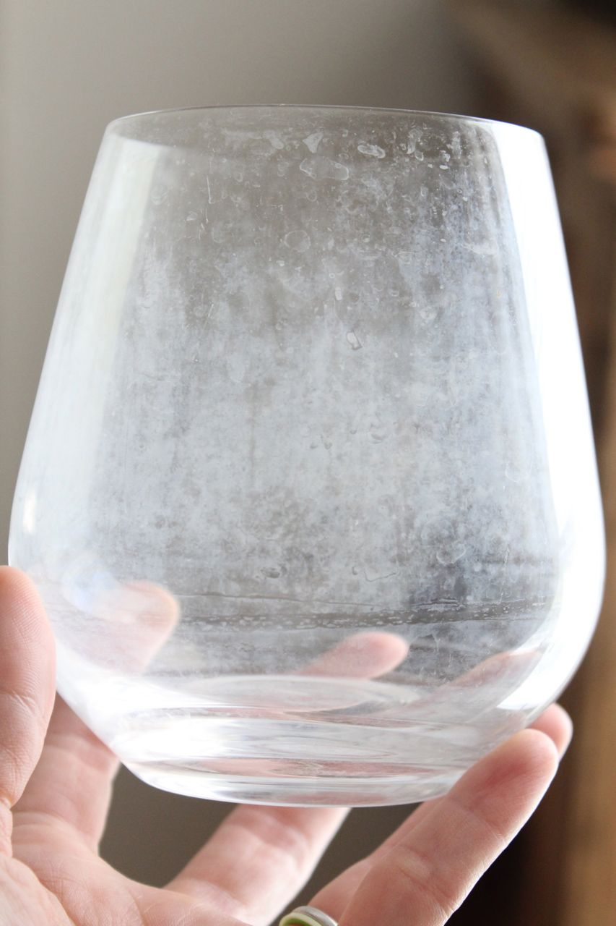
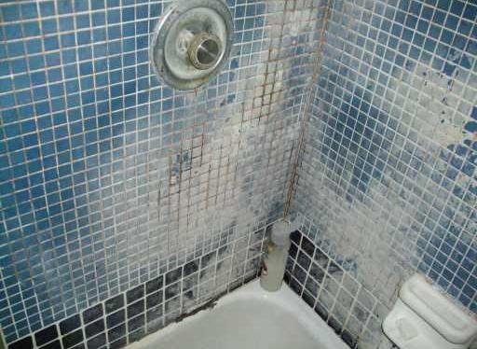
Soap Scum:
Calcium Ions attached to Soap Molecules

Slide 17
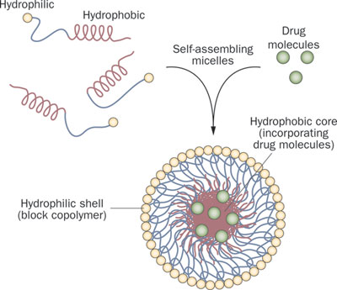
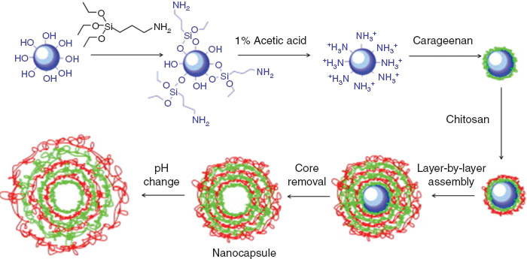
Industrial Applications for Polymer Micelles
A chemical delivery system for medication – polymers used to create a “nanocapsule” (University of Akron)
Creating multi-layered micelles with polymers (University of Akron)

Slide 18
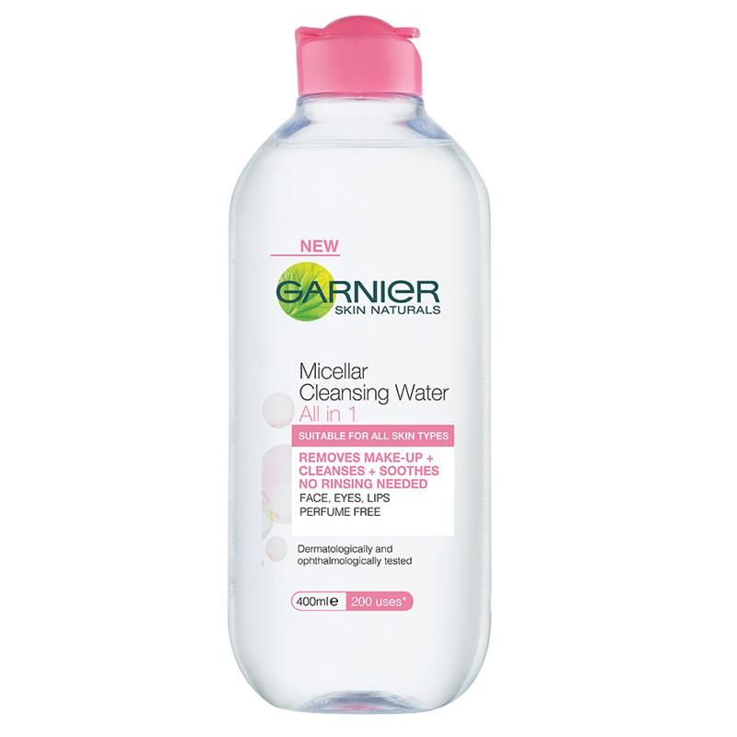
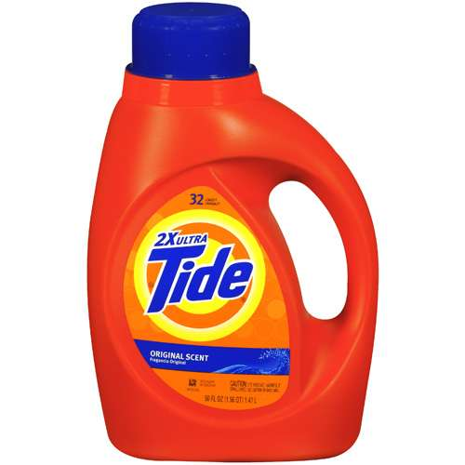
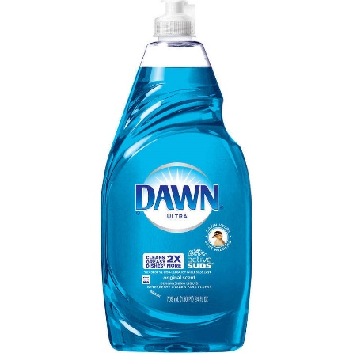
Industrial Applications for Polymer Micelles
Many lotions and beauty products contain chemicals that enhance the effect of micelles.
Lubrizol Corporation makes chemical additives that are placed into lotions which enhance the effectiveness of micelles.
Detergent companies have been researching better methods of using micelles for over 100 years.

Slide 19
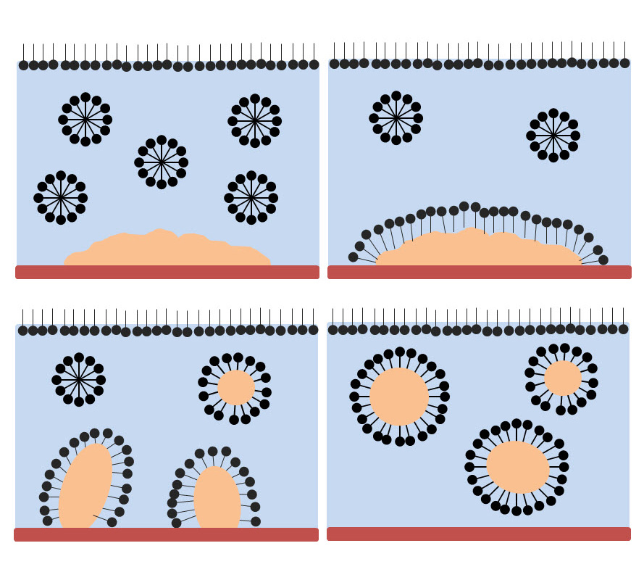
Can you describe what is happening in the images below using proper chemistry terms?

Slide 20
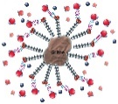
Reference
http://www.soaphistory.net/
http://www.bioteach.ubc.ca/Bio-industry/Inex/
https://science360.gov/obj/tkn-video/81074969-11e0-4a2e-b674-8fc8886fd9c3
Copyright © 2007 Pearson Benjamin Cummings. All rights reserved.
https://water.usgs.gov/edu/hardness.html
Chemistry, A Molecular Approach Tro 2014 Pearson
http://amrita.olabs.edu.in/?sub=73&brch=3&sim=120&cnt=1

