Slide 1
Micelles to the Rescue: How Soap Transports Debris
Name: ______________________________________

Slide 2
History of Soap Making - A Brief Overview
Soap may be ________________________________________________!
2,800 B.C. –
1550 B.C. – Egyptian writing reveals soap Egyptians made soap by mixing ____________________________________________________.
Egyptians medical scrolls recommend a soap for skin conditions

Slide 3
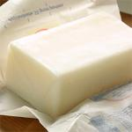
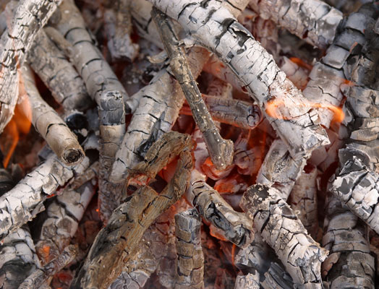
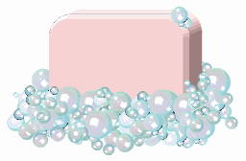
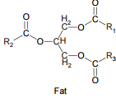
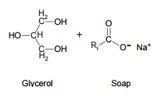
The Chemistry of Soap
____ ________ ______

Slide 4
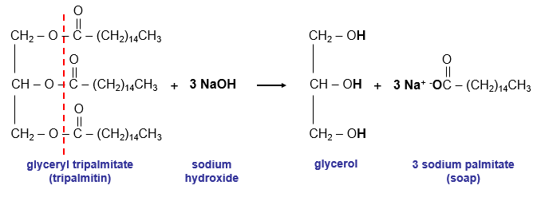
The Chemistry of Soap
Saponification____________________________________________
_________________________________________________________
The soap incorporates the glycerol and forms an ________________ molecule
______________________________________________________________________________________________________________________________

Slide 5
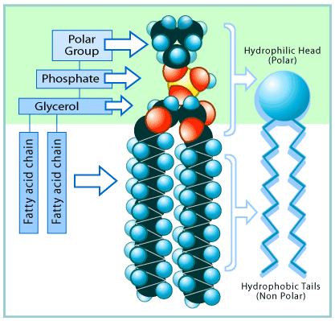
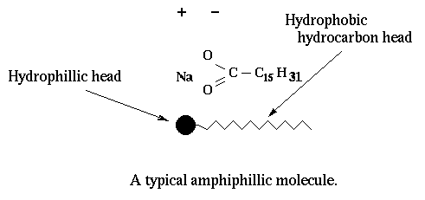
Chemistry of Soap
Amphiphilic Soap Molecule

Slide 6
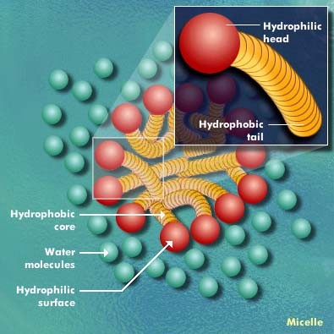
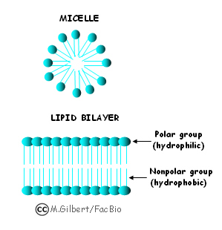
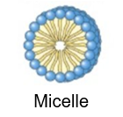
Chemistry of Soap
Soap molecules act like a diplomat, _________
________________________________________________________________________________
How?
When soap is added to the water, the _______________________heads of its molecules stay in the water (they are attracted to water),
The long _____________________chains join the oil particles and remain inwards (escaping from the water).
This behavior forms a _____________

Slide 7
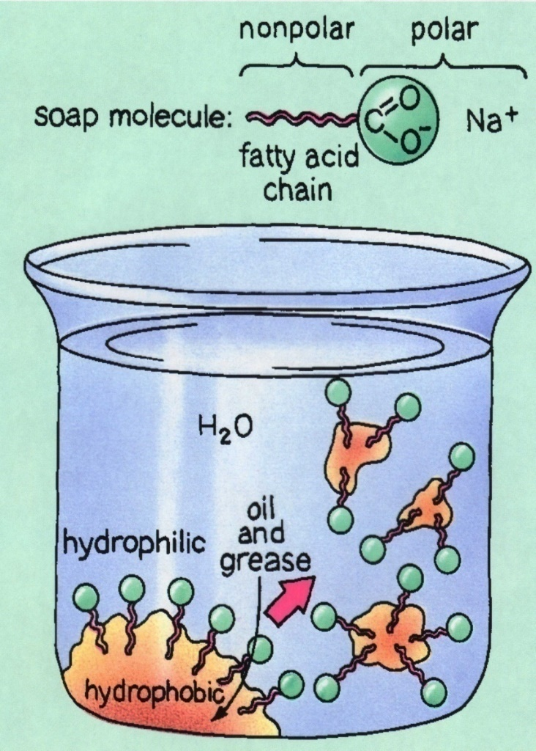
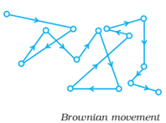
Micelles Formation
How Soap Works – Video
When enough soap is added to water the soap molecules (sodium stearate) aggregate into micelles.
_________________________________________
________________________________________________________in solution due to collisions with other molecules in the solution
The specific colloid formed is called an ____________
Emulsion: ________________________________________
__________________________________________________
When viewed under a microscope, colloids are very jittery due to ___________________________

Slide 8
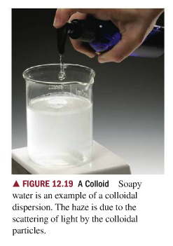
Micelle Formation
The “colloidal particles” are micelles which form immediately when the soap dissolves in water.
.
.
.

Slide 9
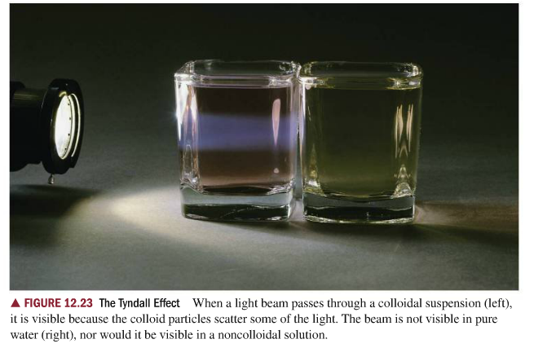
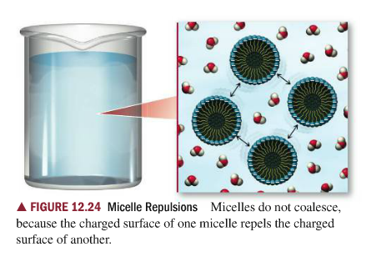
Micelle Formation
You can tell if a substance is a colloid if the substance refracts light when shined into a colloidal solution. _______________________
_______________________________________________________

Slide 10
Micelles form when using Soap
Why can’t water just clean everything? Why use soap?
_____________________keeps water from easily spreading across a surface
_______________________________________________________________________________________________.Water is not attracted to oil because oil is a nonpolar substance
Soap can weaken surface tension because _____________________
Surfactant: SURface ACTive agents (they reduce surface tension of water)
Surfactants _____________________________________________ , and this IMF attraction is what causes strong surface tension in water.
The soap allows the water to flow more ________________ which allow __________________________across an oily surface to collect grime to be washed away.

Slide 11
Soap Breaks Surface Tension
Soap Breaking Surface Tension
Marangoni Effect – Soap Powered Boat

Slide 12
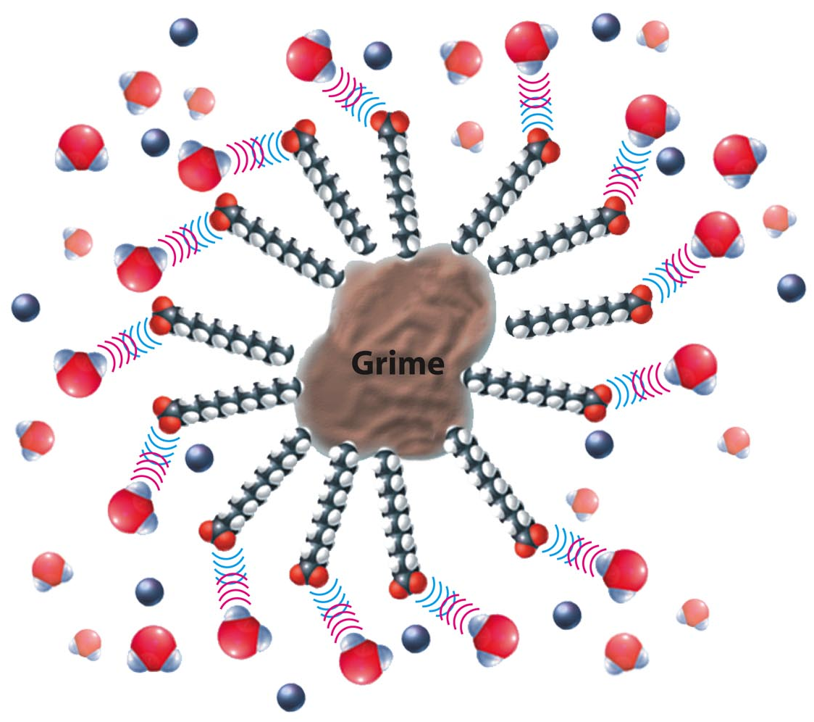
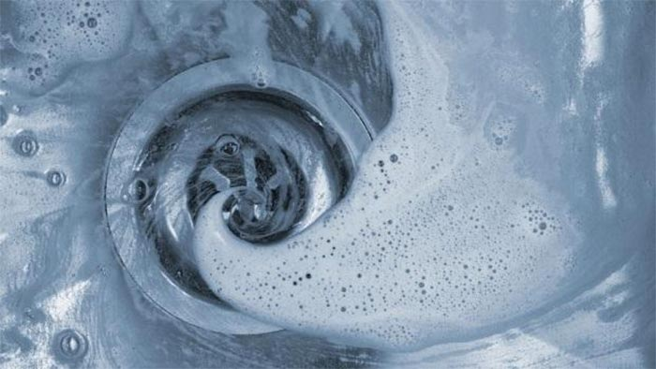
Micelles to the rescue
The micelles carry the oily dirt particles away from the skin (or surface).
The water molecules hold the micelles in solution and carry them down the drain!

Slide 13
Describe what is happening:

Slide 14
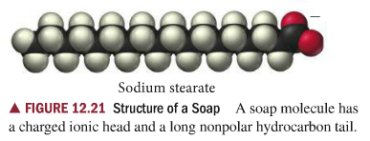
Water Hardness Affects Micelles Formation
What is water hardness?
_____________________________________________________________
A common dissolved ionic compound in water is Calcium Carbonate (CaCO3)
0-60 mg/L CaCO3 (_________________________)
61-120 mg/L CaCO3 (___________________________)
121-180 mg/L CaCO3 (___________________________)
How does hard water affect soap?
The hydrophilic (polar) end of an individual soap molecule is negatively charged. So what do you think happens when using soap in hard water?

Slide 15
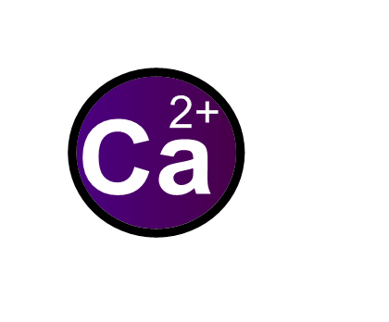
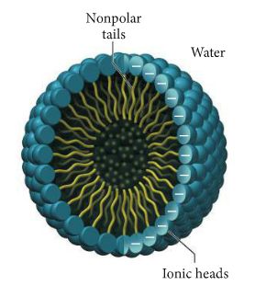
Water Hardness Affects Micelle Formation
(IN WATER) CaCO3 (s) → Ca²⁺ (aq) + CO3²⁻ (aq)
.
.

Slide 16
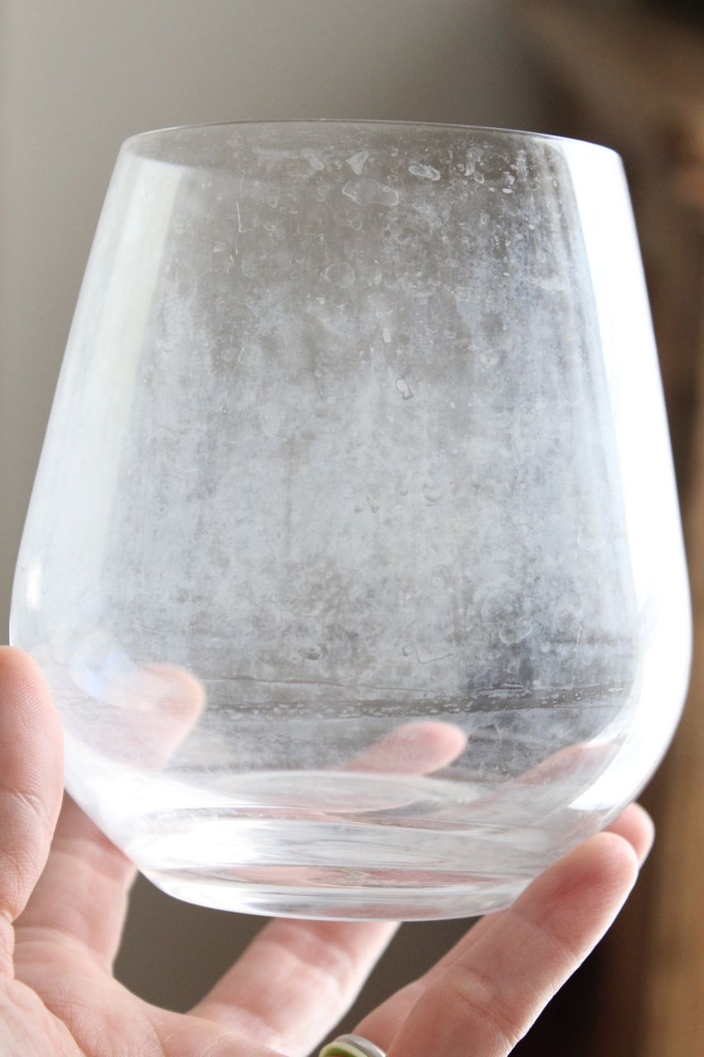
Soap Scum: Calcium Ions attached to Soap Molecules

Slide 17
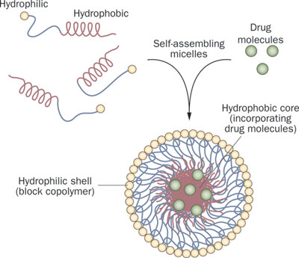
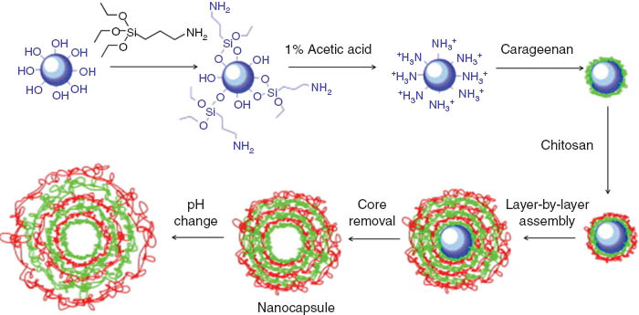
Industrial Applications for Polymer Micelles
A chemical delivery system for medication – polymers used to create a “nanocapsule” (University of Akron)
Creating multi-layered micelles with polymers (University of Akron)

Slide 18
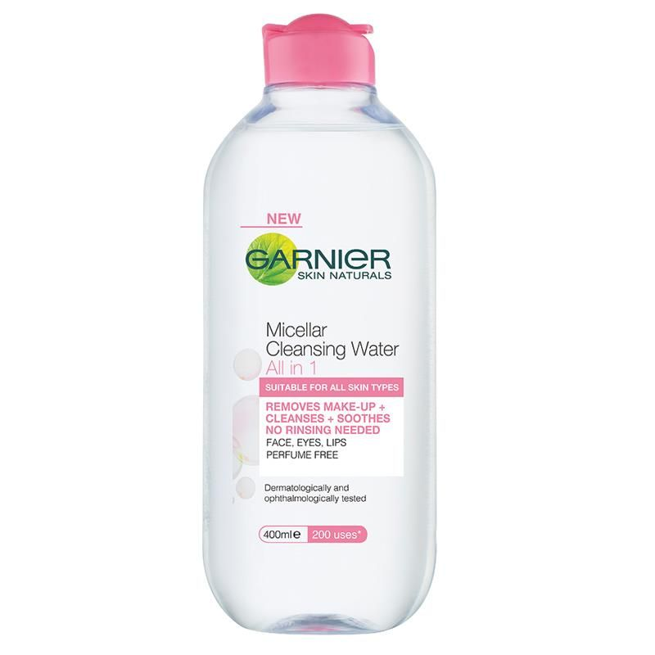
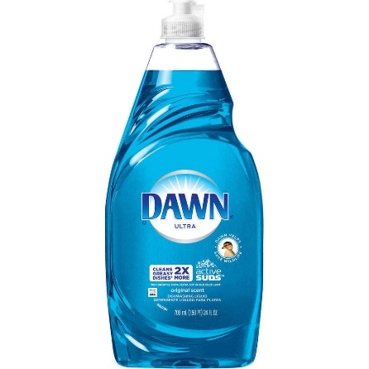
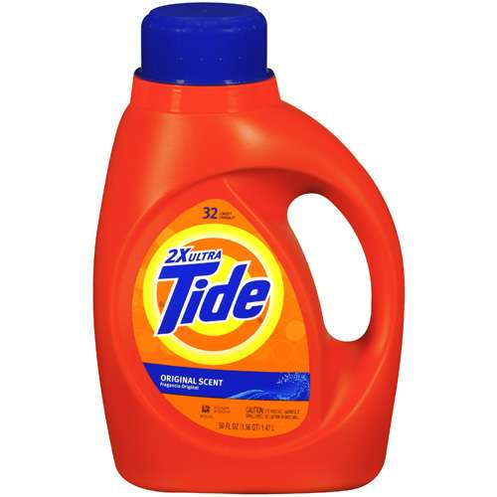
Industrial Applications for Polymer Micelles
Many __________________________contain chemicals that enhance the effect of micelles.
Lubrizol Corporation makes chemical _____________ that are placed into lotions which enhance the ______________________________.
Detergent companies have been researching better methods of using micelles for over 100 years.

Slide 19
Can you describe what is happening in the images below using proper chemistry terms?

Slide 20
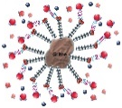
Reference
http://www.soaphistory.net/
http://www.bioteach.ubc.ca/Bio-industry/Inex/
https://science360.gov/obj/tkn-video/81074969-11e0-4a2e-b674-8fc8886fd9c3
Copyright © 2007 Pearson Benjamin Cummings. All rights reserved.
https://water.usgs.gov/edu/hardness.html
Chemistry, A Molecular Approach Tro 2014 Pearson
http://amrita.olabs.edu.in/?sub=73&brch=3&sim=120&cnt=1

