Slide 1
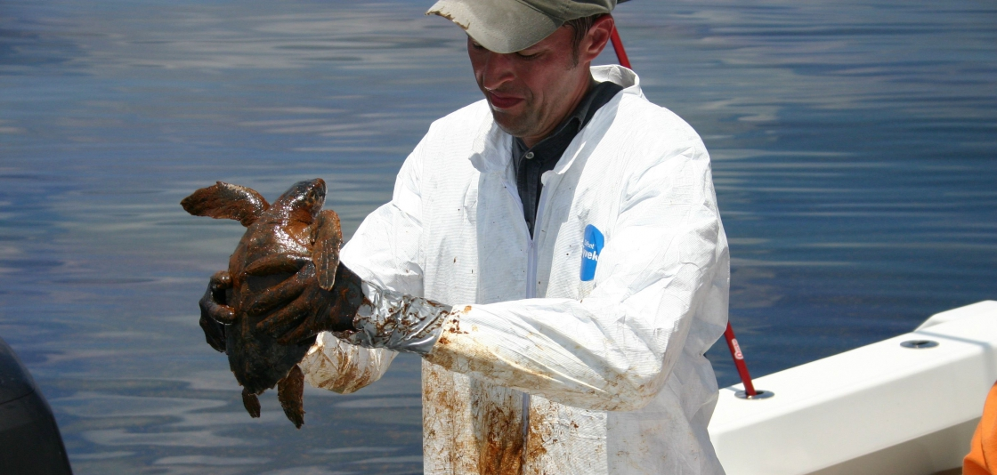
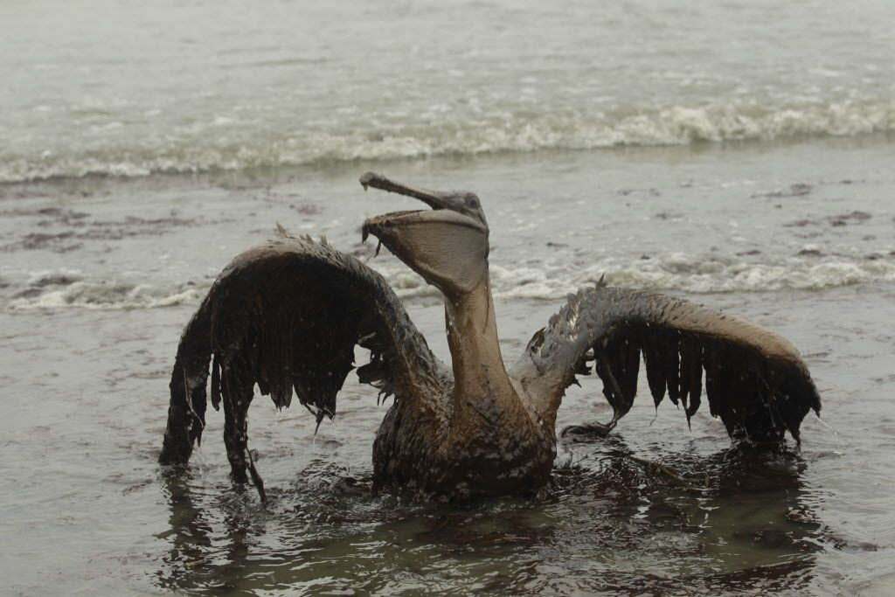
Oil absorbing polymer
Ryan Kiddey – RET Program 2018
University of Akron

Slide 2
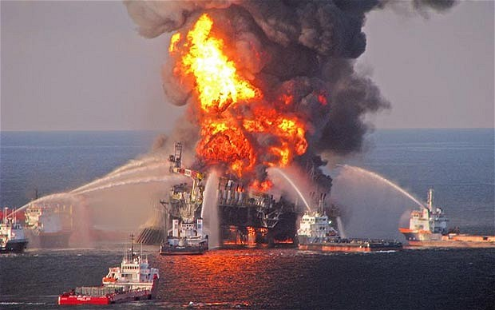
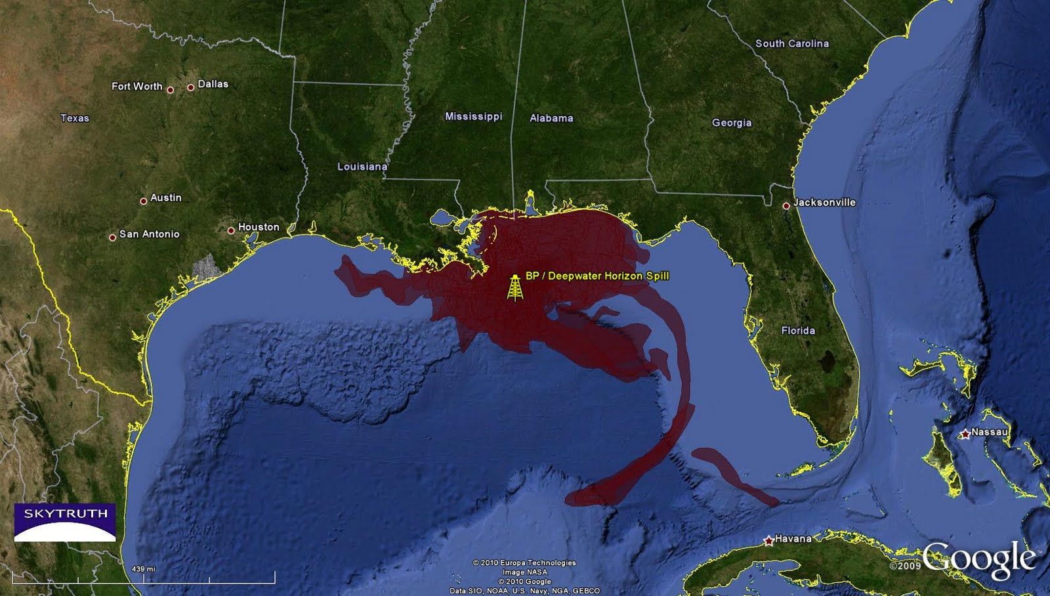
2010 BP Oil Spill Disaster
Video Summary of Disaster
Video of Wildlife Affected by the Disaster

Slide 3
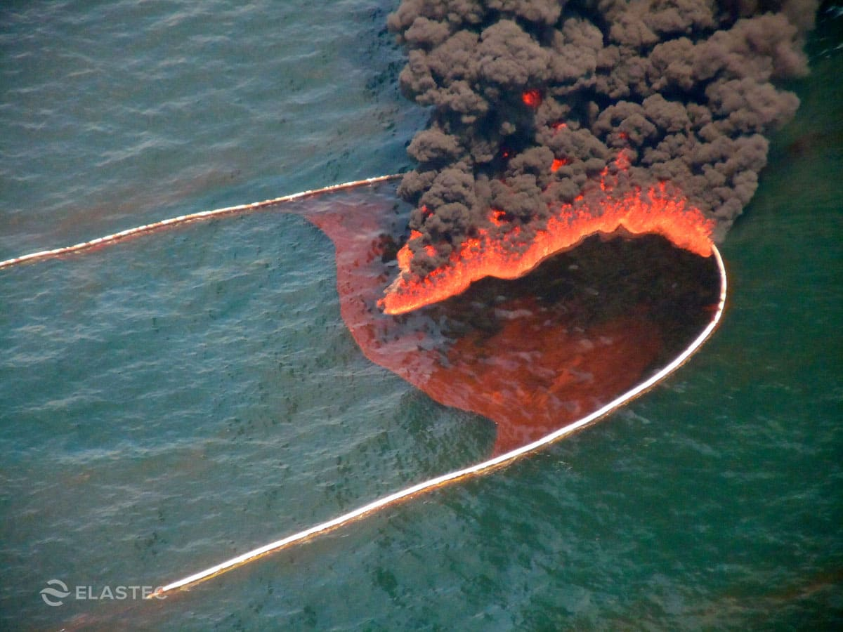
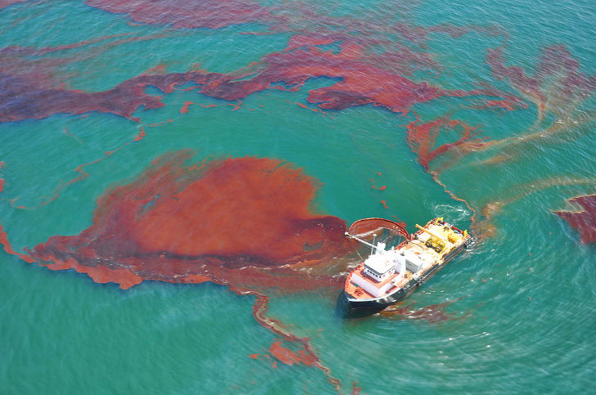
What could have been done to contain the oil slick on the water?

Slide 4
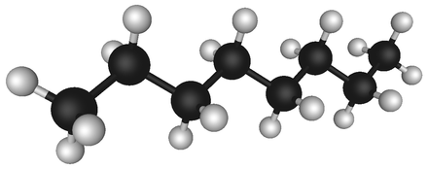
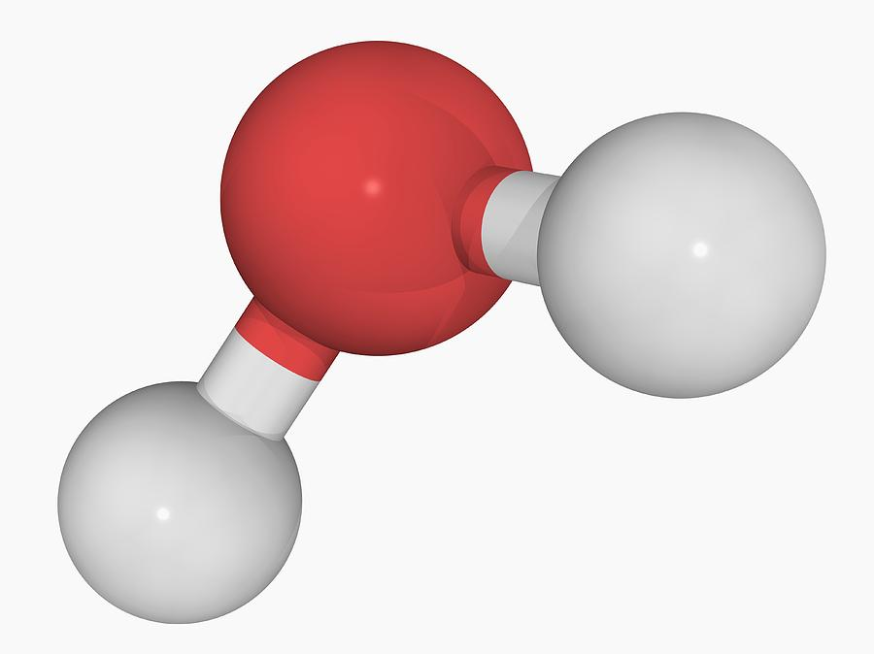
Why doesn’t Oil and Water Mix?
Oil is a nonpolar substance
  .
  .
Water is a very polar substance
  .
  .

Slide 5
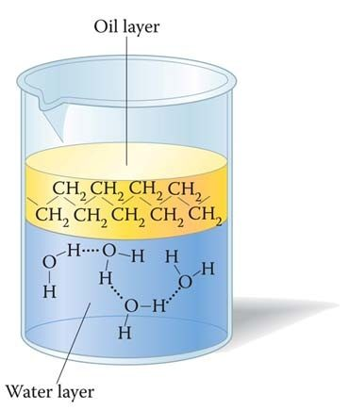
Why doesn’t oil and water mix?
.
.
If Oil has a slight temporary dipole (dispersion force) why won’t it mix with the highly polar water???
  .
  .
  .

Slide 6
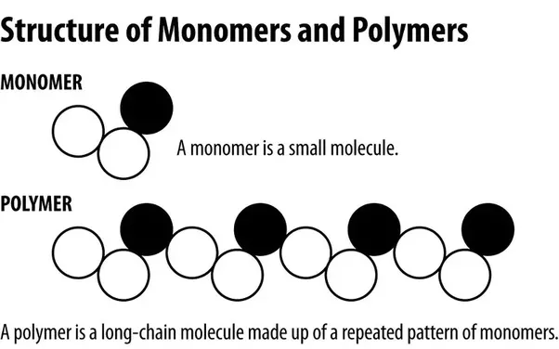
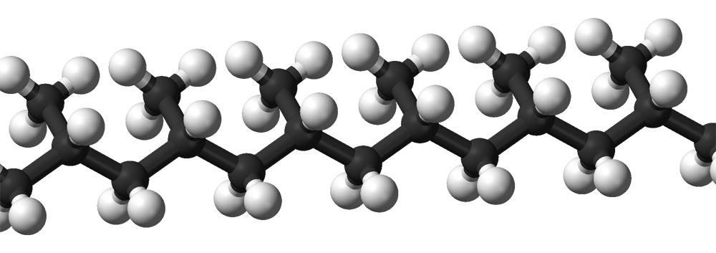
Oil Absorbing Polymer
Enviro-Bond 403 is a polymer that is very non-polar.
  .
What is a polymer?
  .
Enviro-Bond is patented so we don’t know exactly what it looks like (trade secret) however it’s probably similar to the structure to the right →

Slide 7
References
http://www.noaa.gov/resource-collections/gulf-oil-spill
http://www.startribune.com/us-states-finalize-settlement-with-bp-over-gulf-oil-spill/330676651/
https://www.elastec.com/products/floating-boom-barriers/fire-resistant-oil-boom/hydro-fire-boom/
http://www.wikiwand.com/en/Petroleum
https://fineartamerica.com/featured/3-water-molecule-laguna-design.html
https://www.quora.com/What-is-polymer-How-many-types-of-polymers-are-classified-Explain-each-polymer-with-properties-and-applications
https://sl.wikipedia.org/wiki/Slika:Isotactic-polypropylene-3D-balls.png

