Slide 1
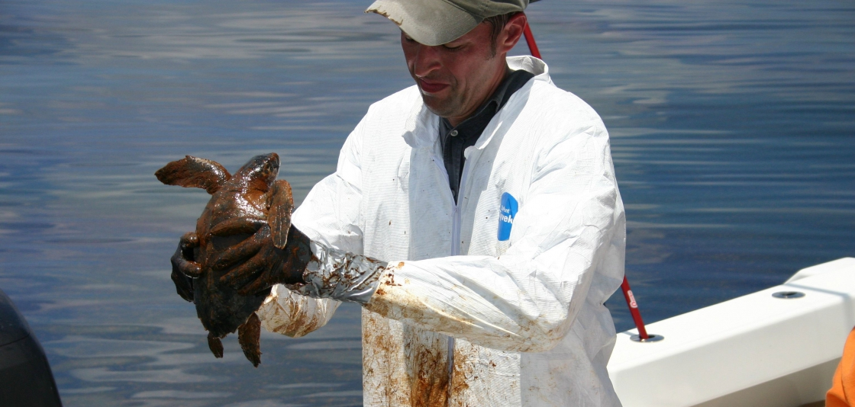
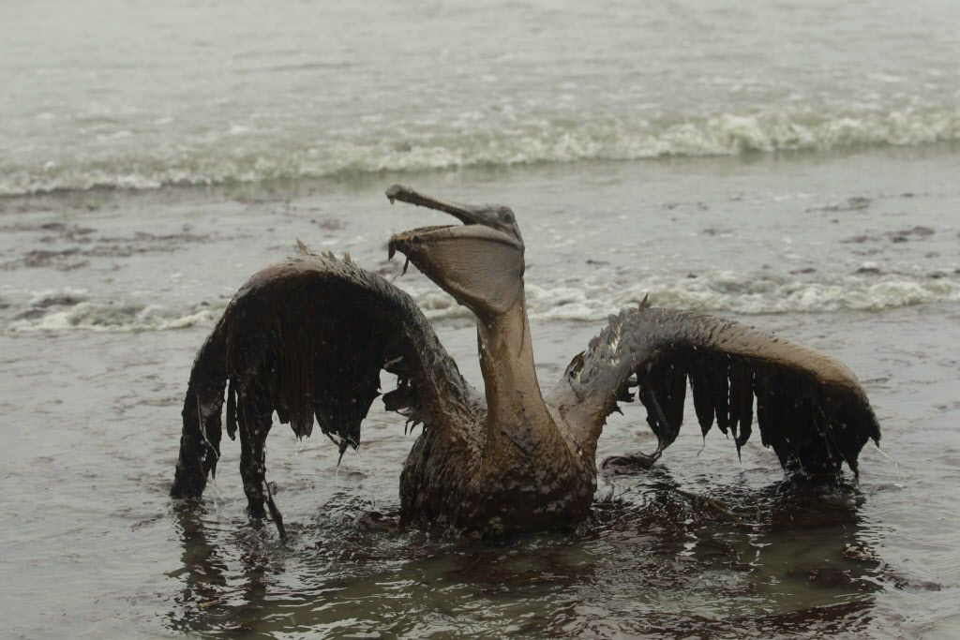
Oil absorbing polymer
Ryan Kiddey – RET Program 2018
University of Akron

Slide 2
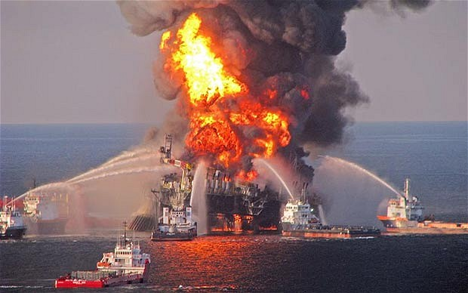
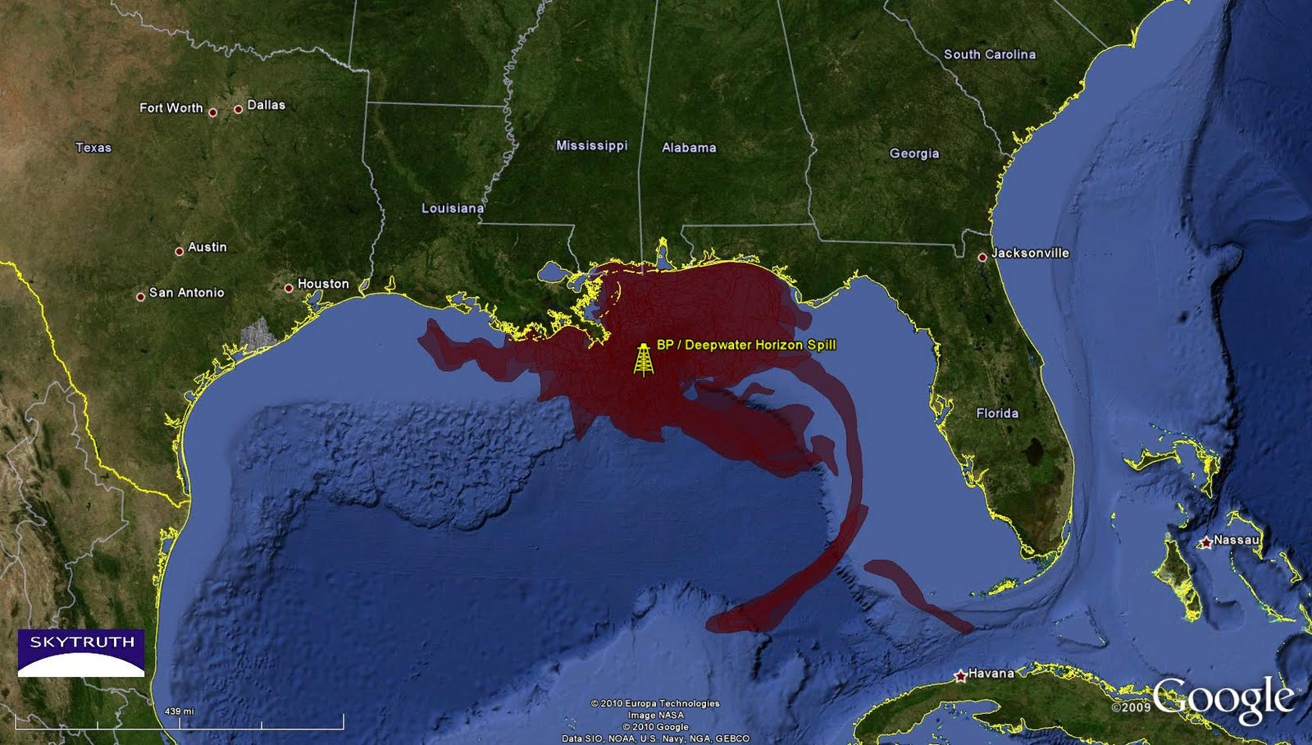
2010 BP Oil Spill Disaster
Video Summary of Disaster
Video of Wildlife Affected by the Disaster

Slide 3
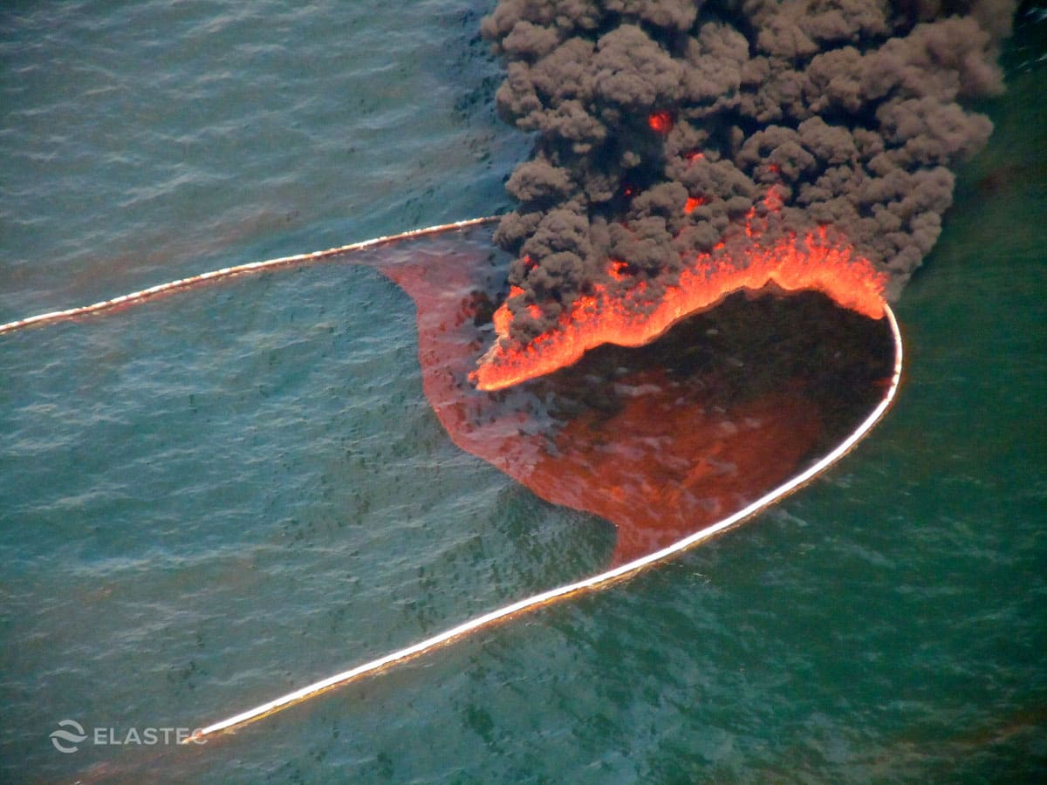
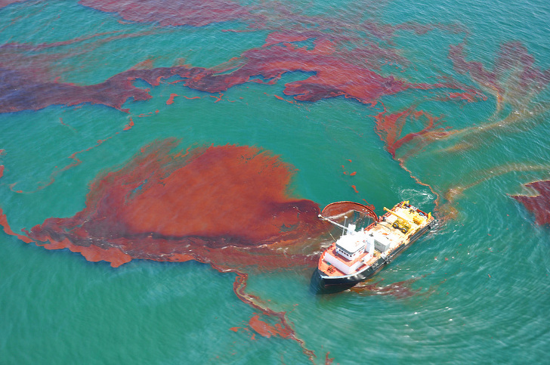
What could have been done to contain the oil slick on the water?

Slide 4
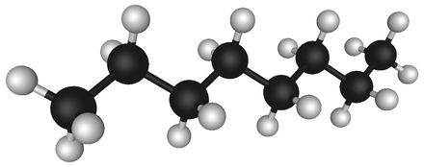
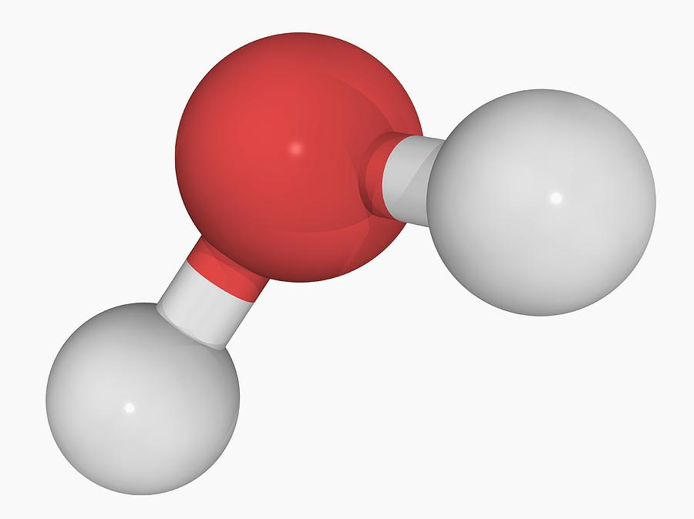
Why doesn’t Oil and Water Mix?
Oil is a nonpolar substance
There are many hydrogen atoms on the molecule, however they are connect to carbon (not O, N, or F)!
Oil is not very attractive to strongly attractive molecules
Water is a very polar substance
The hydrogens are connected to oxygen which allows the molecule to potentially interact with neighboring molecules by hydrogen bonding to it.
Water is very attracted to other extremely attractive molecules.

Slide 5
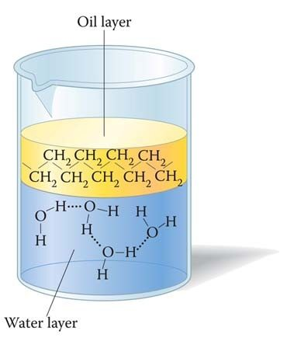
Why doesn’t oil and water mix?
Water molecules are STRONGLY attracted to each other due to their ability to hydrogen bond (IMF).
The oil molecules will come together through very weak dispersion forces.
If Oil has a slight temporary dipole (dispersion force) why won’t it mix with the highly polar water???
THINK OF WATER MOLECULES AS VERY STRONG MAGNETS AND OIL MOLECULES AS VERY WEAK MAGNETS.
Oil molecules have to weak of a pull on water so something stronger (like another water molecule) will partner up with it.
As soon as one water molecule forms a hydrogen bond (IMF) with another water molecule the charges are canceled out and the oil isn’t able to interact with the water.

Slide 6
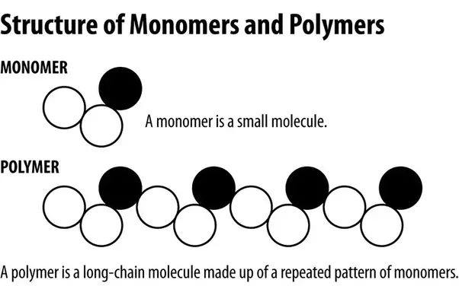
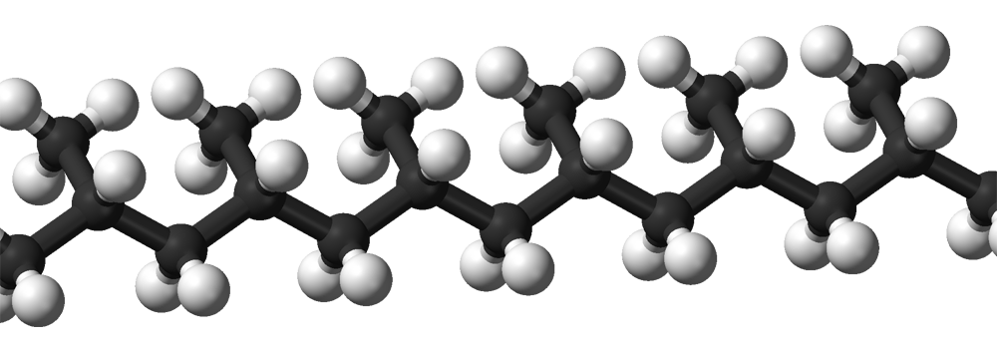
Oil Absorbing Polymer
Enviro-Bond 403 is a polymer that is very non-polar.
This causes it to be hydrophobic (just like oil).
What is a polymer?
a substance that has a molecular structure consisting chiefly or entirely of a large number of similar units bonded together, e.g., many synthetic organic materials used as plastics and resins.
Enviro-Bond is patented so we don’t know exactly what it looks like (trade secret) however it’s probably similar to the structure to the right →

Slide 7
References
http://www.noaa.gov/resource-collections/gulf-oil-spill
http://www.startribune.com/us-states-finalize-settlement-with-bp-over-gulf-oil-spill/330676651/
https://www.elastec.com/products/floating-boom-barriers/fire-resistant-oil-boom/hydro-fire-boom/
http://www.wikiwand.com/en/Petroleum
https://fineartamerica.com/featured/3-water-molecule-laguna-design.html
https://www.quora.com/What-is-polymer-How-many-types-of-polymers-are-classified-Explain-each-polymer-with-properties-and-applications
https://sl.wikipedia.org/wiki/Slika:Isotactic-polypropylene-3D-balls.png

