Slide 1
The Chemistry of Coatings
Scientific Inquiry Project

Slide 2
Scientific Method

Slide 3
Steps of the Scientific Method
Purpose
Research
Hypothesis
Experimental Design
Analyze Results
Conclusion

Slide 4
What makes a Good Procedure?
Testable Hypothesis
Quantitative Measurements (SI units)
Controls
Variables
Trials
Data Table/Charts

Slide 5
Engineering Design

Slide 6
Steps of the Engineering Design
Define the problem
Research
Specify Requirements
Develop and Prototype Solution
Test Solution
Communicate Results

Slide 7
Notes:
http://k12s.phast.umass.edu/sess/gralinski/Scientific_inquiry_vs__Engineering_Design.pdf

Slide 8
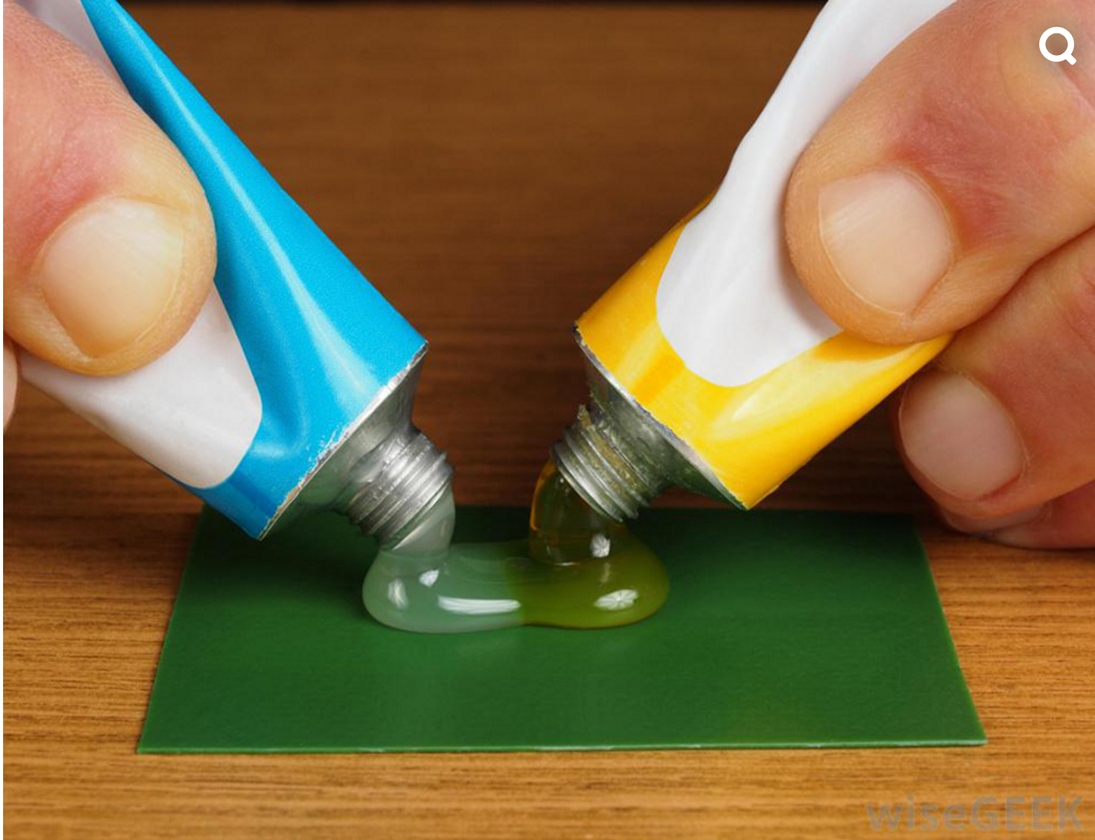
The Chemistry of Coatings
Notes:
http://www.core77.com/posts/27568/Epoxy-Resin-101

Slide 9
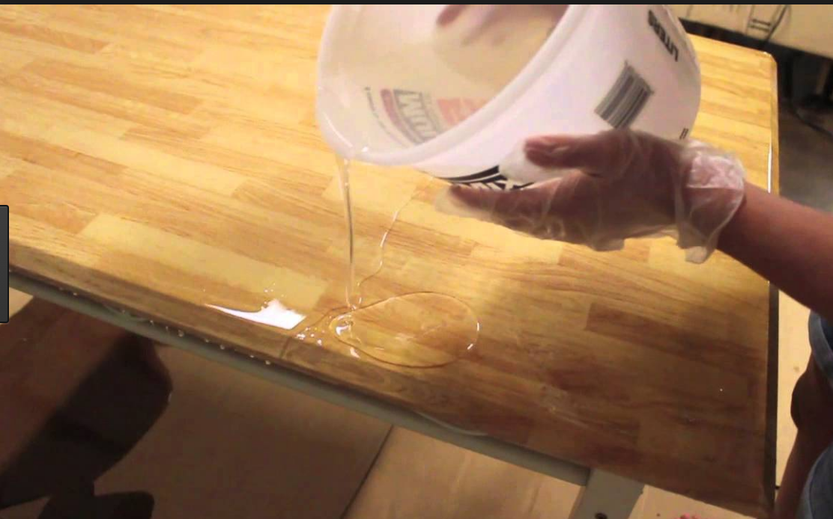
Polymers and Coatings
Notes:
https://www.youtube.com/watch?v=nX6GxoiCneY
https://www.google.com/search?site=&tbm=isch&source=hp&biw=1144&bih=637&q=epoxy+resin&oq=epoxy&gs_l=img.3.0.35i39k1j0l9.751.1510.0.2758.6.6.0.0.0.0.196.474.3j2.5.0....0...1.1.64.img..1.5.474.0.3Y-LqIDNpZM#tbm=isch&q=epoxy+resin&chips=q:epoxy%20resin,g_2:countertop&imgrc=WyUdNXRqbpld4M:

Slide 10
What is a Polymer
Polymer: a substance that has a molecular structure consisting chiefly or entirely of a large number of similar units bonded together, e.g., many synthetic organic materials used as plastics and resins.
Notes:
https://chem.libretexts.org/Textbook_Maps/General_Chemistry_Textbook_Maps/Map%3A_Chem1_(Lower)/07%3A_Solids_and_Liquids/7.09%3A_Polymers_and_Plastics

Slide 11
Examples of Polymers
Kevlar
Polysaccharides
Nucleic Acids
Polyester
Polyethylene
Epoxies
Notes:
Cite Olmstead and Williams Book

Slide 12
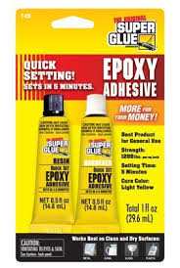
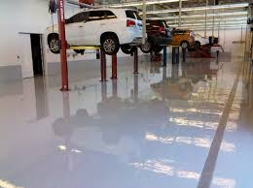
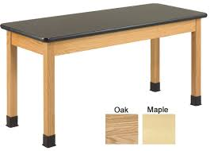
What is an epoxy?
Epoxy
A flexible usually thermosetting resin made by polymerization of an epoxide and used chiefly in coatings and adhesives.
Notes:
Image Links
epoxy-science-table-diversified
http://epoxytechhouston.com/houston-epoxy-flooring-services/commercial-epoxy-flooring/
https://www.amazon.com/Super-Glue-T-QS12-Setting-Adhesive/dp/B004YEN22Q

Slide 13
Uses for Epoxy Resins
Paintings and Coatings
Adhesives
Industrial tooling
Electronics
Art Pigments
Jewelry
Flooring
Boating

Slide 14
Stoichiometry

Slide 15
Stoichiometry
-Stoichiometry is the process of using quantitative relationships to determine the amount of material needed to form a certain amount of product.

Slide 16
Stoichiometry
If I need to make enough sandwiches for the class, how many slices of bread and cheese would I need?

Slide 17
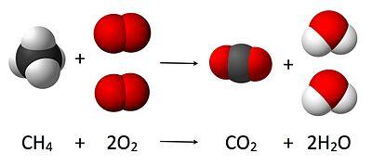
Stoichiometry
Stoichiometry can help scientists calculate the amount of reactants or products needed in order to get the desired results for any reaction.

Slide 18
Stoichiometry and Epoxies
Most formulated products include mixtures of epoxy resins, diluents (reactive and unreactive), fillers, additives,…. It is essential to determine the Epoxy Equivalent Weight (E.E.W.) of the mixture to determine proper stoichiometric ratios with the curing agent. This is accomplished with the following equation:

Slide 19
Project Objective

Slide 20
Goal of Project
Group 1: Scientific Method
You’re goal is to use the scientific method and create an experiment to determine the ideal ratio of epoxy and resin that has the most strength.
Both Groups:
The final structure will be tested with a three point flexural test and the amount of deviation of the line.
Group 2: Engineering Design
Constraints:
You must not use more than 10 mL total of part A and part B
Part A costs $0.10/1mL and Part B costs $1.00/1mL.
In order to have a successful structure it must fall less than 15% of the original beam height.

Slide 21
Appendix: Chemistry of Epoxy

Slide 22
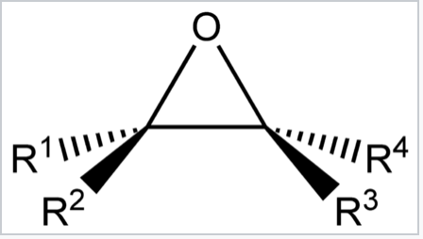
Epoxy and Amine Structure

Slide 23
Epoxide Formation
Epoxy=Di-functional Amine= Hexa-functional
We can manipulate the thermosets properties by varying the ratio of epoxy to amine.

Slide 24
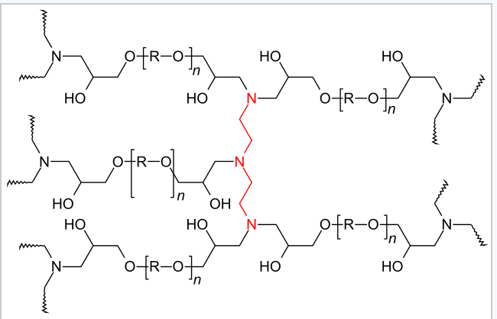
Application of Epoxies to Bonding
Notes:
https://en.wikipedia.org/wiki/Epoxy#/media/File:VernetzteEpoxidharze.svg
Image from

Slide 25
Stoichiometry and Epoxies
Most formulated products include mixtures of epoxy resins, diluents (reactive and unreactive), fillers, additives,…. It is essential to determine the Epoxy Equivalent Weight (E.E.W.) of the mixture to determine proper stoichiometric ratios with the curing agent. This is accomplished with the following equation:
(Can have students calculate this if you would like!!)

