Slide 1
Polymers

Slide 2
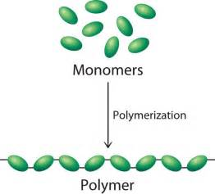
What are Polymers?
Long chains of repeating monomers

Slide 3
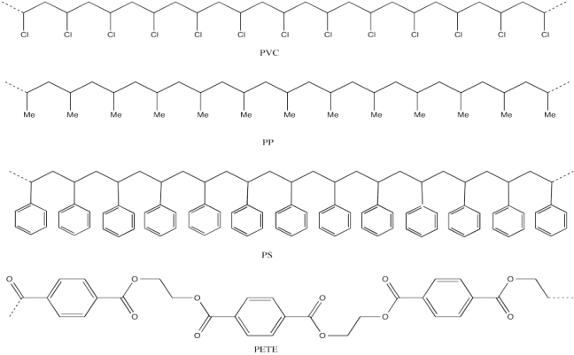

Slide 4
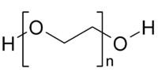

Slide 5
Natural Polymers
Silk/Wool
Cellulose/Lignin
Starches/Polysaccharides
DNA/RNA
Rubber
Proteins

Slide 6
Synthetic Polymers
Plastics
Synthetic Fibers (nylon, polyester, etc.)
Films
Elastomers
Adhesives
Synthetic rubbers

Slide 7
Properties of Polymers
Large molar masses
Structure of monomer determines properties of polymer (and what function it may serve)
Rubber: liquid at room temperature

Slide 8
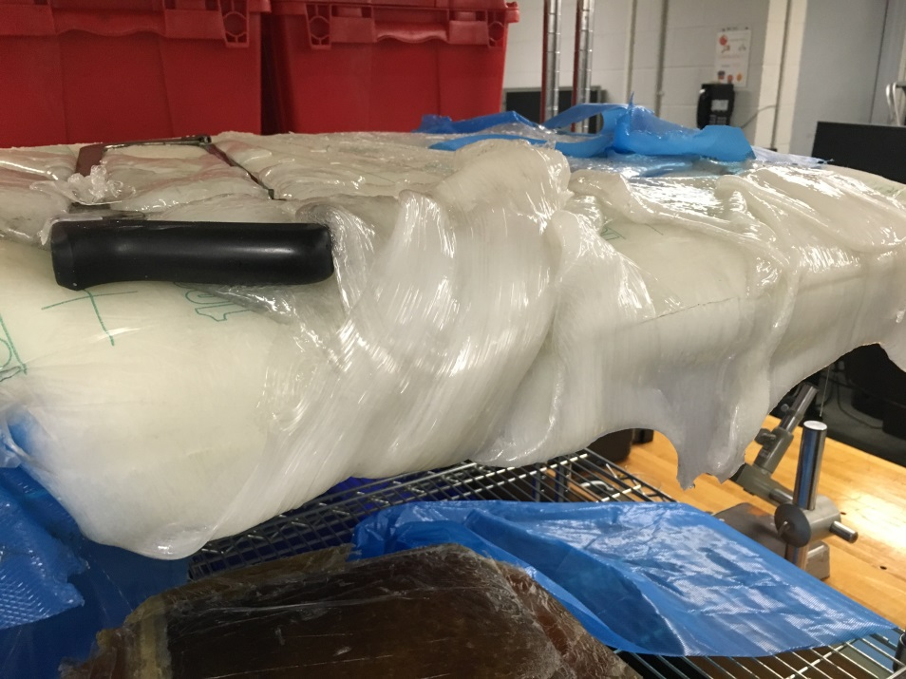
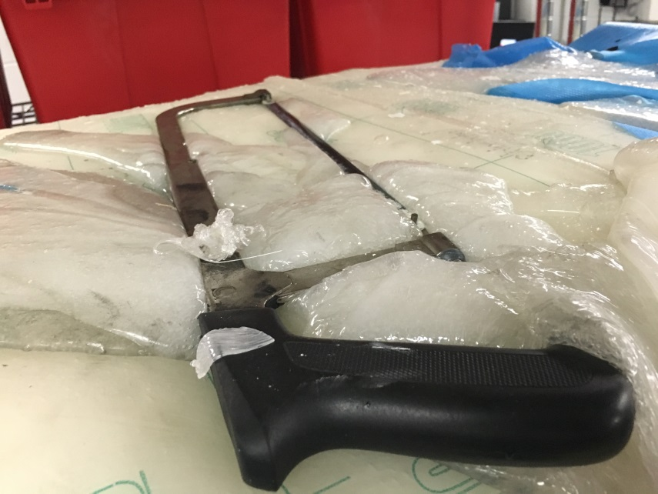
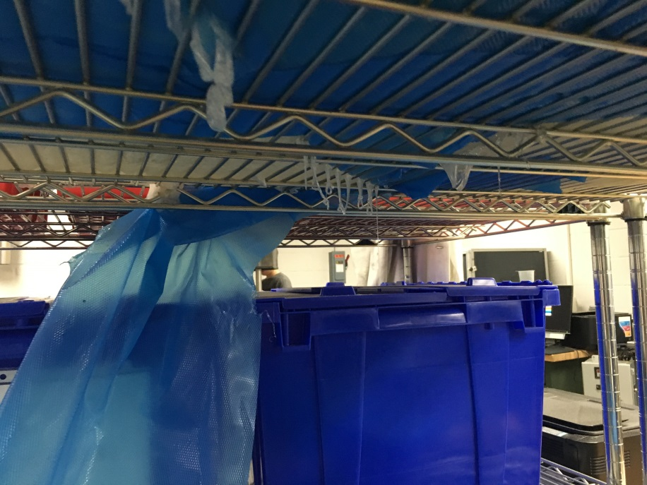

Slide 9
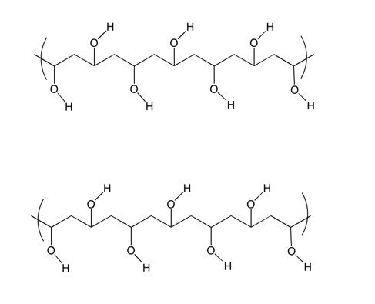
Glue
Polymer composed of primarily collagen

Slide 10
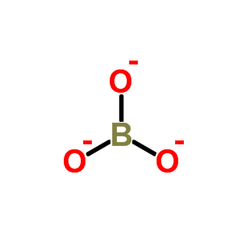
Borax (Borate ion, BO₃²⁻)

Slide 11
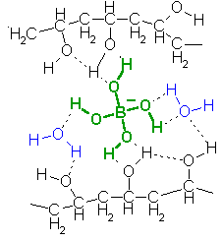

Slide 12
Glass-Transition Temperature
temperature at which a polymer transitions from crystalline to amorphous
elastomers (such as rubber) have relatively low T_{G} and are amorphous under standard conditions

Slide 13
Cross-linking
1839 – Goodyear - vulcanization
By covalently connecting polymer chains, “solid-like” properties can be obtained
Tensile strength, stiffness, toughness, etc.

Slide 14
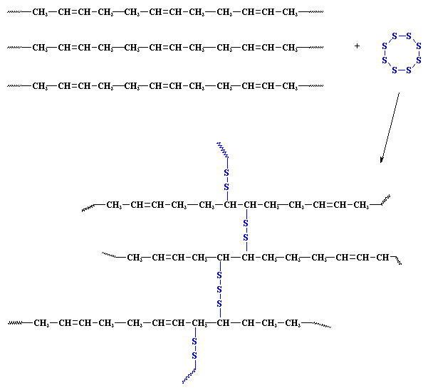

Slide 15
Is the polymer crosslinked?
Nuclear magnetic resonance
Diffusion tests
Scanning electron microscope
Swell test

