Slide 1
Post-Lab Discussion
Wacky Water
Jennifer Tumlin, Tallmadge HS

Slide 2
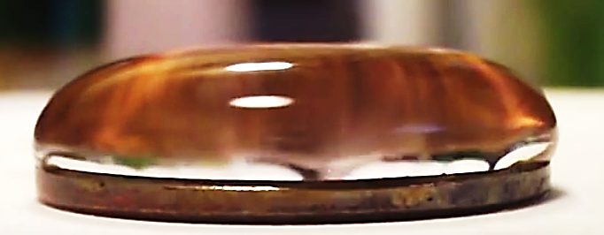
Water on a penny.
What causes this?
Discuss it with your neighbor.
Describe the role that cohesion and adhesion play.
Notes:
Adhesion: As the water spreads across the coin it eventually encounters the lip. The water adheres to the coin, allowing it to build up with out spilling over the edge.
Q - What would happen if the coin was completely smooth, lacking an edge?
A- less area for water to adhere to, spill over the side.
Q- What differences would be observed if soapy water was used?
A- Less adhesion and cohesion since soaps disrupt H bonds and lower surface tension.
FYI We have pulmonary surfactants in our lungs to decrease surface tension in the alveoli. Defective pulmonary surfactants make inflating the alveoli very difficult. Imagine trying to open tiny, wet plastic baggies….
Cohesion: The water molecules are attracted to each other and form the “bubble” over the penny. We can see the water bulging over the side a bit.
? What bonds are responsible for cohesion?

Slide 3
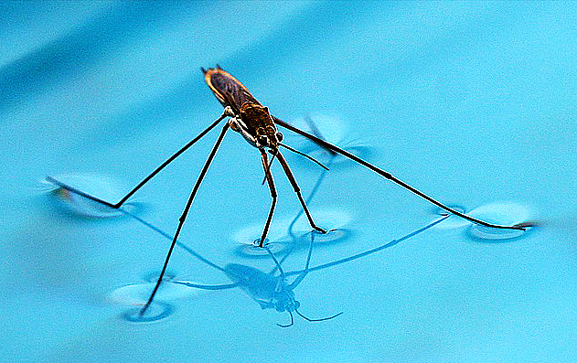
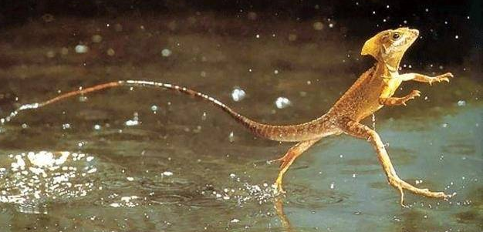
What do these illustrate?
Notes:
SURFACE TENSION
What exactly causes surface tension? Up next…
https://www.quora.com/Could-Usain-Bolt-run-on-the-dead-sea
Basilisk lizard

Slide 4
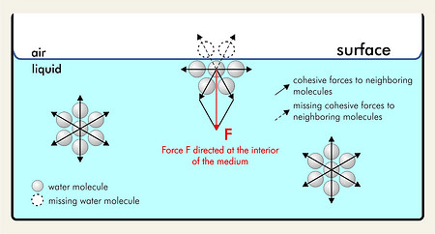
Surface Tension
Notes:
In depth look at surface tension
A water molecule has a cohesive range of 10⁻⁹ m, this is also known as the sphere of molecular activity. This means that other water molecules within this range will “feel” the cohesive “pull” from an individual water molecule. The bulk of the water contains countless water molecules adjacent to one another. As a result the “tug of war” or forces between water molecules cancels each other out. In the bulk the F_{net} = 0 and the water molecule is at equilibrium.
As a water molecule approaches the boundary of the water-air interface the molecular forces are no longer balanced. At the air interface there are no water molecules pulling up on an individual water molecule located near the bulk, therefore, the molecule “feels” more of an attraction to its neighbors below and beside it. This is what causes surface tension. This is why water seems to have a “skin” at the surface.
Liquids try to assume the shape with the smallest surface area or lowest potential energy, forming a sphere. A water droplet that is on a surface, like glass or wood, tries to form a sphere but it feels the adhesive forces of the surface and gets “stuck” in a shape other than a sphere.
Good resource on all things water:
https://manoa.hawaii.edu/exploringourfluidearth/chemical/properties-water/hydrogen-bonds-make-water-sticky
Exploring Our Fluid Earth, a product of the Curriculum Research & Development Group (CRDG), College of Education. © University of Hawai‘i, 2017. This document may be freely reproduced and distributed for non-profit educational purposes.
Image from https://www.sita-process.com/information-service/process-parameter-surface-tension/overview/

Slide 5
What determines surface wettability? Did you figure out the 2 responsible factors? Some hints…..
Notes:
The purpose of the next slides is to get students to see that microscopic texture and some sort of coating (surface chemistry) are responsible.

Slide 6
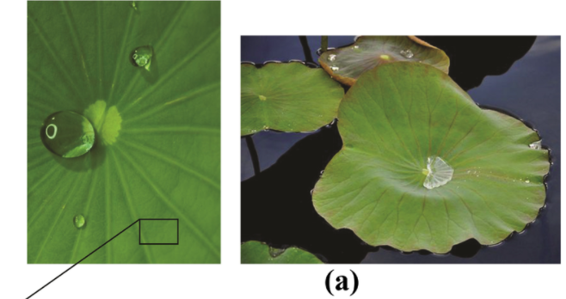
Lotus Leaves
Notes:
Polymers 2014, 6(5), 1266-1311; doi:10.3390/polym6051266
Review
Polymeric Slippery Coatings: Nature and Applications
Mohamed A. Samaha ¹ and Mohamed Gad-el-Hak ^{2,}*
http://www.mdpi.com/2073-4360/6/5/1266/htm

Slide 7
Micro-structures on the leaves from 10 to 0.4 micrometers
Notes:
Surface structures on lotus leaves.
Find videos to show the super hydrophobicity of lotus, honey on lotus, self cleaning, etc. Or show the videos from the author with milkweed, iris and mullein plants.
Polymers 2014, 6(5), 1266-1311; doi:10.3390/polym6051266
Review
Polymeric Slippery Coatings: Nature and Applications
Mohamed A. Samaha ¹ and Mohamed Gad-el-Hak ^{2,}*
http://www.mdpi.com/2073-4360/6/5/1266/htm

Slide 8
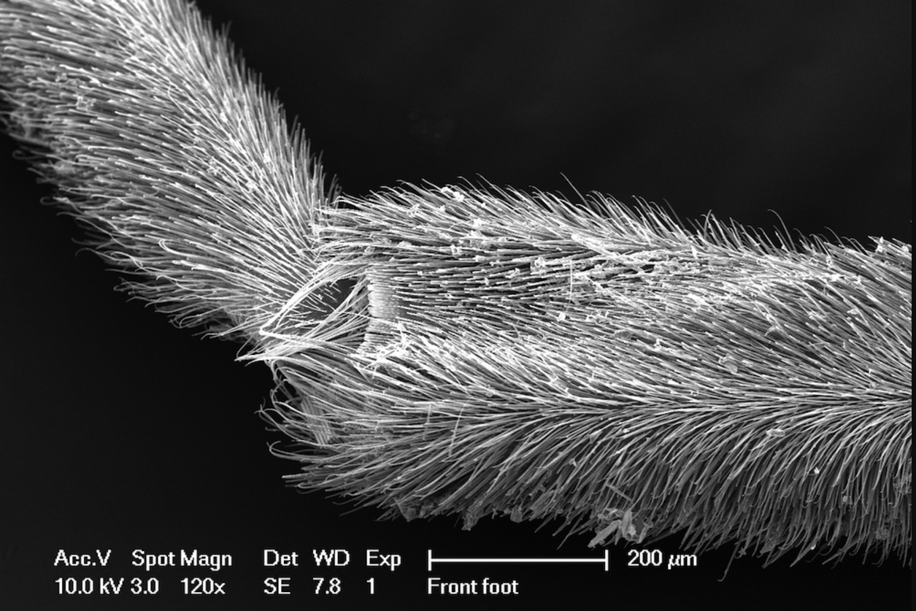
Notes:
The legs of a water strider under 120x magnification. This is the portion which comes in contact with the water.
https://savageimageaward.files.wordpress.com/2013/04/20cs-copy.jpg

Slide 9
Notes:
Optional video.
Seoul National University, Korea (SNU), Harvard's Wyss Institute for Biologically Inspired Engineering, and the Harvard John A. Paulson School of Engineering and Applied Sciences, has unveiled a novel robotic insect that can jump off of water's surface. In doing so, they have revealed new insights into the natural mechanics that allow water striders to jump from rigid ground or fluid water with the same amount of power and height. The work is reported in the July 31 issue of Science. Read more at: https://phys.org/news/2015-07-robotic-insect-mimics-nature-extreme.html#jCp

Slide 10
A B C D E
Notes:
Some parts of the leaves were washed with soapy water. Can you guess which drops are on that surface? What do you think is causing the hydrophobic property?
On left, Iris leaf: drops from left to right: rubbed with dry cotton ball, unaltered surface, rubbed with soapy cotton ball, then rinsed.
On right, milkweed leaf: from left to right: unaltered surface, rubbed with soapy cotton ball, then rinsed.

Slide 11
Nature Know-How…

Slide 12
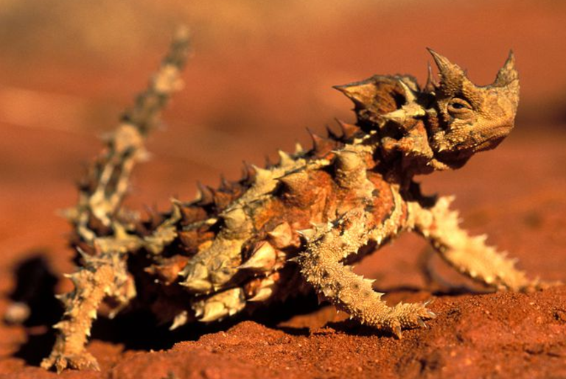
Thorny Devil from Australia
Notes:
http://www.smithsonianmag.com/science-nature/spiky-lizard-drinks-sand-its-skin-180961002/
The thorny devil is looking sharp. Rows of cactus-like spikes and thorns give this Australian reptile a formidable armor and a don’t-even-think-about-eating-me swagger. But its exterior is remarkable for another reason too: This lizard drinks with its skin.
Australia's deserts are among the driest places on Earth, with rain falling just a couple times a year. In that kind of arid environment, animals need every drop they can get. So nature has gotten creative. Tucked under this lizard's scales is a network of tiny tunnels, which collect and channel water up to its mouth like a built-in irrigation system.
During the rare rainfall, the lizard drinks up when its skin soaks up water. Now, lab experiments suggest it can also quench its thirst from wet sand. "A very likely regular water source appears to be wet sand," says Philipp Comanns, a biologist at RWTH Aachen University in Germany and author of a new study on the lizard's unlikely drinking system in this week's issue of the Journal of Experimental Biology. "Almost every morning, we have this dew-wetted sand."
The thorny devil's drinking style is a rarity. When water accumulates on its body, the small channels draw in the water via capillary action—the same way a nurse draws blood when pricking your finger. The water sticks to the inner walls of the channels, and is pulled in. So far, only the Texas horned lizard in North America and Horvath's toad-headed agama in Turkey are known to have this network of water-collecting channels within its skin.
What's great about water-collecting skin is that it enables a diversity of drinking techniques. Unlike boring humans, the lizard can guzzle water through its legs while standing in a puddle. (Though that probably doesn't occur much in the wild, since puddles rarely exist in the lizard's sandy, arid habitat.) It might sip the condensation that forms on its skin when the rising sun rapidly heats the desert. Or, it might suck the moisture out of sand that's wet from morning dew.
But which approach was more likely? To find out, Comanns and colleagues put the lizards in all three situations in the lab: in a puddle, in a humid environment where condensation would form on the lizard, and in sand with varying levels of moisture. By weighing the reptiles after each session and then again after air drying, the researchers determined how much water the lizards had taken in.
Not all that water got drunk, though. To actually imbibe the liquid, the lizard opens and closes its jaws—perhaps to squeeze the water into its mouth, although no one knows for sure. But even when it's not moving its mouth, the capillary system still takes in water. About half of the lizards in the puddle actively drank, but the lizards only drank while in the puddle, and not in humidity or wet sand.
By comparing the water intake of a lizard that actively drank from the puddle and one that didn't—but still pulled in water—the researchers could determine how much water the lizard's capillary system could hold: about 3 percent of its body weight. That's important, because water can only reach the lizard's mouth when the channel system is flush with water.
This wasn't the case in the humid environment. Condensation couldn't fill the capillary systems at all, ruling that out as a water source—an idea that had persisted for decades. "That's the most exciting part for me," says Wade Sherbrooke, a biologist at the Southwest Research Station of the American Museum of Natural History in Arizona who was not involved in the study. "They dismiss a number of hypotheses that were put out earlier."
Things got interesting with moist sand. The lizards could extract water from the sand, but even from the wettest sand, they could only fill up to 59 percent of their capillary system. Still, Comanns says, that's not necessarily a deal-breaker, pointing to a curious observation made more than 25 years ago.
In 1990, after a light rain, Sherbrooke noticed sand on a lizard's back and markings in the sand: The lizard it appeared to have kicked up wet sand onto its back. He had no idea why. The researchers now hypothesize the lizard may have been drinking.
To test their idea, the researchers placed wet sand on an artificial replica of the lizard's skin. They found that gravity helped pull more water into the lizard's capillary channels, and that the wet sand moistened the skin, which boosted the capillary action. Both factors mean tossing wet sand on the back could be a viable way of drinking. "We're 95 percent confident that wet sand is one of the major water sources for thorny devils," Comanns says.
Sherbrooke, however, is skeptical. On the lizards he saw, there wasn't much sand at all. "It's an inadvertent thing that happens," he says. "I'm not convinced that's how they get any water for drinking." In the experiments, the researchers placed about a centimeter-thick layer of sand on the fake skin—much more than what Sherbrooke thinks is likely.
Before the lizards tossed the sand, Sherbrooke had seen them rubbing their bellies in the wet sand. Having filled their capillary system during the rain, they might have been trying to squeeze out another sip, he says. But to do so, they needed leverage. "So they're moving around, pushing and pushing, trying to get that belly down in the sand as far as they can," he explains. "In the process, they kick up some sand and some of it lands on their back—that's my guess."
Which would leave rain, however rare, as the thorny devil's main source of water. Sherbrooke, who has seen the lizard lick droplets off plants after rain, hypothesizes that these animals might also get rub up against wet plants. Even when there's but a drizzle, the lizard takes advantage.
"They've been going without water for six to eight months," he says. "If they can pick up some of that, it may mean life or death."

Slide 13
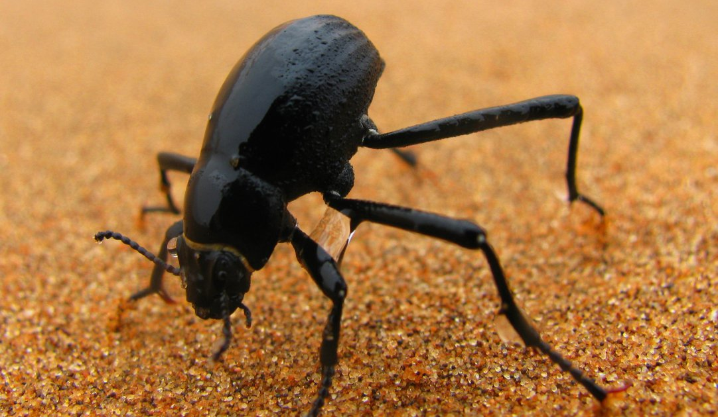
Darkling Beetle from Namibia
Notes:
Where is Namibia? What is the climate like? What is the beetle doing? Do you see water? How?
Darkling beetles (family Tenebrionidae) of the Namib Desert, located on the southwest coast of Africa, live in one of the driest habitats in the world. But some species of Darkling beetle can get the water they need from dew and ocean fog, using their very own body surfaces. Several researchers are studying the beetles, as well as synthetic surfaces inspired by the beetle’s body, to uncover the roles that structure, chemistry, and behavior play in capturing water from the air. Micro-sized grooves or bumps on the beetle’s hardened forewings can help condense and direct water toward the beetle’s awaiting mouth, while a combination of hydrophilic (water attracting) and hydrophobic (water repelling) areas on these structures may increase fog- and dew-harvesting efficiency. For certain species of Darkling beetle, the act of facing into the foggy wind and sticking its rear end up in the air (known as fog-basking behavior) is thought to be just as important as body surface structure for successfully harvesting water from the air.
https://asknature.org/strategy/water-vapor-harvesting/

Slide 14
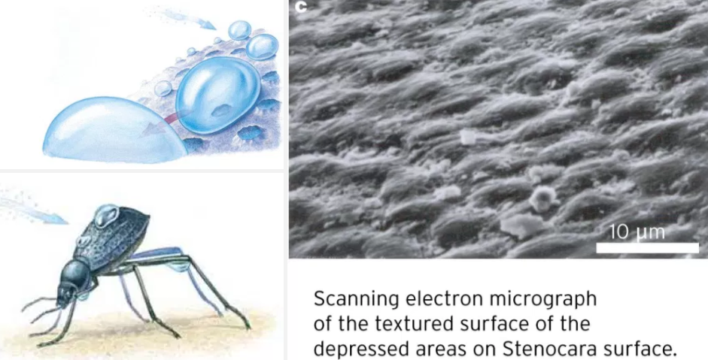
Notes:
REFERENCES
JOURNAL ARTICLE Water balance and osmoregulation in Physadesmia globosa, a diurnal tenebrionid beetle from the Namib desertJournal of Insect PhysiologyOctober 24, 2003 S.G. Naidu, J. Hattingh
JOURNAL ARTICLE Irregular fog as a water source for desert dune beetlesOecologiaOctober 29, 2004 M. K. Seely

Slide 15
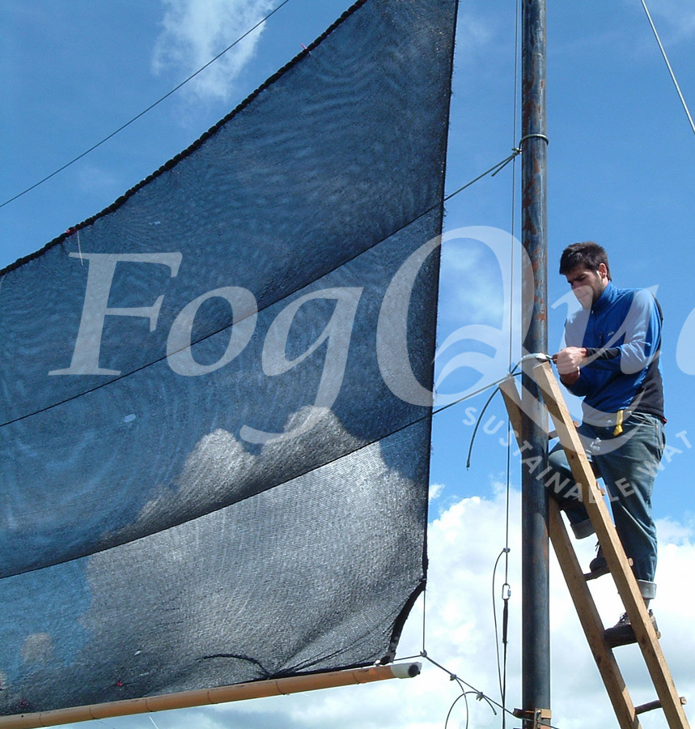
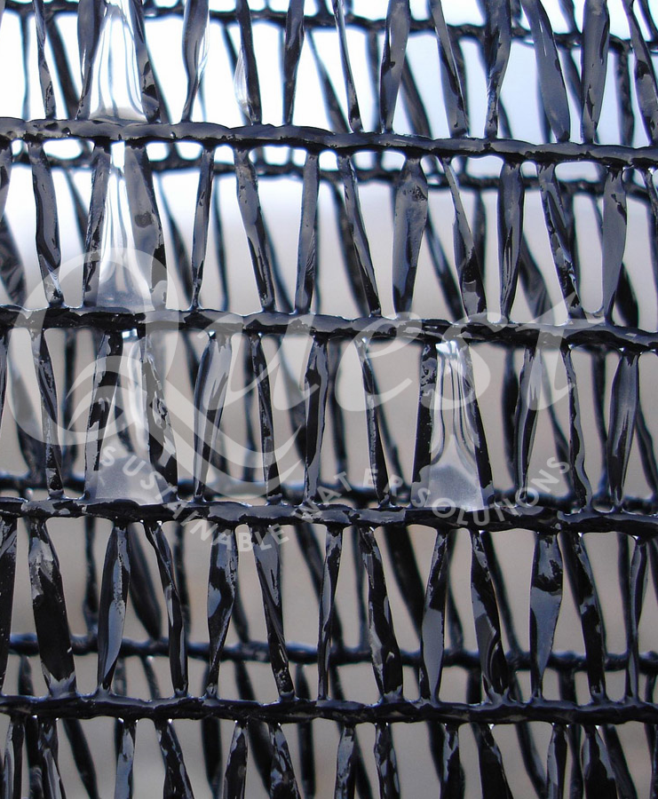
Notes:
Before showing this slide you could ask students to brainstorm about how these examples from nature could be used to solve problems in the real world.
http://www.fogquest.org/f-a-q/
What type of coating would be best? Hydrophobic or hydrophilic and why?

Slide 16
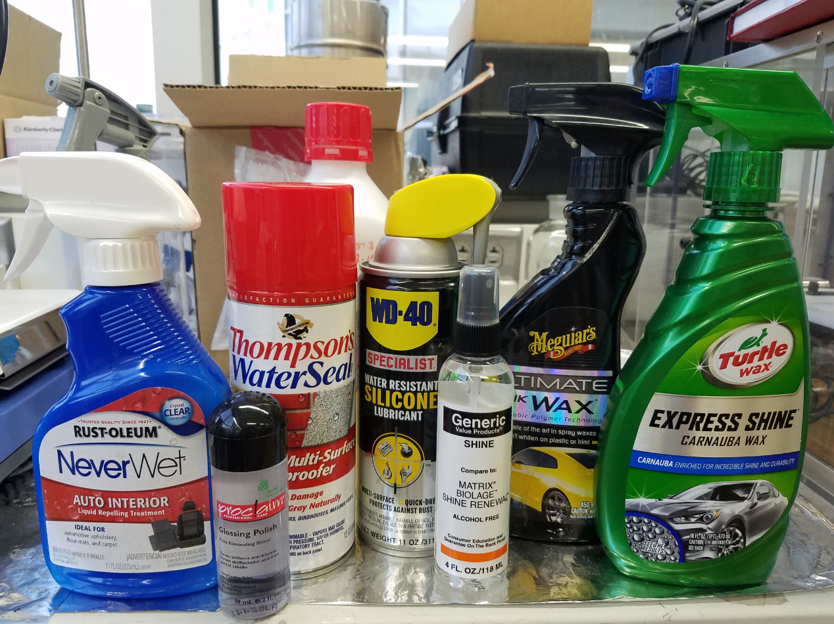
Everyday applications?
Notes:
Hair products (shampoo, conditioner, shine serums, nearly all hair styling products contain silicones and waxes, oils etc.)
Floor and car waxes
Cosmetics (makeup primer, lotions, lipsticks etc)
Lubricants
Nanotex clothing

Slide 17
Uncoated
WD40
Thompson
Quik Wax
Never Wet
Glossing
Polish
Generic
Carnauba
Perfluoro
Maleic
Anhydride
Contact Angle
Sandpaper Grit
Notes:
Here is the data from the following products, testing using Rame Hart contact angle apparatus. Note the uncoated values.

