Slide 1
Pre-Lab Discussion
Wacky Water
Jennifer Tumlin, Tallmadge HS
Adapted from
https://sites.google.com/site/mshernandezbiology/biology-accelerated/lab-super-hydrophobic-surfaces

Slide 2
Surface wettablity- The degree to which a liquid droplet spreads or beads-up on a surface.
Thin water layer
water
water
water
Greatest wettability!
Lowest wettability!

Slide 3
How do we classify surface wettability?
Classify by analyzing a droplet’s shape on a surface
Contact angle: A way to measure liquid-surface interactions.
liquid
air
θ_{c}
Surface

Slide 4
Superhydrophilic surface: “Super water-loving surface”
Surfaces with a contact angle θ_{c} < 15°
Water nearly completely spreads out on surface
Hydrophilic surface: “Water-loving surface”
Surfaces with a contact angle θ_{c} < 90°
Water spreads out on surface
Thin water layer
superhydrophilic
hydrophilic

Slide 5
Hydrophobic surface: “Water-fearing surface”
Surfaces with a contact angle θ_{c} > 90°
Superhydrophobic surface: “Super water-fearing surface”
Surfaces with a contact angle θ_{c} > 150° and low roll off angle
hydrophobic
superhydrophobic

Slide 6
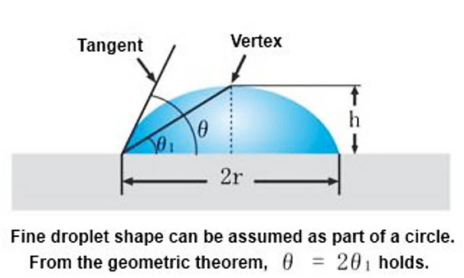
Surface Classifications by Contact Angle
θ_{c} = Contact angle
liquid
air
θ_{c}
Surface
hydrophobic
Notes:
Give students instructions on how to measure the angle to the vertex, then use the highlighted equation to find the contact angle. The contact angle is the tangent, but it is difficult to measure the tangent by “eyeball.”

Slide 7
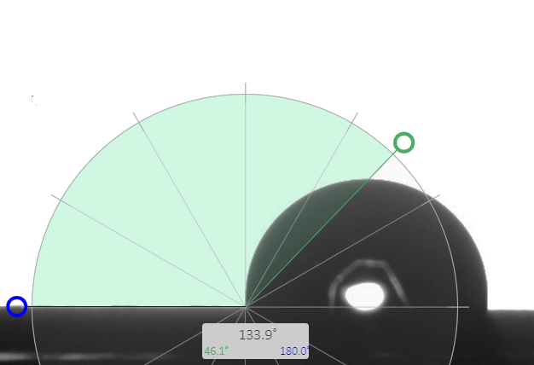
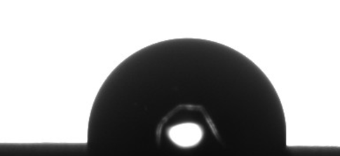
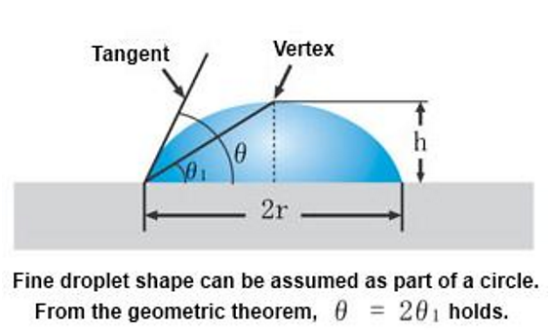
1. Find the vertex
2. Use a protractor to find θ₁
3. Calculate θ (contact θ)

Slide 8
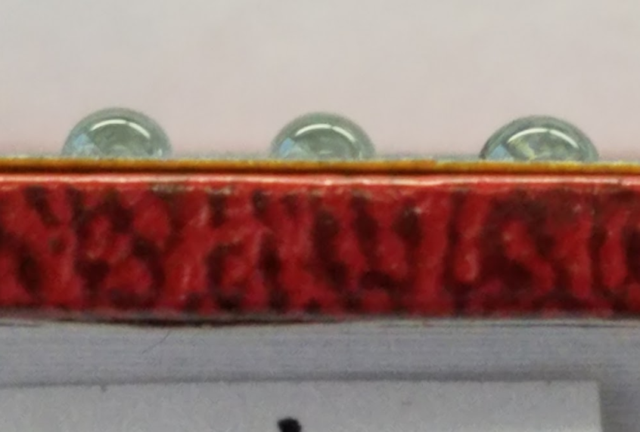
Place the sample at the edge of a table or book.
Place your camera lens “eye level” so you can get a profile picture.
If your camera has a “macro” setting, use it. Try to get as close as possible. Way closer than shown here!
Don’t wait too long, or your drop will start to spread.
Zoom in on the picture and measure off of your phone.

