Slide 1
Microsoft Multi-Factor Authentication (MFA) Enrollment Guide
Adult Focus
Scott Roberts
adultfocus@uakron.edu

Slide 2
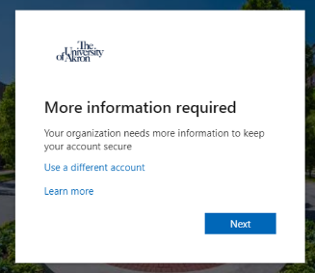
Step 1. When your account has been enabled with MFA, you will be asked to provide more information to keep your account secure, click “Next”.

Slide 3
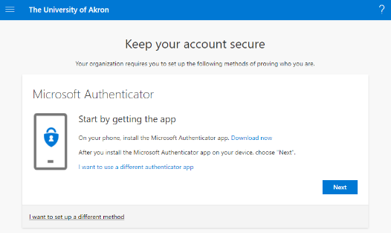
Step 2. Select “I want to set up a different method”.

Slide 4
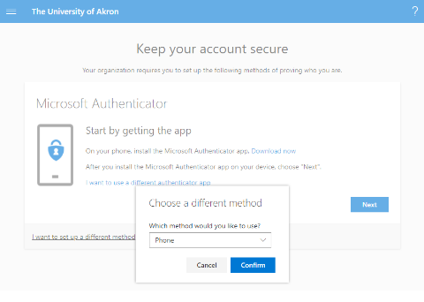
Step 3. From the dropdown box, select “Phone”.

Slide 5
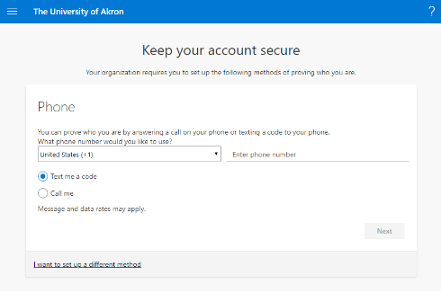
Step 4. Enter your phone number and select “Next” (you may also elect for a phone call).

Slide 6
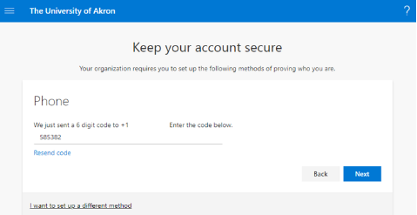
Step 5. Enter the verification code sent to your device.

Slide 7
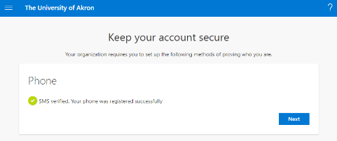
Step 6. Your enrollment is now complete.

